Slide 1
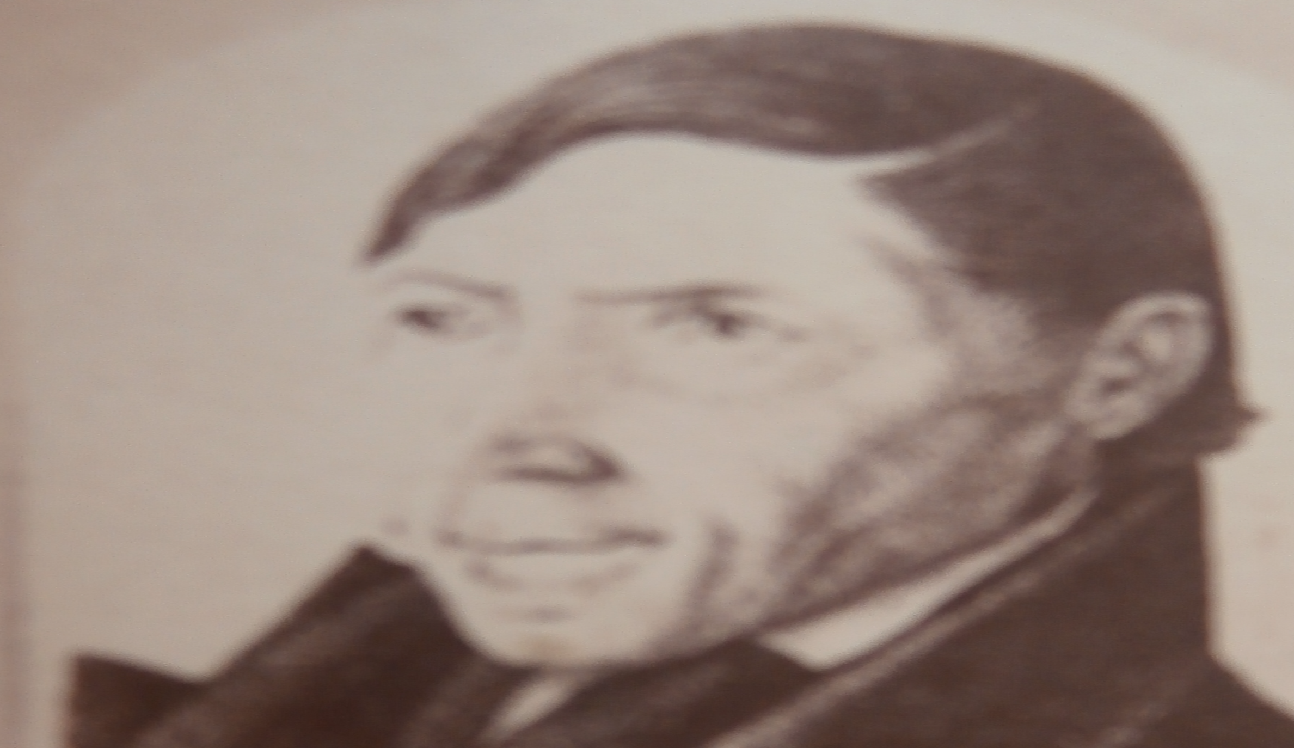
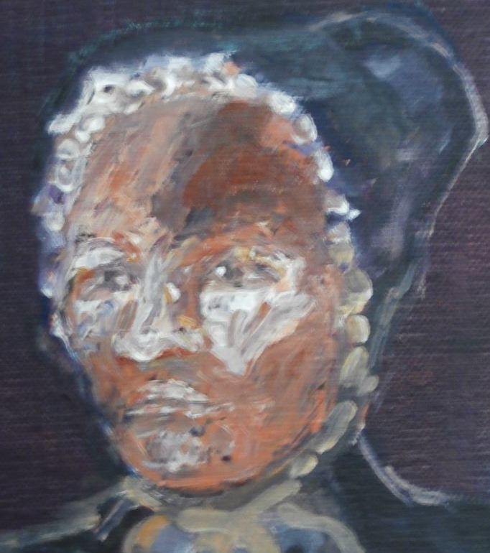
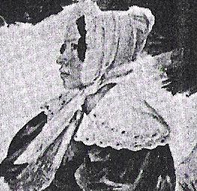
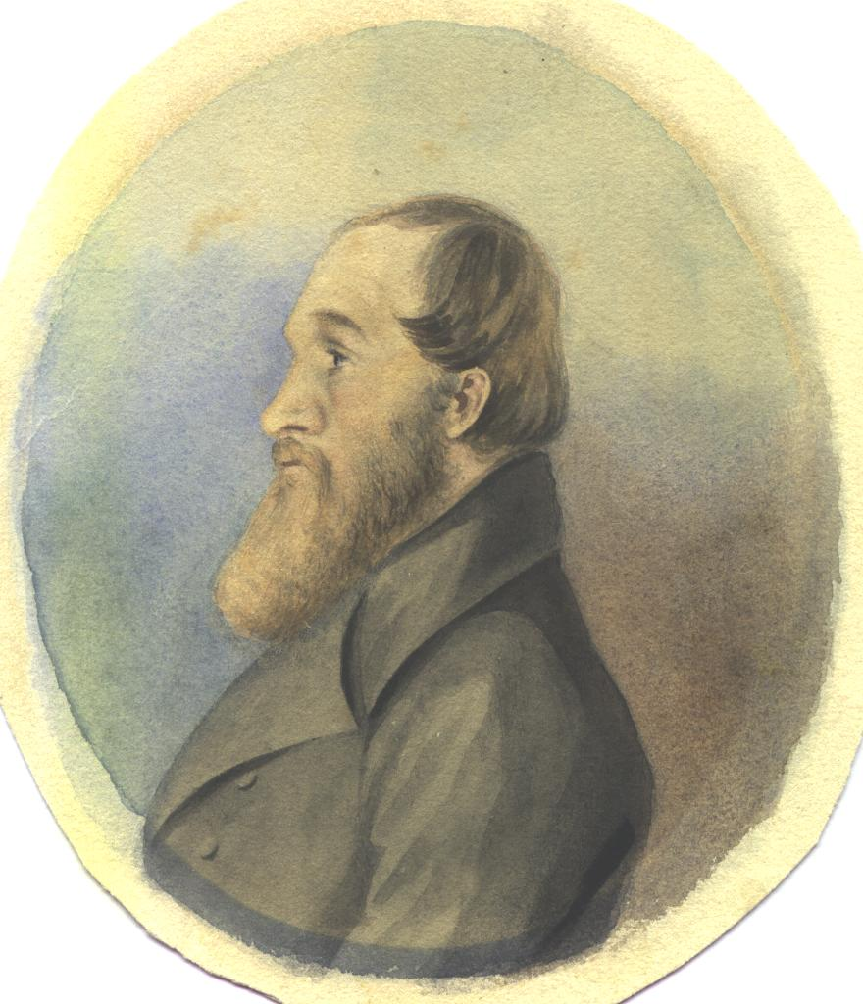
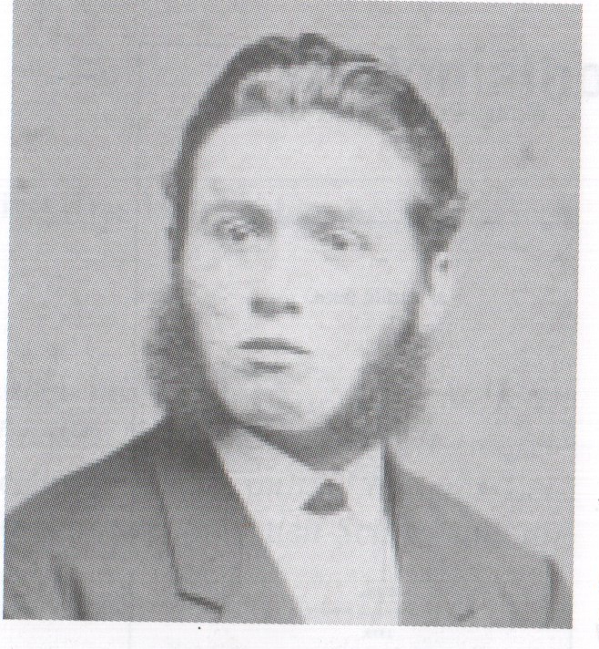
What connects us:
LMS Missionary Hinrich Schmelen
(1776 -1848)
Zara Hendriks (1793 – 1831)
Married Hinrich 1814.
Ferdinand Bam, 3 rd brother married Leentje Cloete and did not leave Komaggas
Jan Bam, brother to Christiaan, became a Rhenish missionary, in Rooibank (Walfidsh Bay)
Schmelen daughter, Johanna (Hanna) married
Rhenish missionary F H Kleinschmidt. They had 8
children. Four lines are pursued here.
Schmelen daughter Friederike
Married Christiaan Bam
His oldest son Johannes’ grave is in the missionary graveyard at Bethanien, as is an infant child of Johannes
Their one son, Albertus had a daughter, Mathilde with a sister of Samuel Maharero,
Who in turn had a son Edward, born 1890
See next page A
See next page B
See next page C
See next page D
See next page E

Slide 2
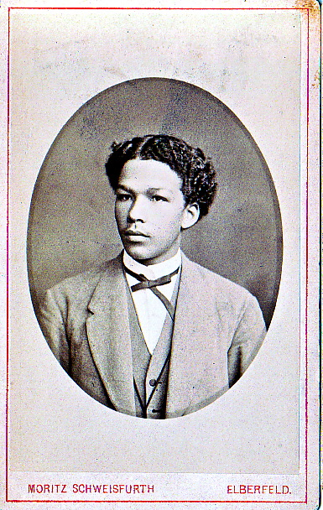
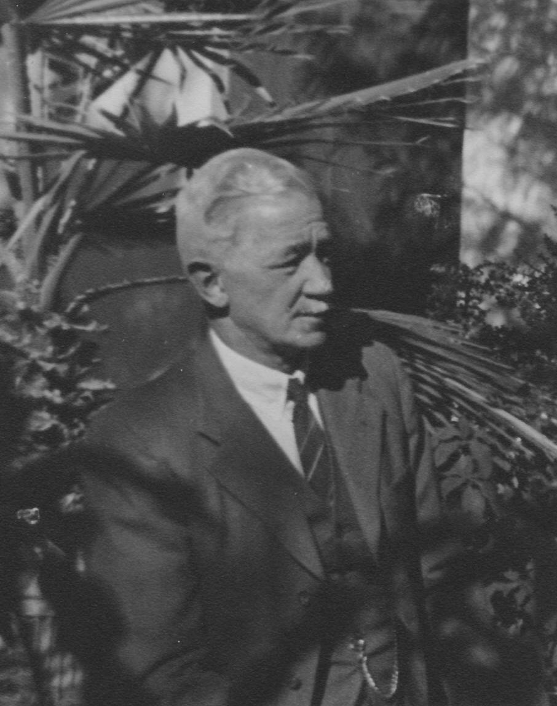
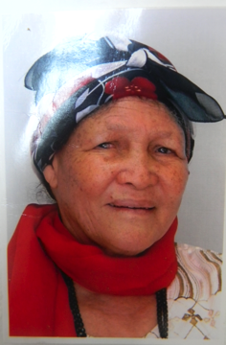
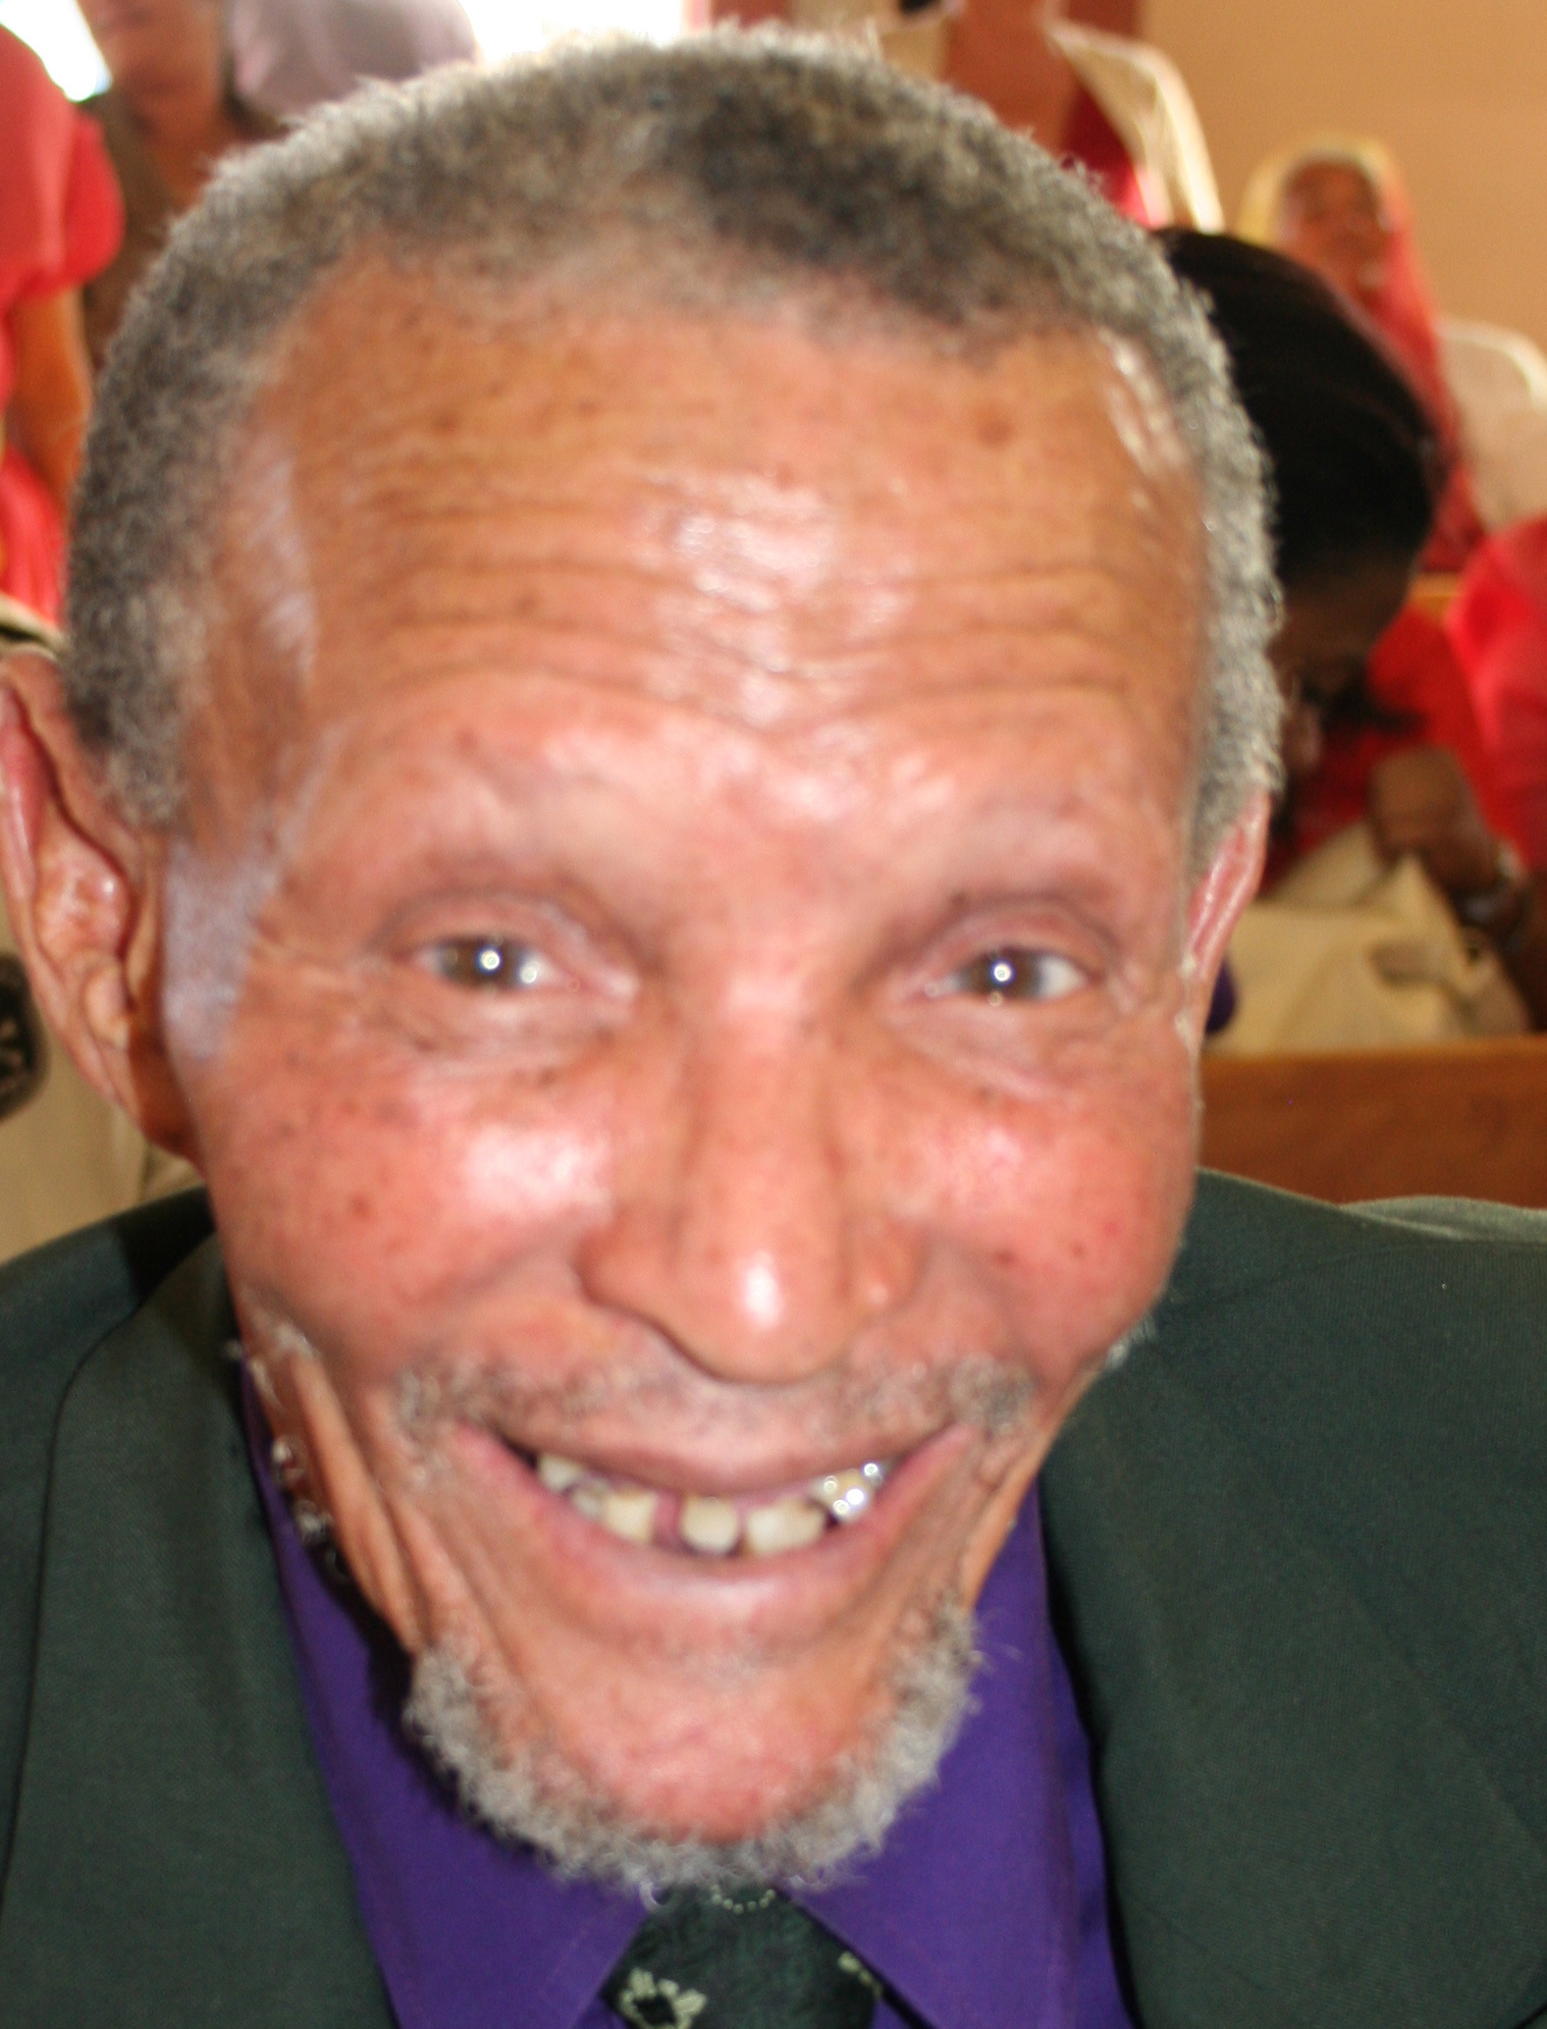
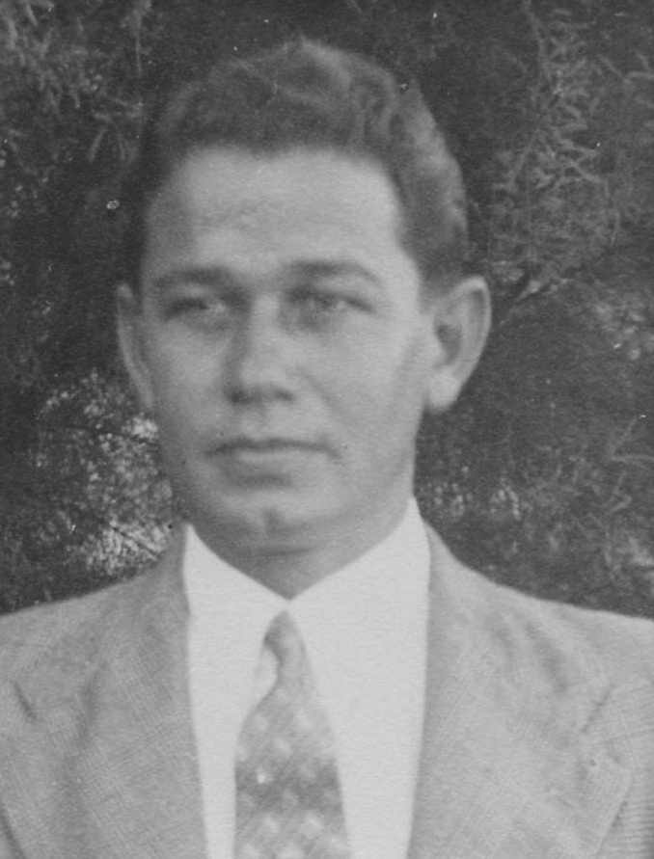
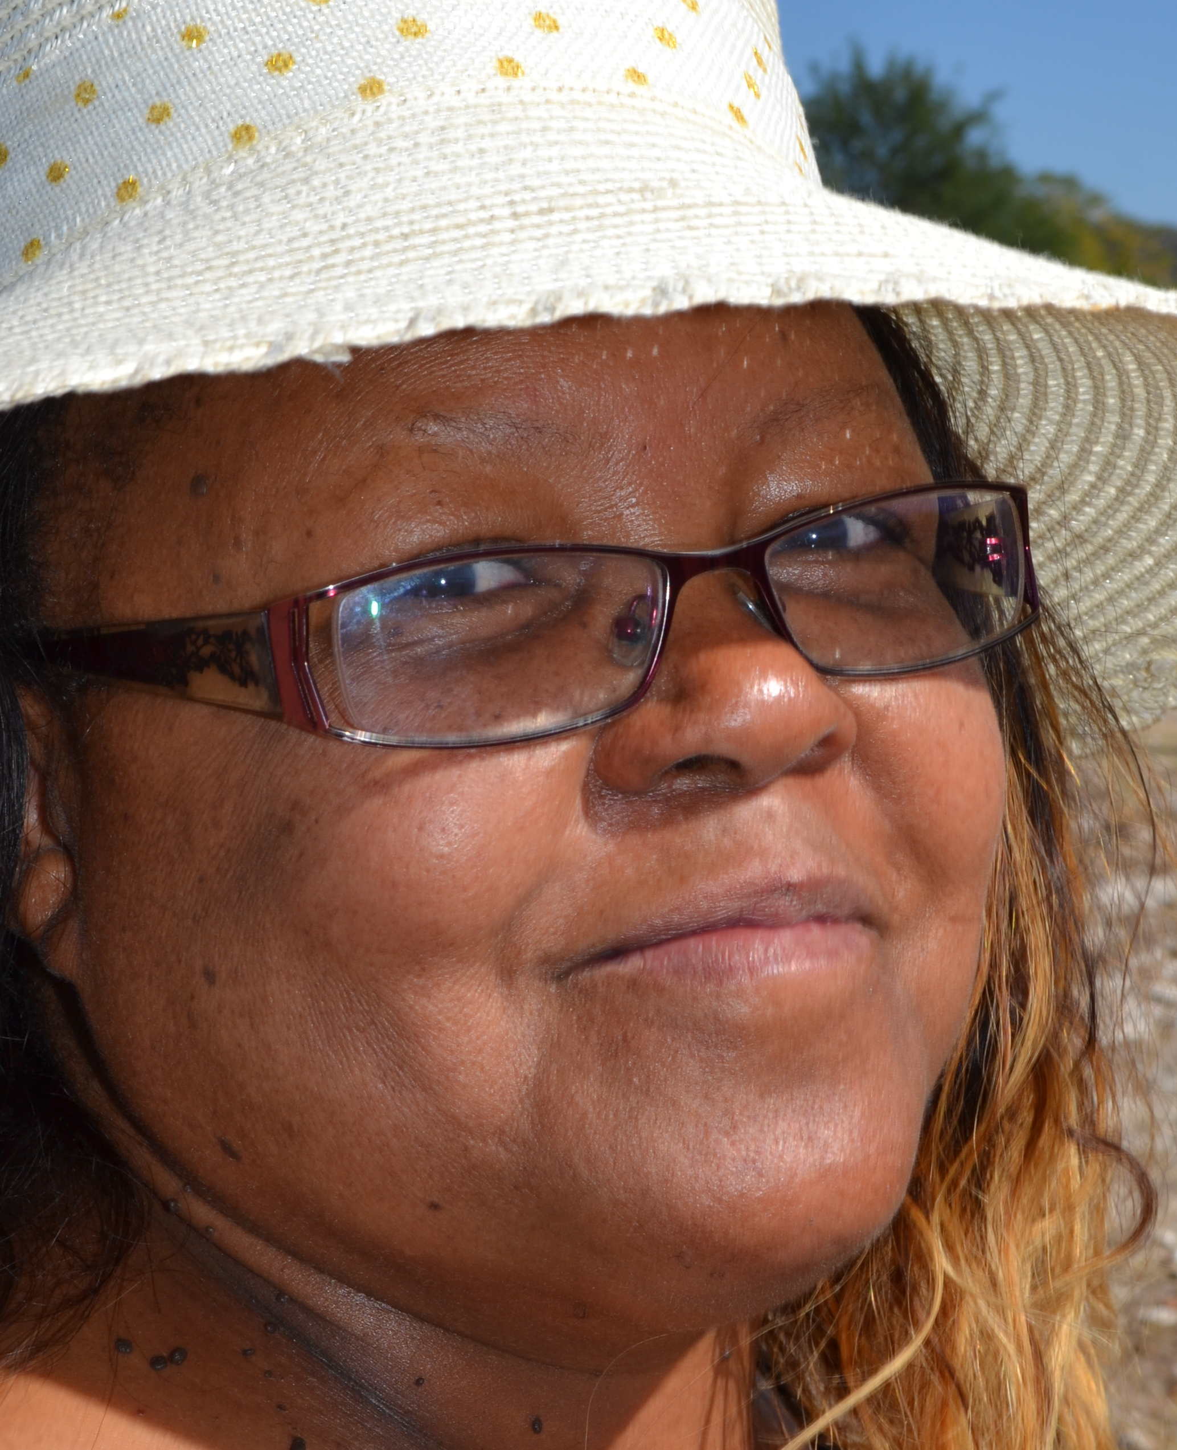
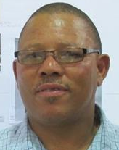
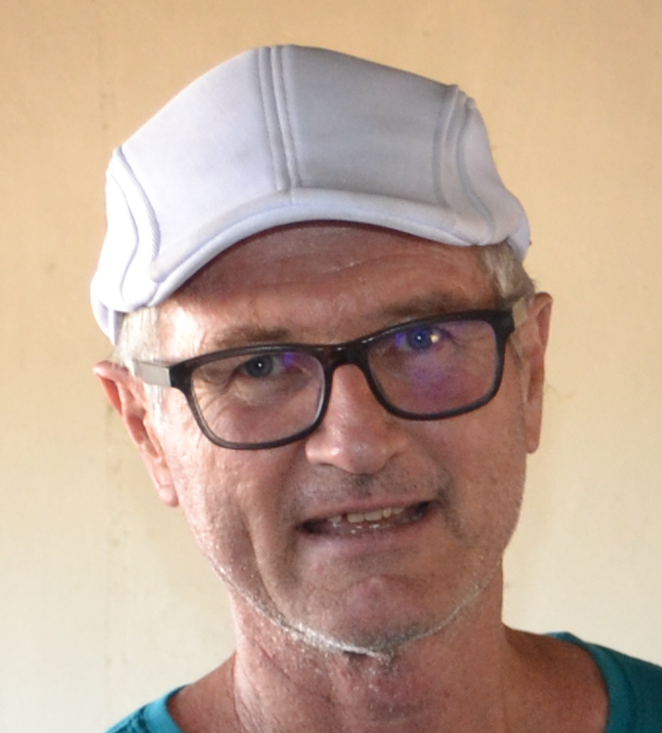
Franz Heinrich and Hanna Kleinschmidt had 8 children. For purposes of the Fransfontein
gathering only 3 of their children’s off-spring are sketched here.
The Bam family can be traced similarly and this is a project yet to be undertaken.
A:
B:
C
D
Bam
family
E
Bam
relatives

