Slide 1
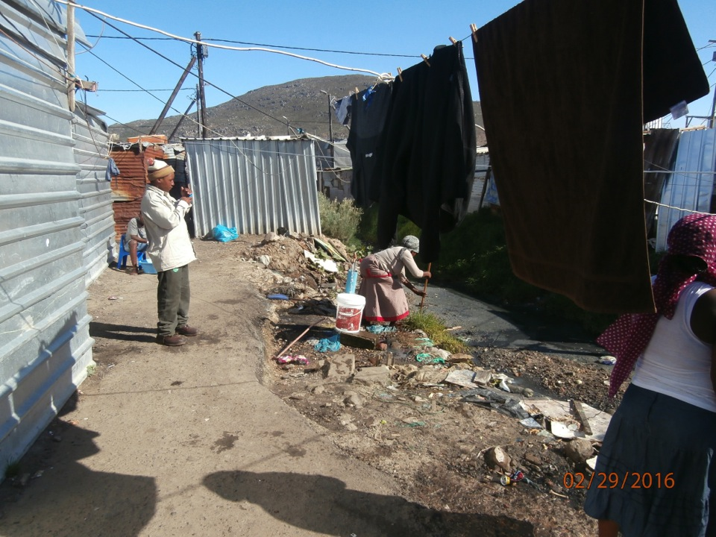
Retrieving fallen washing from the canal

Slide 2
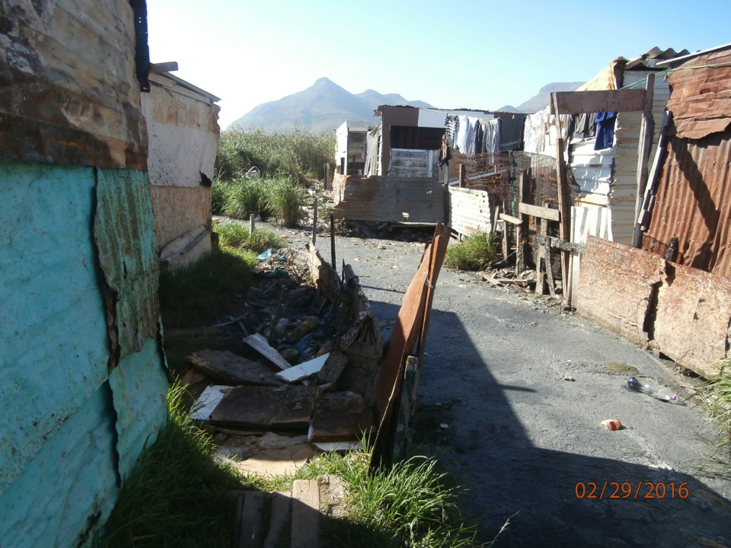
Keeping sewer water from the residential edge

Slide 3
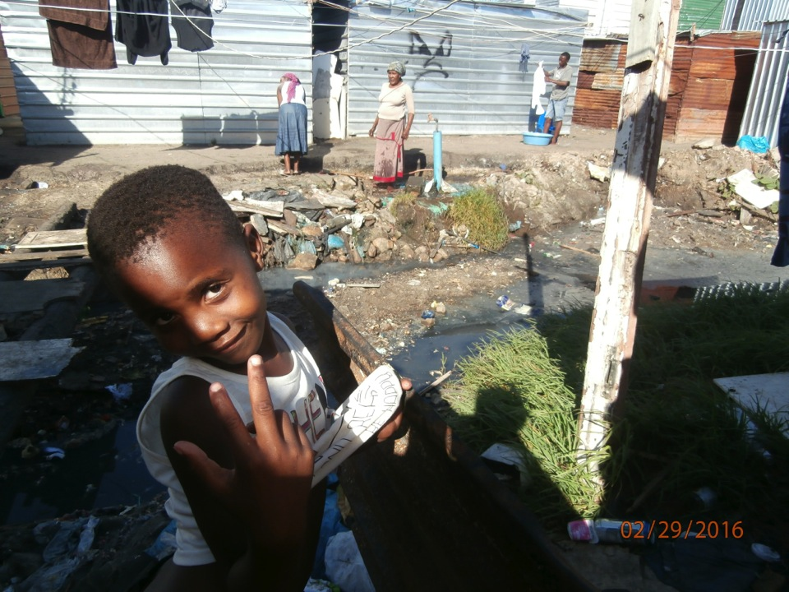

Slide 4
SHACKS THE CITY BUILT FOR FIRE VICTIMS WHO WERE HOUSED IN THE COMMUNITY HALL FOR
TWO MONTHS.

Slide 5
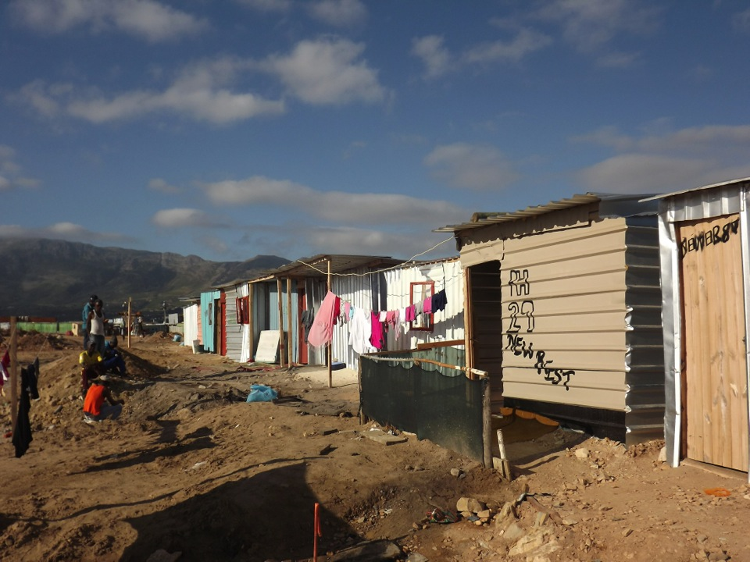
After months in the community hall, this family called their 3x3 meter shack, provided by the City, “New Rest”.

Slide 6
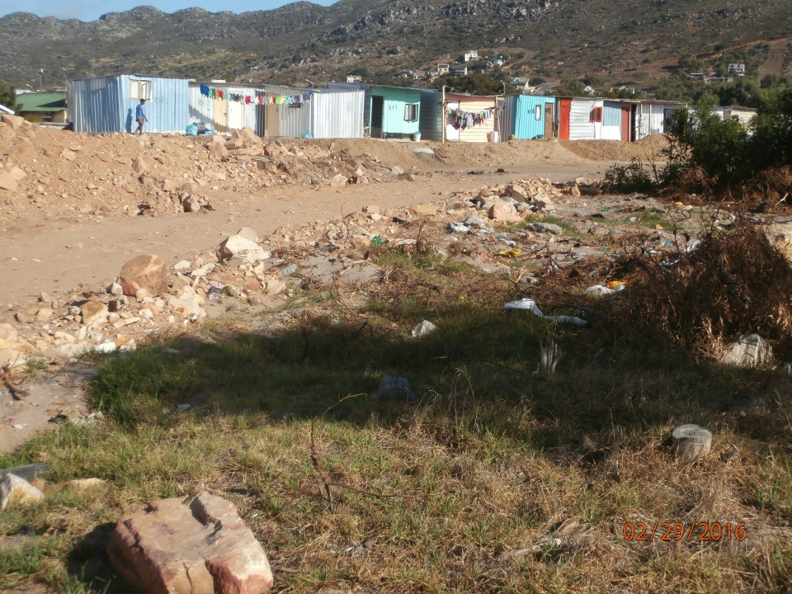

Slide 7
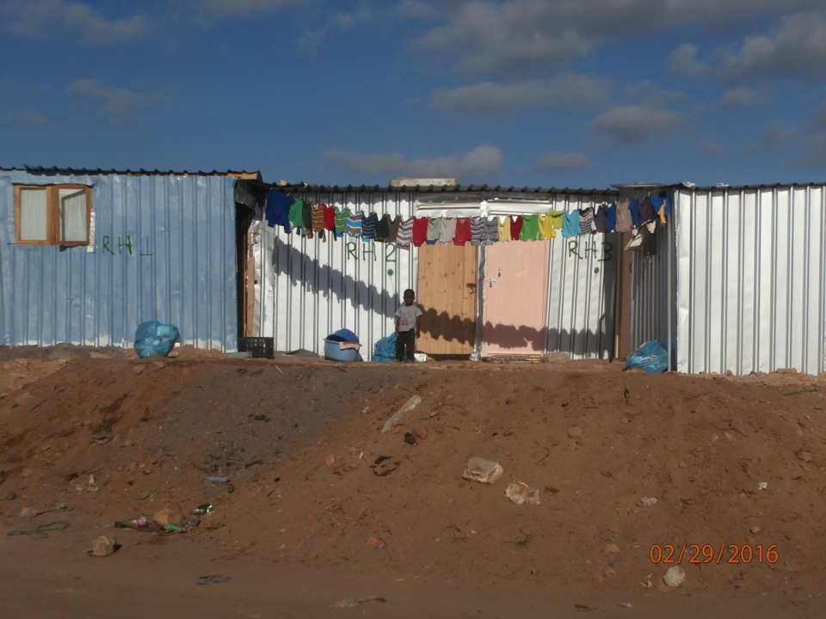
Four family homes, 3x3 meters each, some without a window.
They are not allowed to extend these structures built on a rubble mound.
There is no plan for the longer term for theses people whose houses burnt
Down in November 2015.

Slide 8
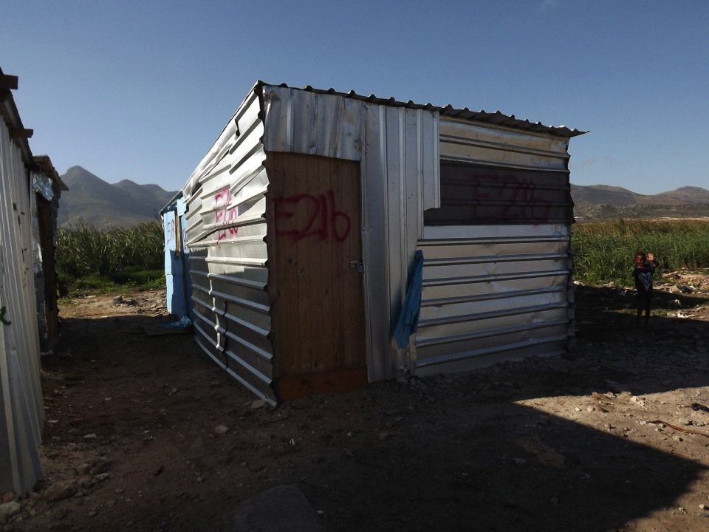
3x3 meters, the prescribed size for families whose houses are re-built after the Nov 2015 fire.

Slide 9
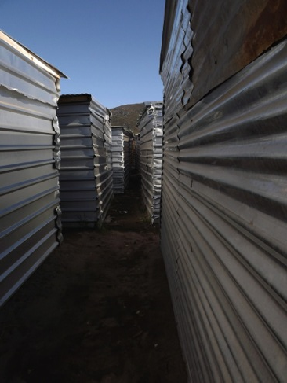
THE WETLAND
Re-built 3x3 after the fire. Those who
Extend their structures have them
Torn down by the City anti-invasion unit.

Slide 10
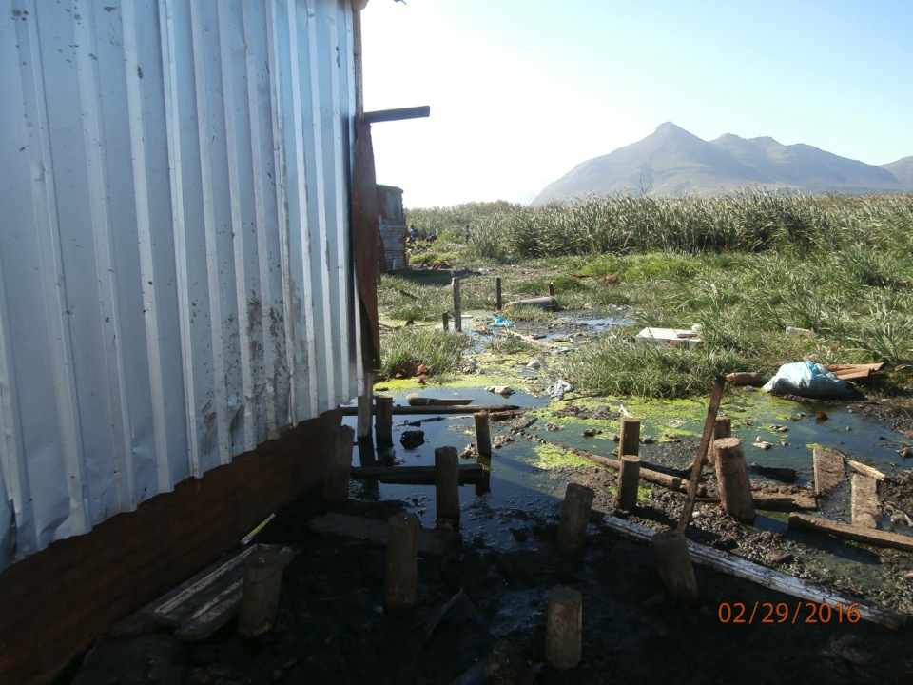
Houses built on stilts. Part of the water is emitted from the sewer/canals.

Slide 11
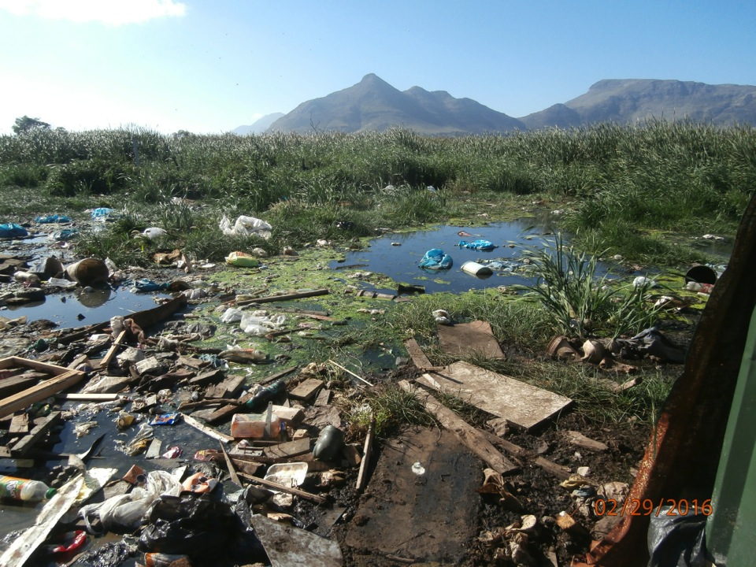
Debris at the edge of human habitation. Some of it are remnants from the last fire.

Slide 12
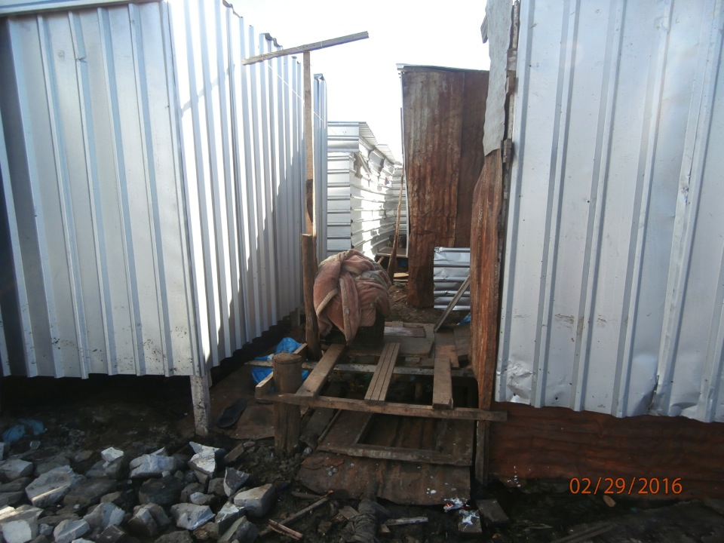
Building on stilts to avoid winter rain or the drain water from the sewers

Slide 13
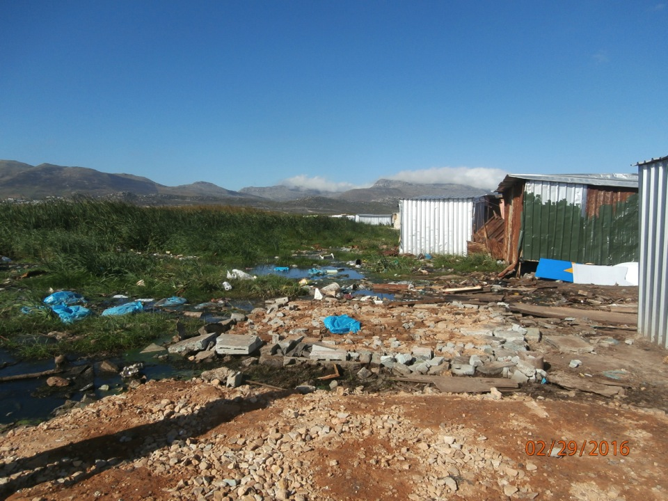
New mounds made from soil and rubble by fire victims. This is the foundation for a new shacks to be built in the ‘wetland area.

Slide 14
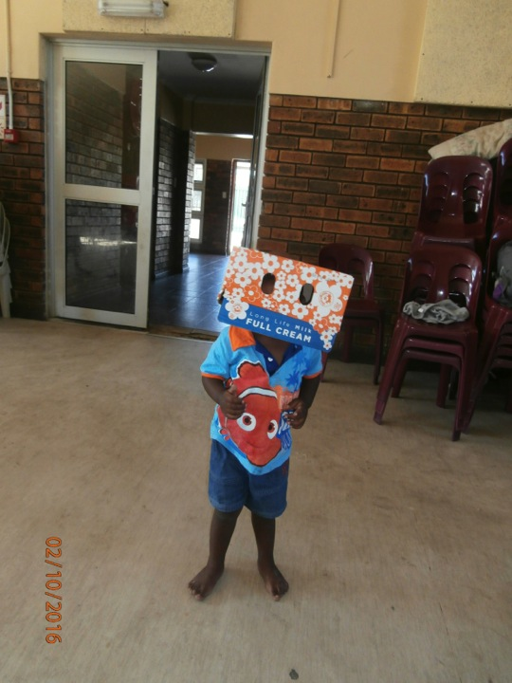
BACK IN THE COMMUNITY HALL:
This little chap
Has spent the last 3 months here with his mother and 30 others.
No privacy, no money, no home comforts and no toys. Innovation when all else seems hopeless!

