Slide 1
Mutti Celebration of a long life Gedenken eines langen Lebens
Eva Frida Kleinschmidt
Born: Jatow
1916 - 2015

Slide 2
Mutti was born at Elizabeth House in Windhoek in 1916. Her parents had arrived here in 1911. Opa worked for Telefunken to build a radio transmitter in this German colony. By 1915 German troops in Namibia had capitulated to South Africa. Opa struggled to find work after that – and going back to Germany was not recommended because of the poverty there. He eventually got work in Swakopmund at Woermann & Brock.
Mutti is a product of Swakopmund where she lived, with intervals most of her life.

Slide 3
Mutti’s parents, Frieda and Hermann Jatow in Kiel, 1911 before leaving for German South West Africa, where Opa was involved in the construction of radio communication. He worked for Telefunken.

Slide 4
Mutti’s mother, Frieda, ca. 1911 in Kiel, on the coast of the Baltic Sea, Germany

Slide 5
Mutti held by Oma, then Mutti’s sister Ilse, brother Horst and Opa with Ruth, ca. 191917 in Windhoek.

Slide 6
Mutti’s father, Hermann Jatow at the ‘Funkenstation’ in Windhoek between 1911 – 1915. Therefore German SWA became South African administered in 1915 and Opa lost his job. Mutti was born a year later. Oma said: In that time I used our last bedsheets to make Opa a good-looking suit so he looked good when he applied for jobs,

Slide 7
Outing/Ausflug, Windhoek ca.1918. Mutti is the toddler, second from left on the lap of a servant. Centre is Tante Frieda Jatow. Far right is Onkel Richard Jaacks, ex Schutztruppe

Slide 8
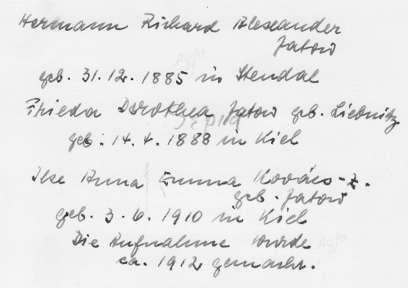

Slide 9
Ca. 1920. Mutti, uncle Männe’ and Tante ‘Tutti’.

Slide 10
Ca. 1920 in Windhoek:
Ilse, Ruth (Tutti), Hermann (Männe), mother Frieda, Eva, Horst

Slide 11
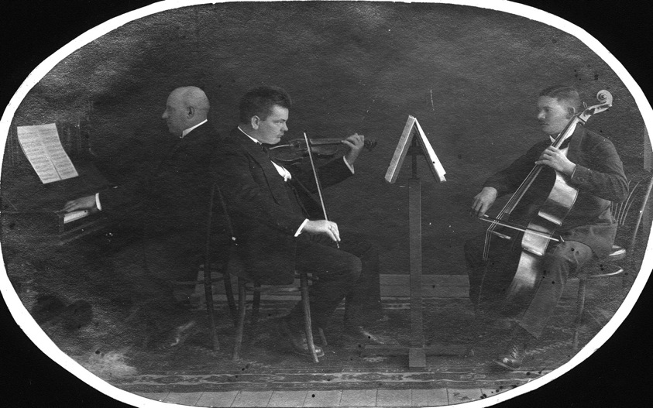
Nachod at the piano, Opa Jatow playing the violin and ? In Windhoek 1912. Nochod (surname?) died of the Spanish influennza in 1918. Opa referred to him as “his renomier-Jude” (The exemplary Jew).

Slide 12
Mutti in the middle

Slide 13
Swakopmund ca. 1925

Slide 14
Kramersdorf, Swakopmund, where Mutti grew up. The oval window on the left, she would tell me recently: that was where I kept my dolls. It was on the half-landing up the steps. (“Puppenecke”)

Slide 15
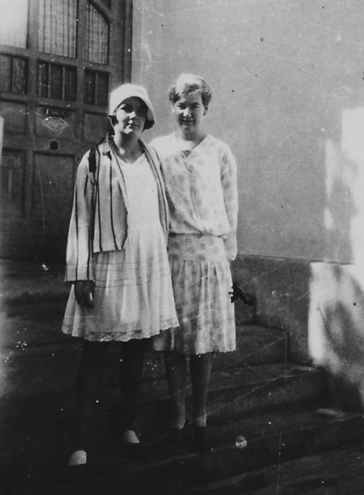
Eva and Ilse Jatow in Kramersdorf, Swakopmund, ca. 1930.

Slide 16
1922 – The Jatows: Horst, mother Frieda, ‘Männe’, Hermann, Ruth (Tutti) standing, Ilse and Eva

Slide 17
Lukas, Ovambo house-help to the Jatow’s, left at the back. Kramersdorf, Swakopmund ca. 1923

Slide 18
In her early grades in the 1920’s, Mutti started school here. It’s an exclusive hotel today.

Slide 19
This was the German School, today an integrated state school. Mutti would say: After 1915 the English (meaning South Africans), took it away from us and we had to be taught at ‘Kaserne’, the military barracks.

Slide 20
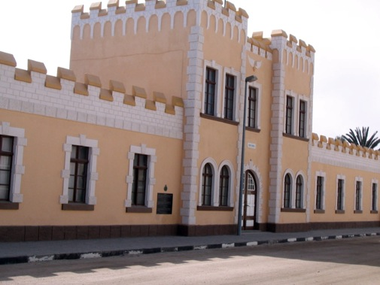
The military barracks where Mutti went to school, because …….

Slide 21
Mutti on 13 Apr 2015, said:
Ich habe bis Std 6 gemacht. Die hatten uns die alte schule zurück gegeben. Dann hatte Opa kein Geld und ich musste arbeiten gehen.
Im Haushalt – musste ich Kinder aufpassen, - bei Wokers, der Bürgermeister. Da war ich unglücklinch – nach ein pahr Monaten hat Opa mich zurück nach Hause gebracht.
War erst 14 Jahr alt und hab dann bei Andern Kinder auf ge passt.
Mutti said on 13 Apr 2015:
I went to school till Std 6. They (“The British” – meaning South Africa) had given us back our school. Then Opa had no money and I had to go and work.
In their home I had to look after the children, - at the Wokers, (he) was the Mayor. I was unhappy there and after a few months, Opa took me back.
I was only 14 and then looked after other children.

Slide 22
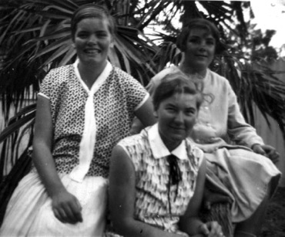
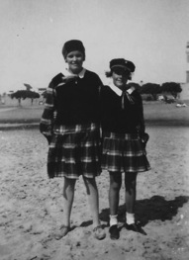

Slide 23
Siblings/Geschwister: Eva, Horst, Hermann, Ruth and Ilse in Kramersdorf, ca 1928.

Slide 24
The Jatow’s: Ruth, mother Frieda, Hermann, father Hermann and Eva, 1930’s

Slide 25
1934

Slide 26
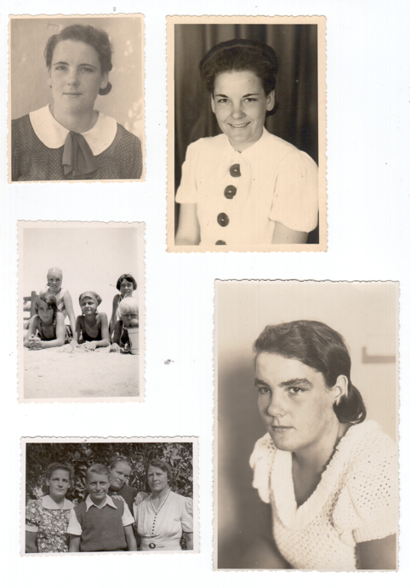
Mutti in Swakopmund in the 1930’s Mutti front left, Ruth behind, cousins Hische and Liddy. (back right unknown) Mutti, Baas (junior), Ruth and mother Baas

Slide 27
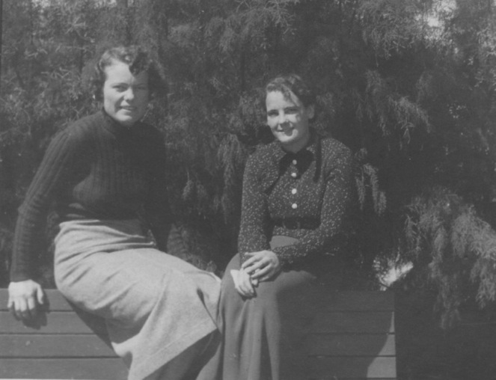
Eva Kerz and Eva Jatow ca 1938.

Slide 28
1928

Slide 29
Mutti, Eva Jatow, Hortenführerin der Pfadfinder in Sewakopmund, ca 1937. “Das war alles so positiv”.

Slide 30
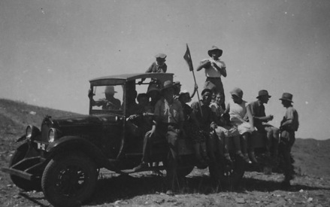
“Knüppelweg”, sidewalk made of wooden planking in Swakopmund 1920’s Below: Ausflug in die Wüste Outing into the desert

Slide 31
The arms at the top of the gross new building are all that is left of the butchery that once existed on this corner. The owner was Hungarian, Recsey. Mutti remembered his wisdom from the 1920’s: Kommt sich Regen kommt sich Geld, kommt sich kein Regen, kommt sich Rechtsanwalt. (When it rains there is money, when there’s no rain the lawyer comes)

Slide 32
Oma Frieda and Opa Hermann Jatow ca. 1925 in Swakopmund

Slide 33
Mutti and Oscar Schatz, late 1930’s. But…

Slide 34
Vati und Mutti’s wedding day in 1944 with bridesmaids and boy in front of the Lutheran Church in Swakopmund

Slide 35
Mutti und Vati on their wedding day with bridesmaid, Karin-Helga in 1944.

Slide 36
Internment camp WWII in Namibia. The camp was the former radio station Opa had help build. But within weeks they were sent to camps in South Africa. Opa Hermann Jatow at back with white shirt.

Slide 37
Frau Otterman (?) with Opa and Oma Jatow, ca. 1947. Opa had been released from the WWII detention camp but was not allowed to return to SWA/Namibia, pending possible deportation to Germany. Oma on visit.
The Otterman’s of Krondahl, Rustenburg, volunteered to take Opa in.

Slide 38
Mutti, fron left, with Immo, `heidi and Horst.
At Mutti’s pasrents home in Rustenburg, ca. 1953

Slide 39
Mutti, Vati and ‘Tante’ Elsa Merryweather in the city, Johannesburg, 1949.

Slide 40
Ca. 1952. Mutti took the picture of dad with Heidi on his arm, Immo and Horst to his side; with Senta the dog at the back of the home of the grandparents in Rustenburg, old stables converted.
The car is a 1949 Chevrolet Fleetline.

Slide 41
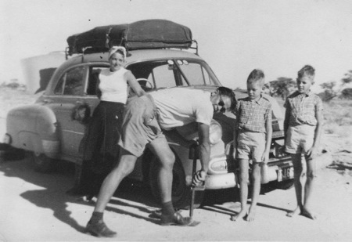
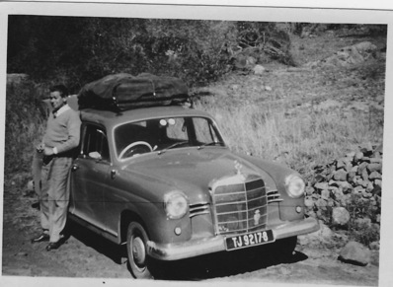
The long road to Namibia, every year.

Slide 42
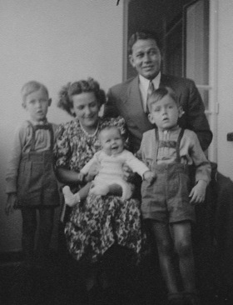
Holiday in Port Shepstone, Natal south coast, ca 1953. And on the veranda, Louis Botha Ave, Johannesburg, of Mr Kempton-Jones, ca. 1951.

Slide 43
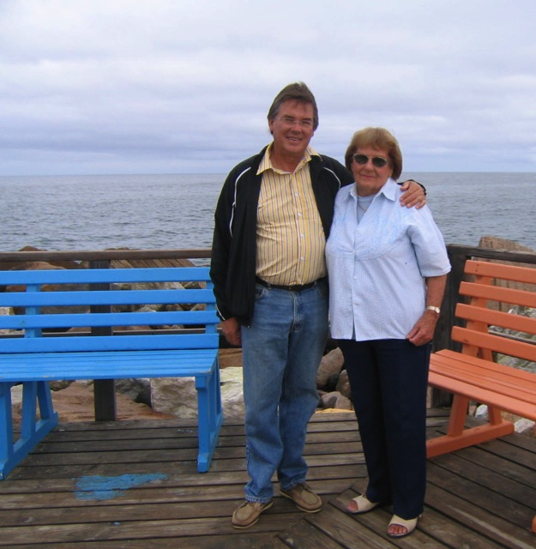
Horst und Mutti an der Mohle, ca. 1992.

Slide 44
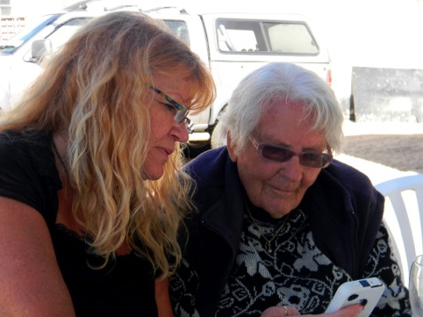
Christine with Mutti at Hansa Hotel on Mutti’s birthday 2014 Heidi and Mutti

Slide 45
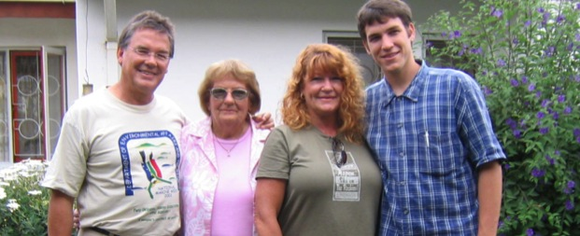
Horst, Mutti, Heidi und Marc, 1995
Mutti with Heid and Horst outside her cottage at the Lions Home ca. 1995
Mutti with Heidi, grandson Marc and Horst in Swakopund, ca. 1996.

Slide 47
The cottage at the Lions Home where Mutti stayed for ca. 30 years
The corner in her flat where she read and did countless cross-word puzzles.

Slide 48
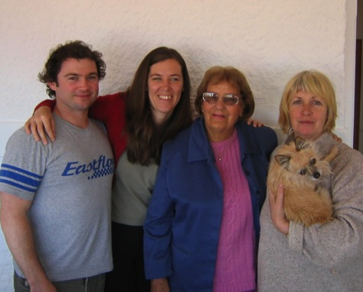
2006, Mutti’s 90th birthday in Cape Town. Carl and Tusha’s marriage took place days earlier

Slide 49
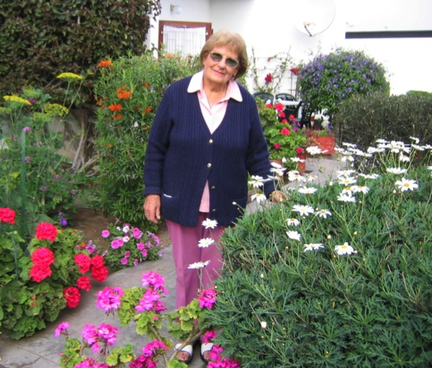

Slide 50
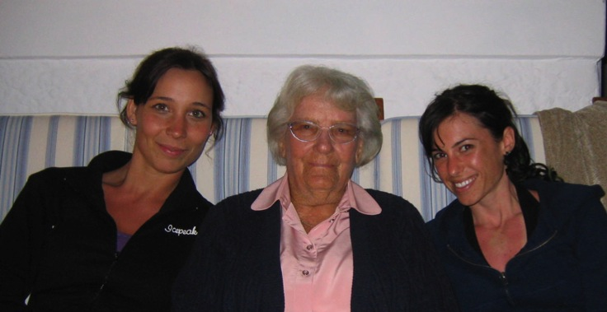
Mutti with granddaughters Tamara and Zindzi, 2006 in Cape Town
Mutti’s pride and joy. her garden in Swakopmund

Slide 51
Immo, Mutti, Carl, Tusha and Heidi at Groot Constantion where Tusha and Carl married. Immo and Heidi are the parents of Tusha.

Slide 52
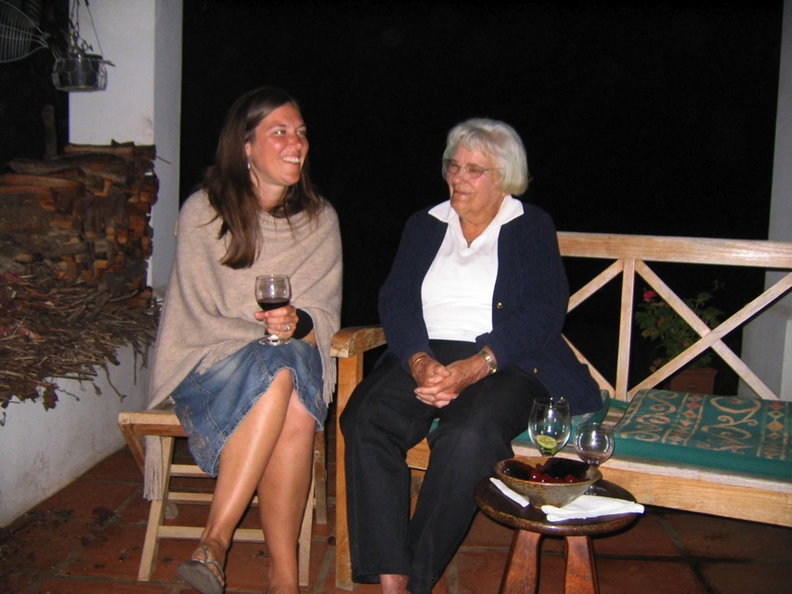

Slide 53
A toast to in celebration of being 93

Slide 54
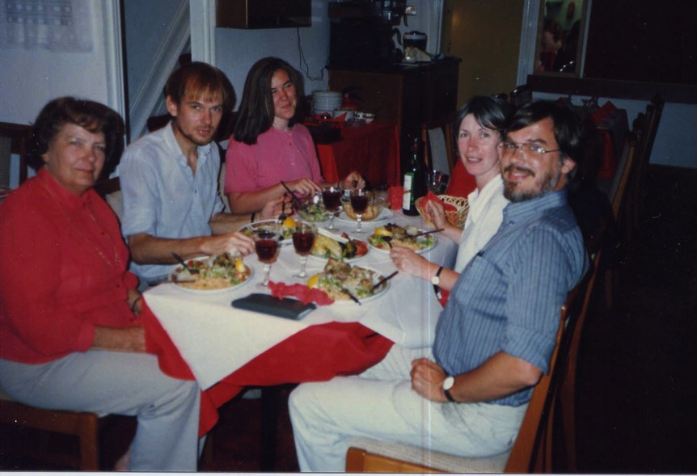
Mutti visiting us in London.
Mutti, Immo, daughter Tusha, Christine and Horst

Slide 55
Mutti tending to the gravestones of her mother, her brother ‘Männe’ and his wife ‘Lukke’ and Mutti’s sister Ruth

Slide 56
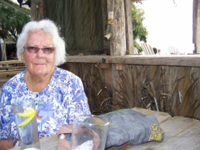
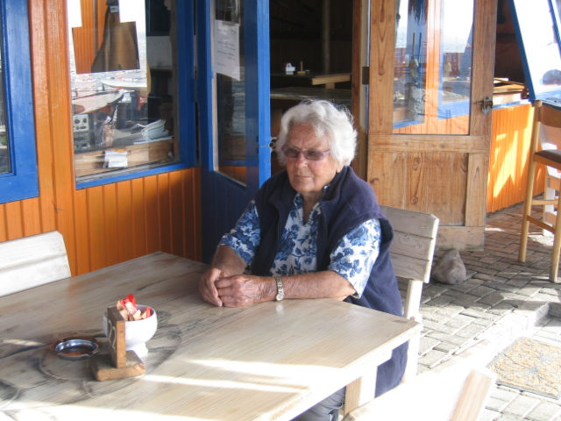
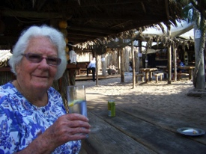

Slide 57
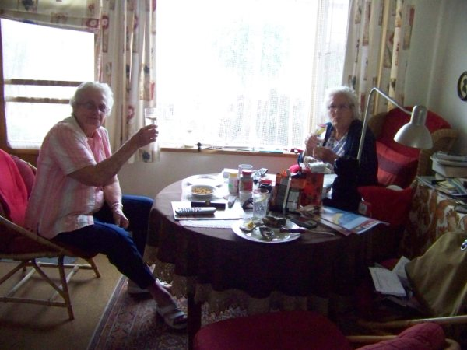
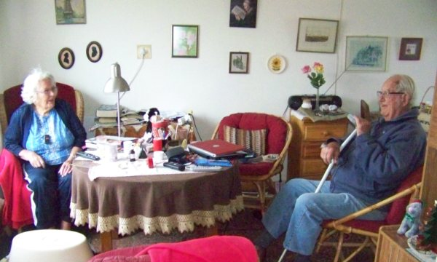
Mit Freundin Grete List
Mit Mr. Loots, a descendent of Dorslandtrekkers who eventually returned from Angola and Swedish colonial traders

Slide 58
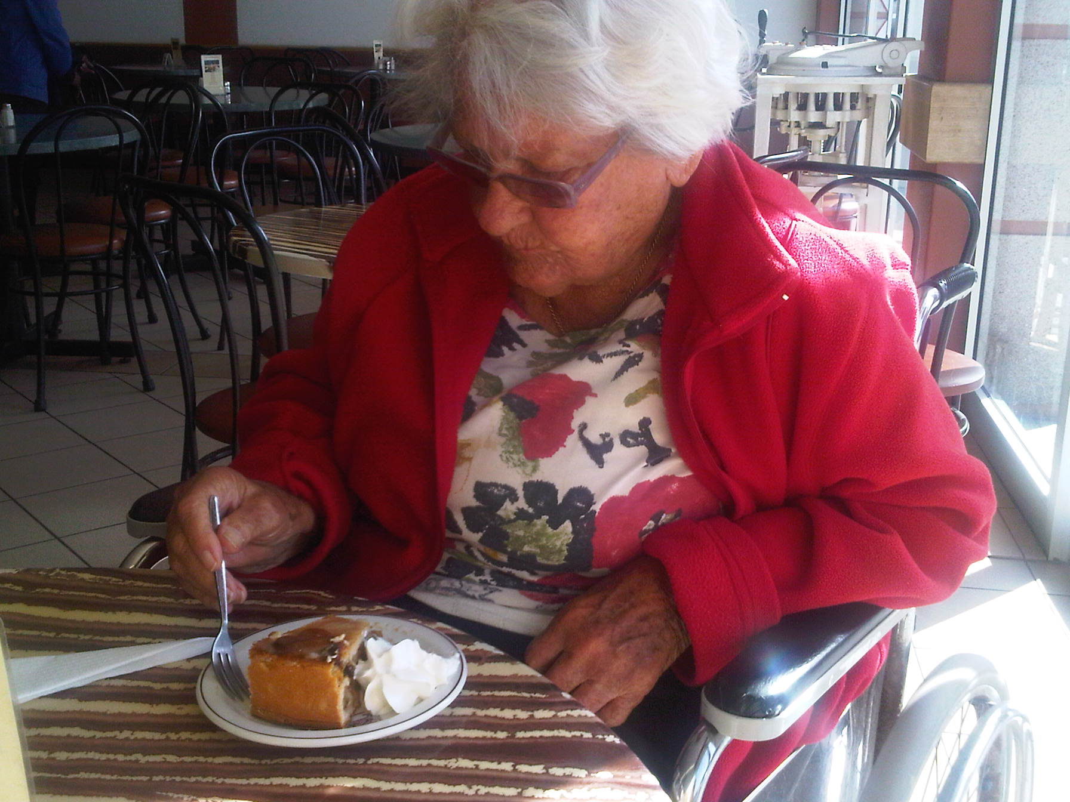

Slide 59
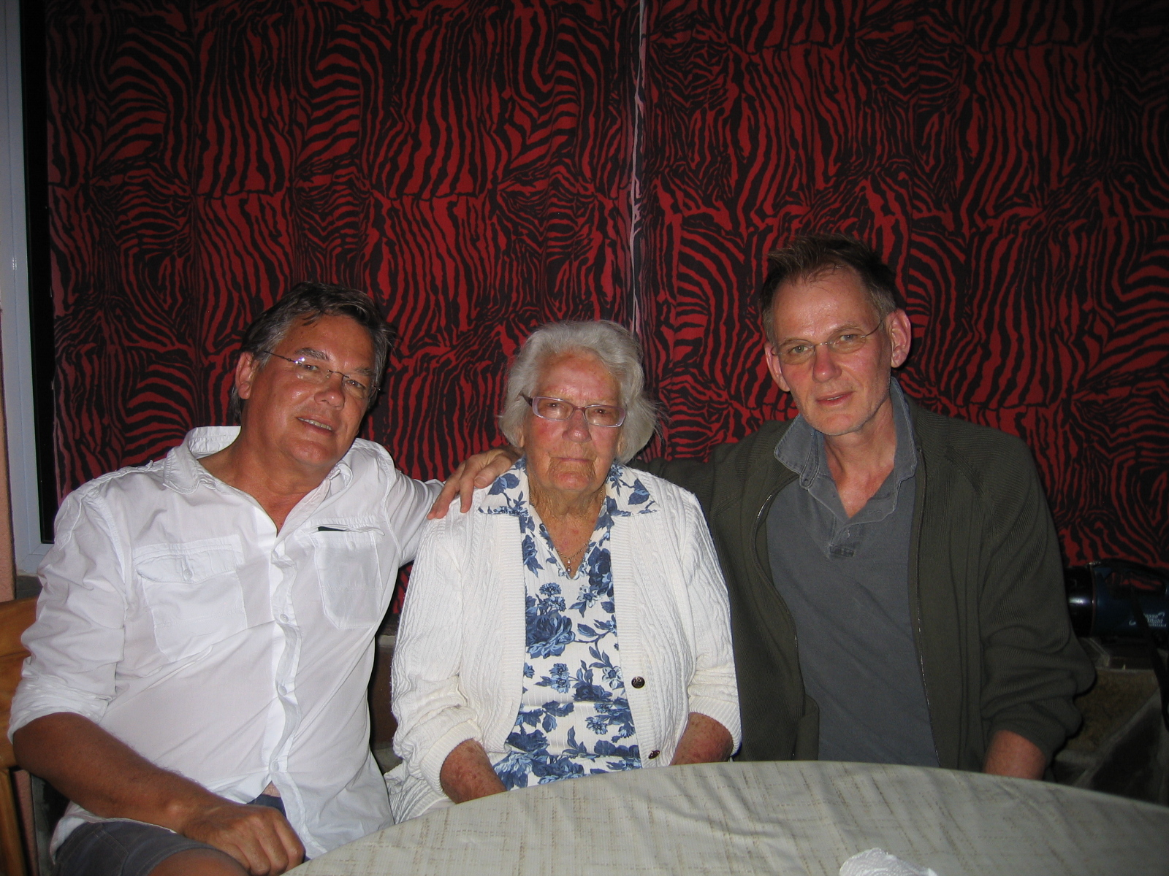

Slide 60
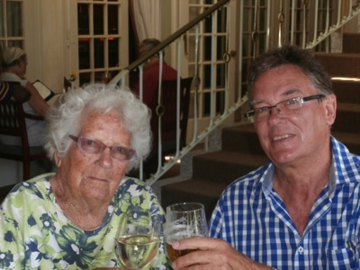

Slide 61
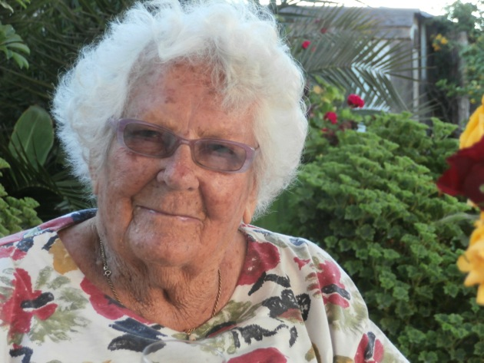

Slide 62
October 2015

