Slide 1
PHOTOGRAPHS FROM MASIPHUMELELE ON THE DANGERS TO PUBLIC HEALTH AND TO CHILDREN
Submitted to the South African Human Rights Commission, as part of the Complaint lodged at the same time.
This presentation is also provided electonically
March 2016

Slide 2
CHILDREN AT RISK
All photos are taken by Rosemary Milbank and are her property.

Slide 3
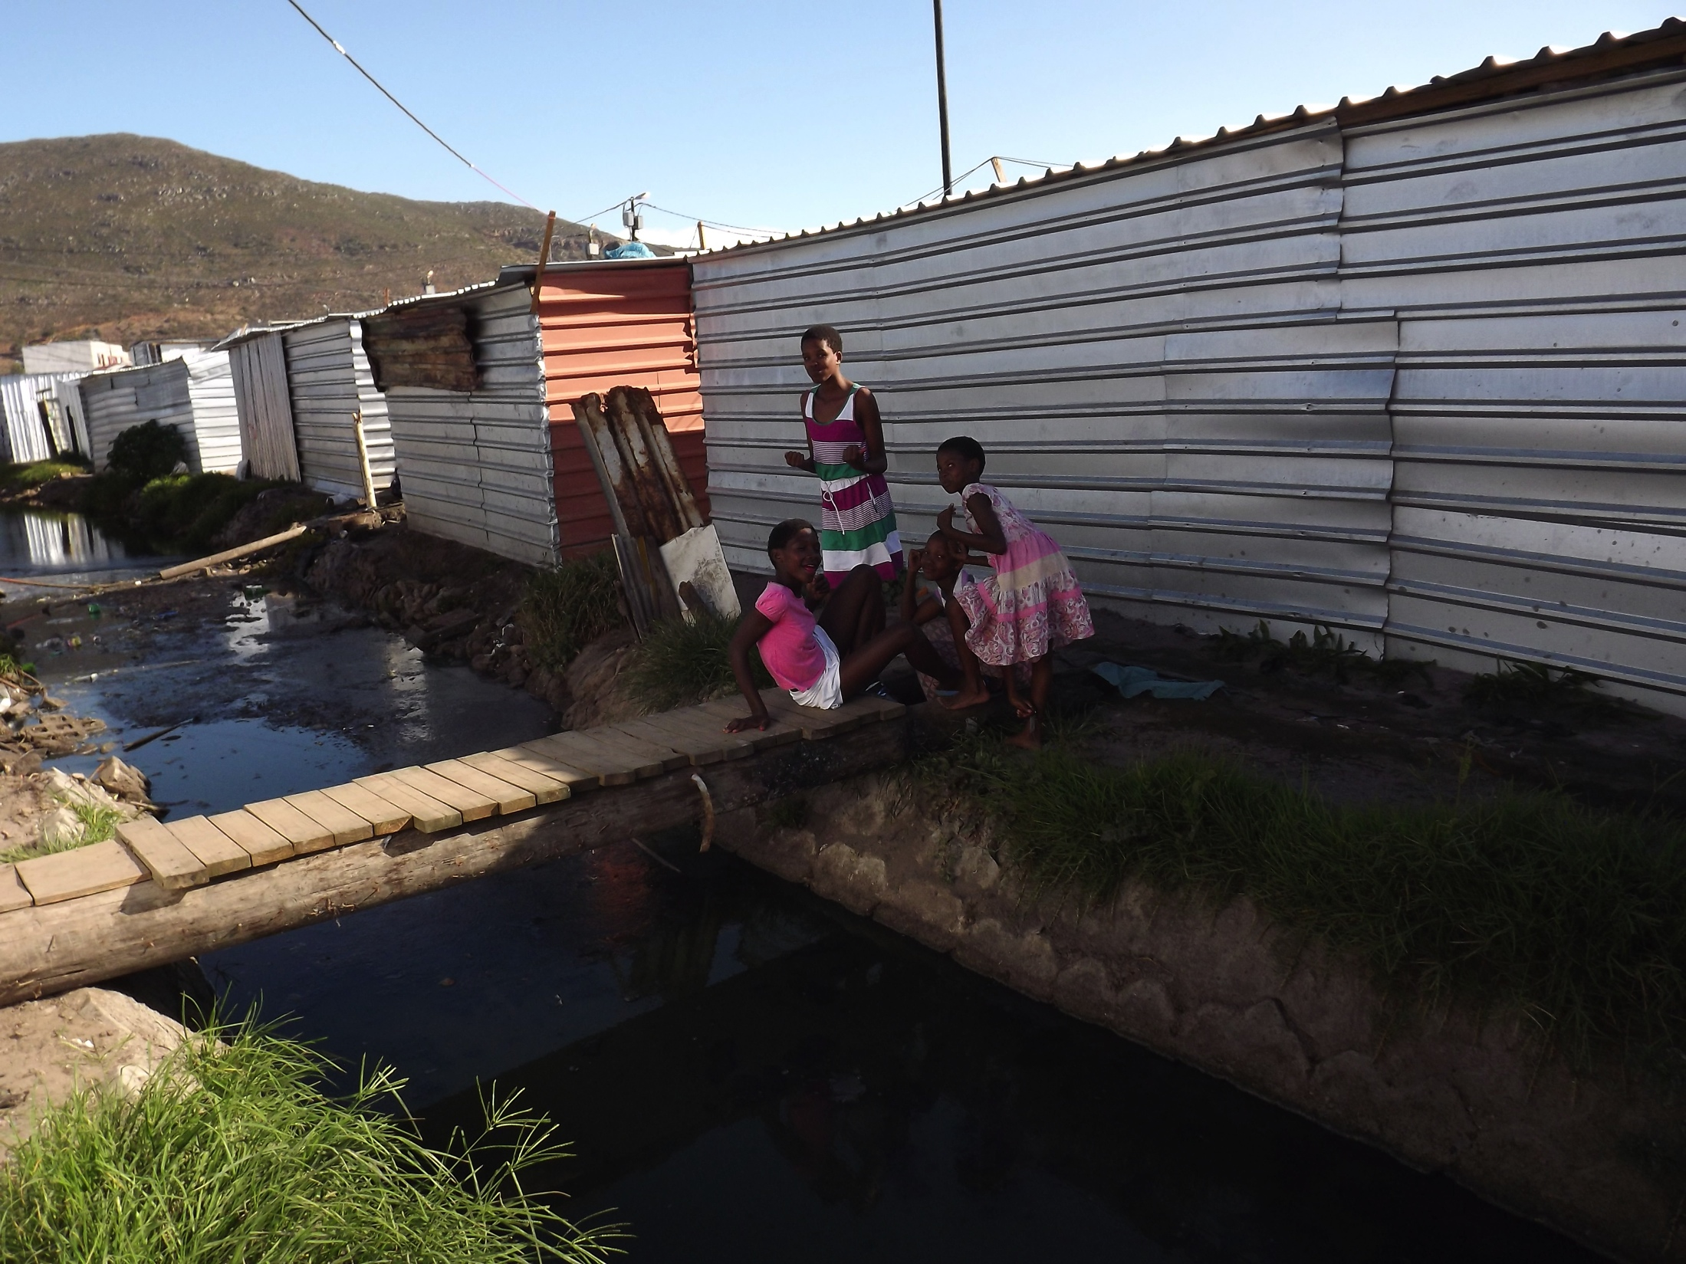
Rickety bridges across unsafe water, the playground for children

Slide 4
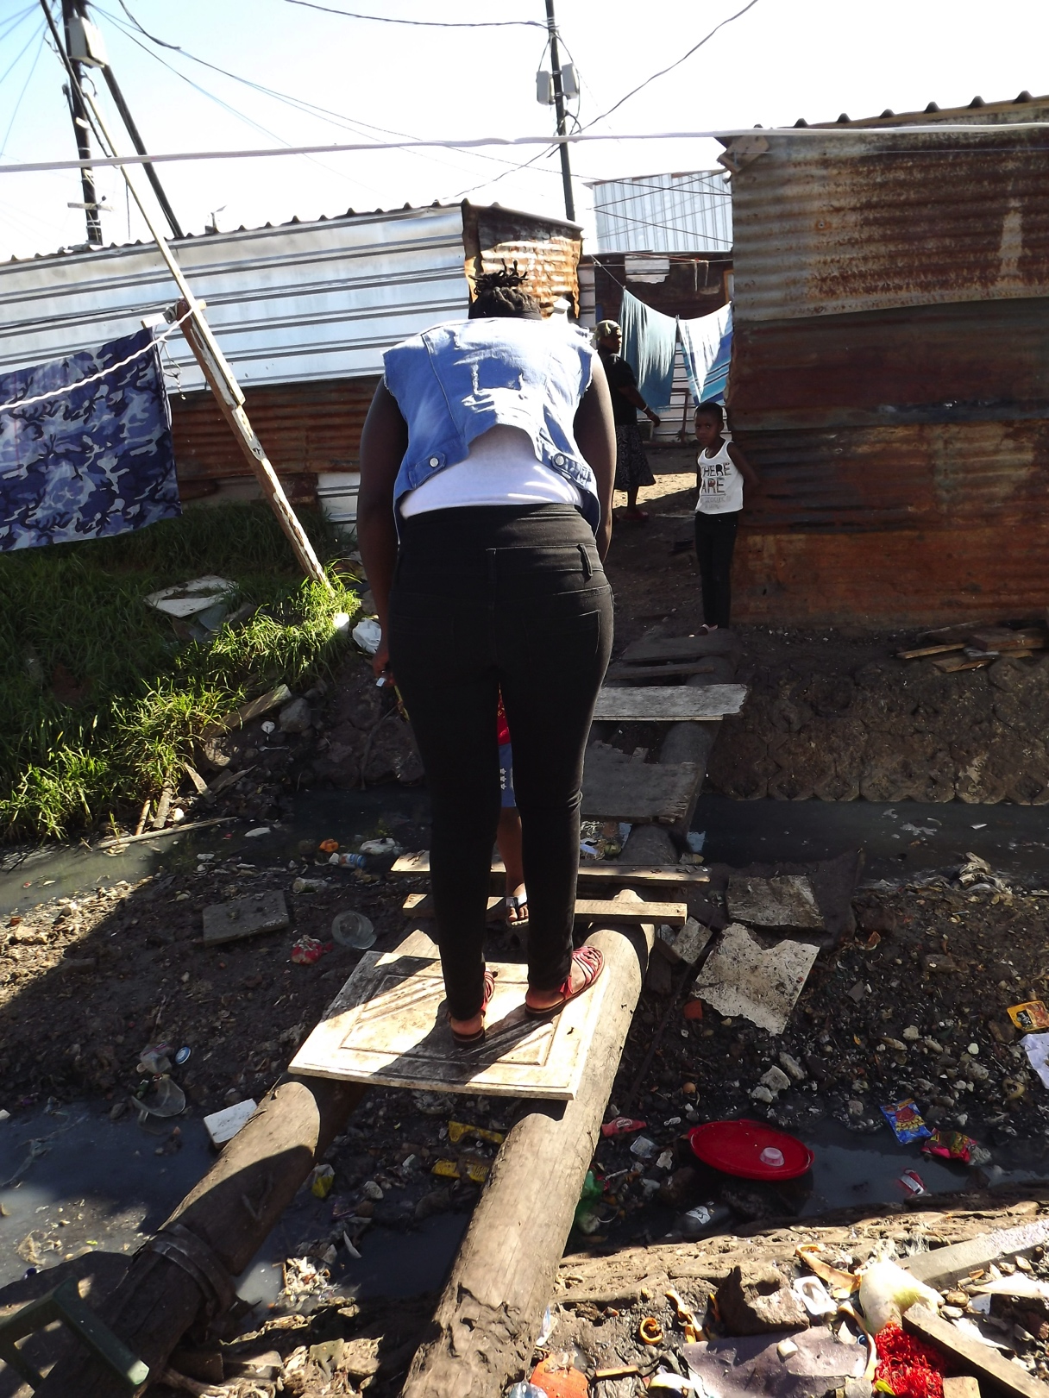
Guiding a child over
A rickety bridge

Slide 5
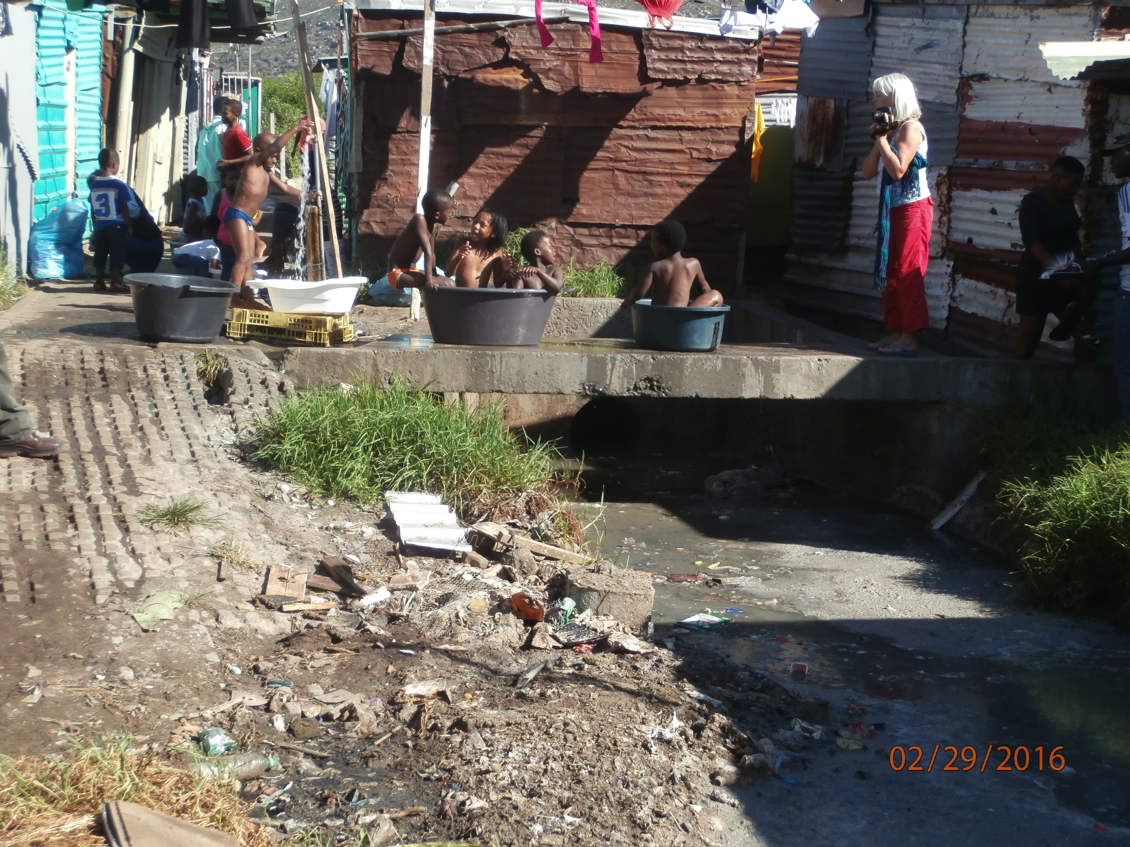
Open, stagnant water in drain with children bathing in tubs on a bridge.

Slide 6
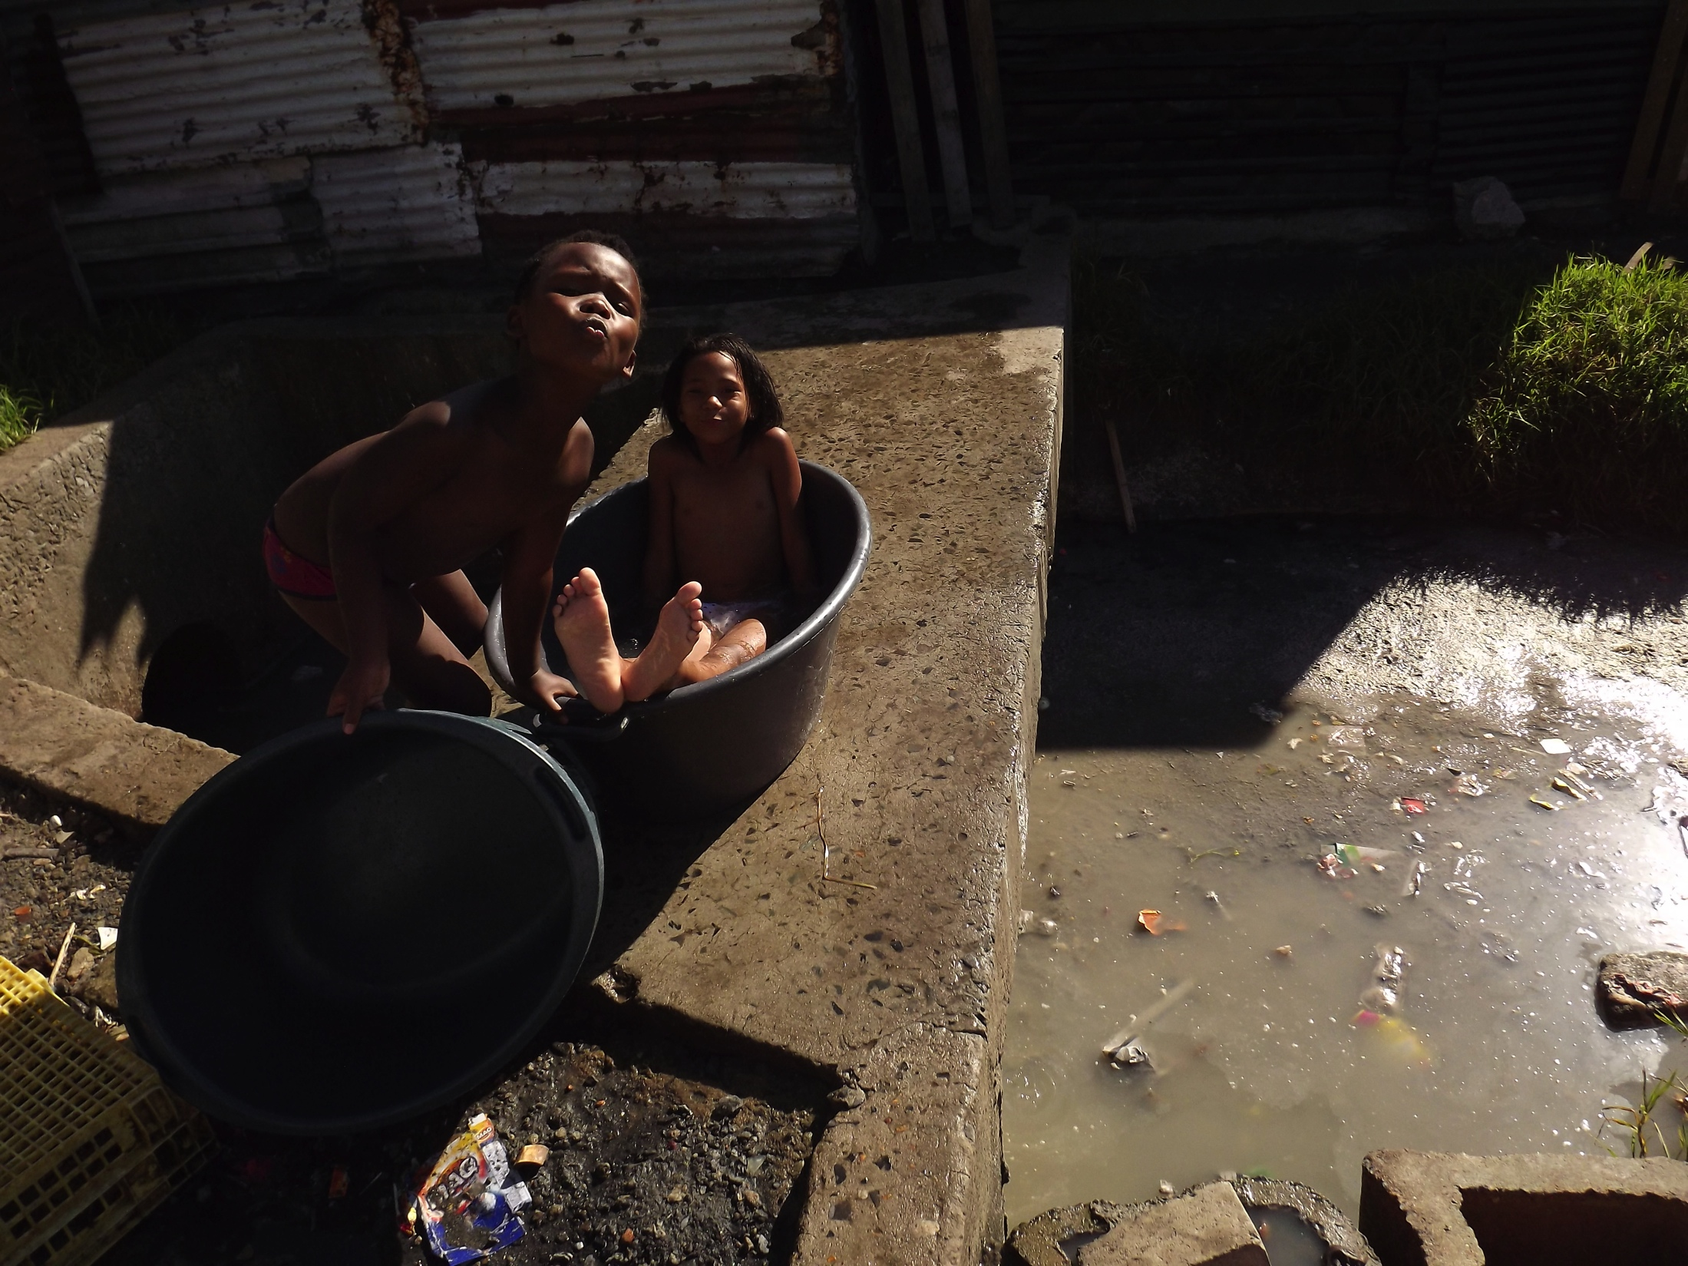
Bath time in clean water, but unsafe water in the ditch underneath them

Slide 7
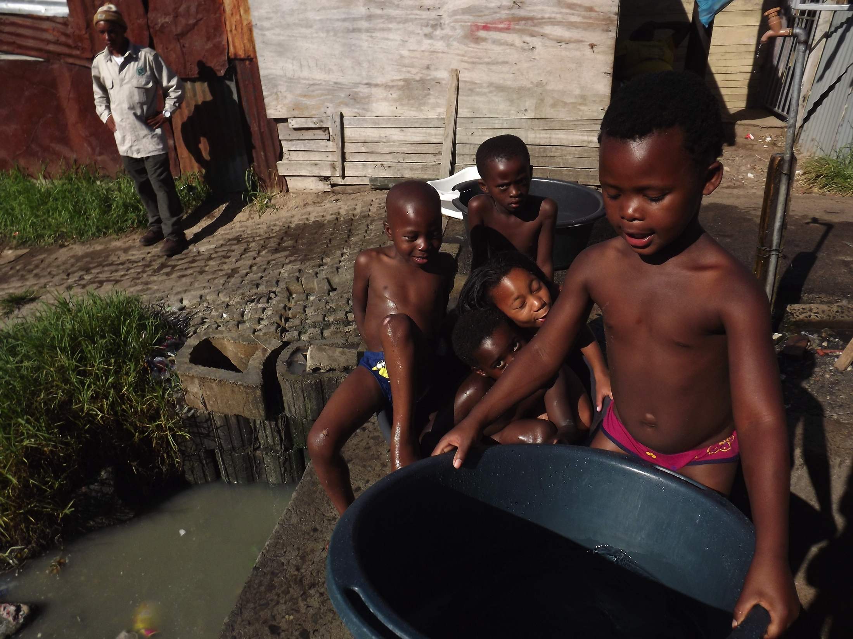

Slide 8
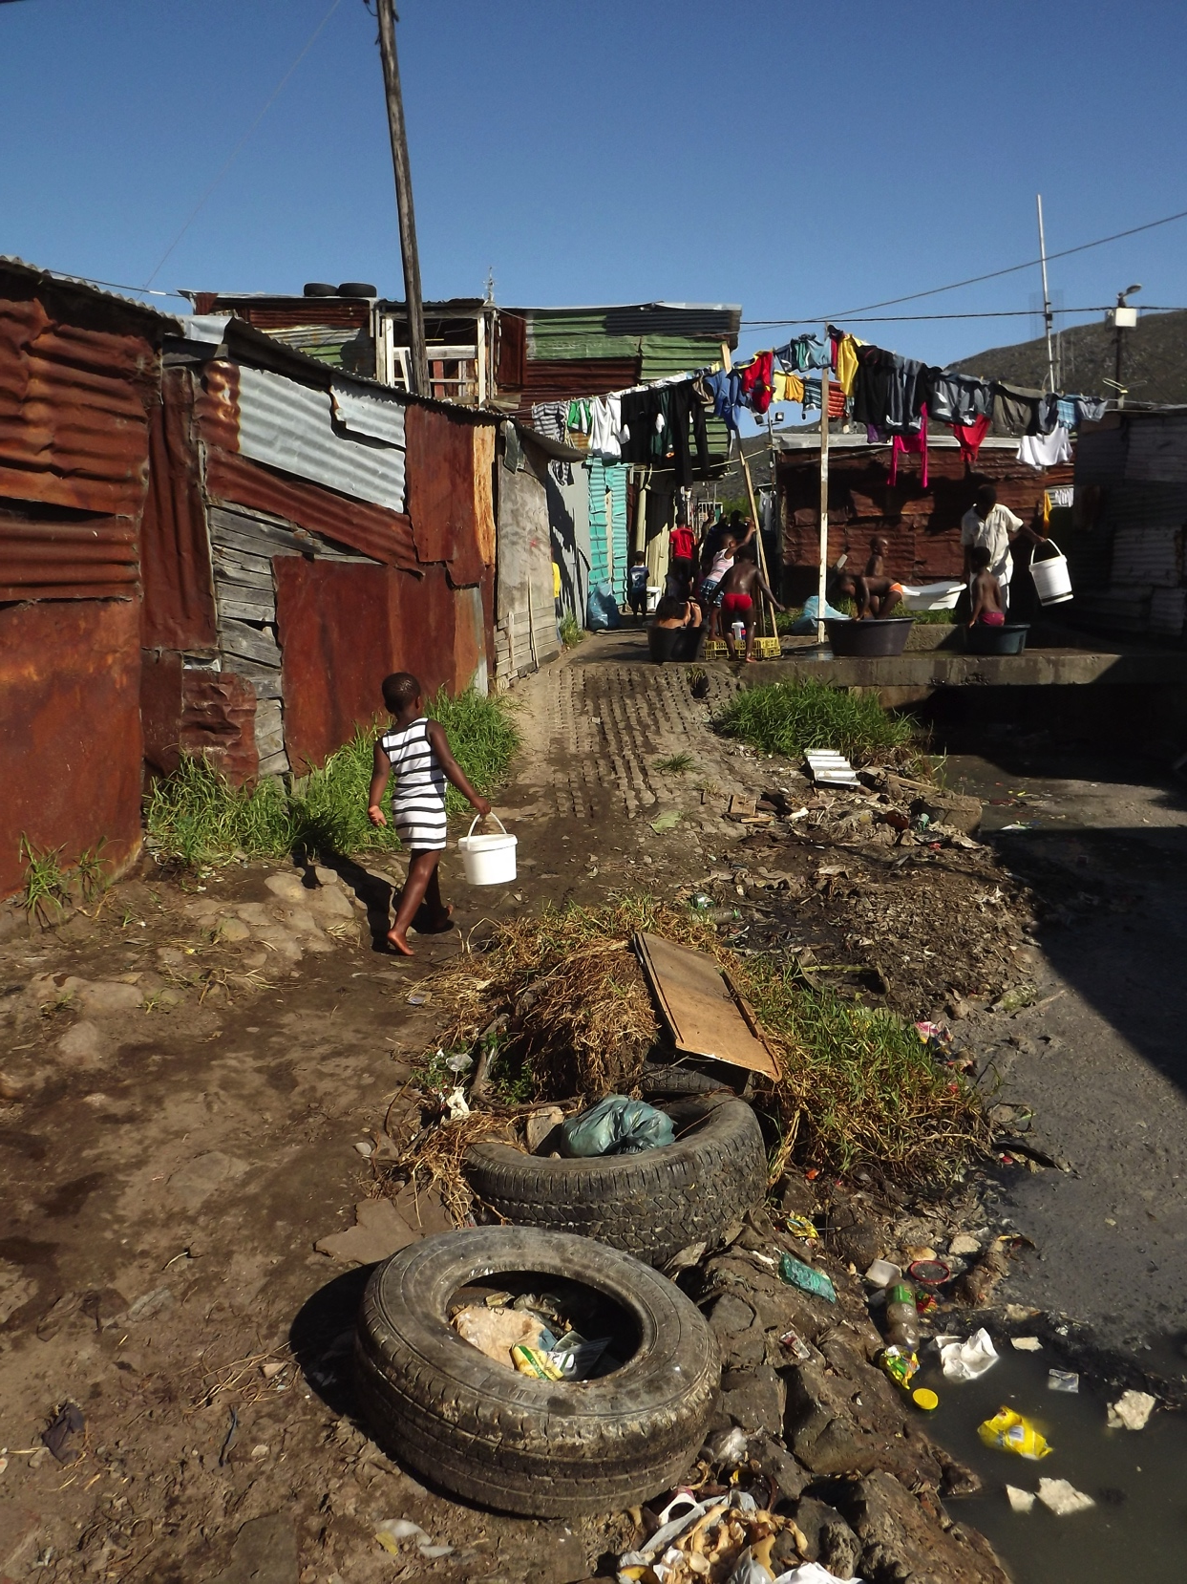
Alongside a smelling drain, a child on the way to
collect water

Slide 9
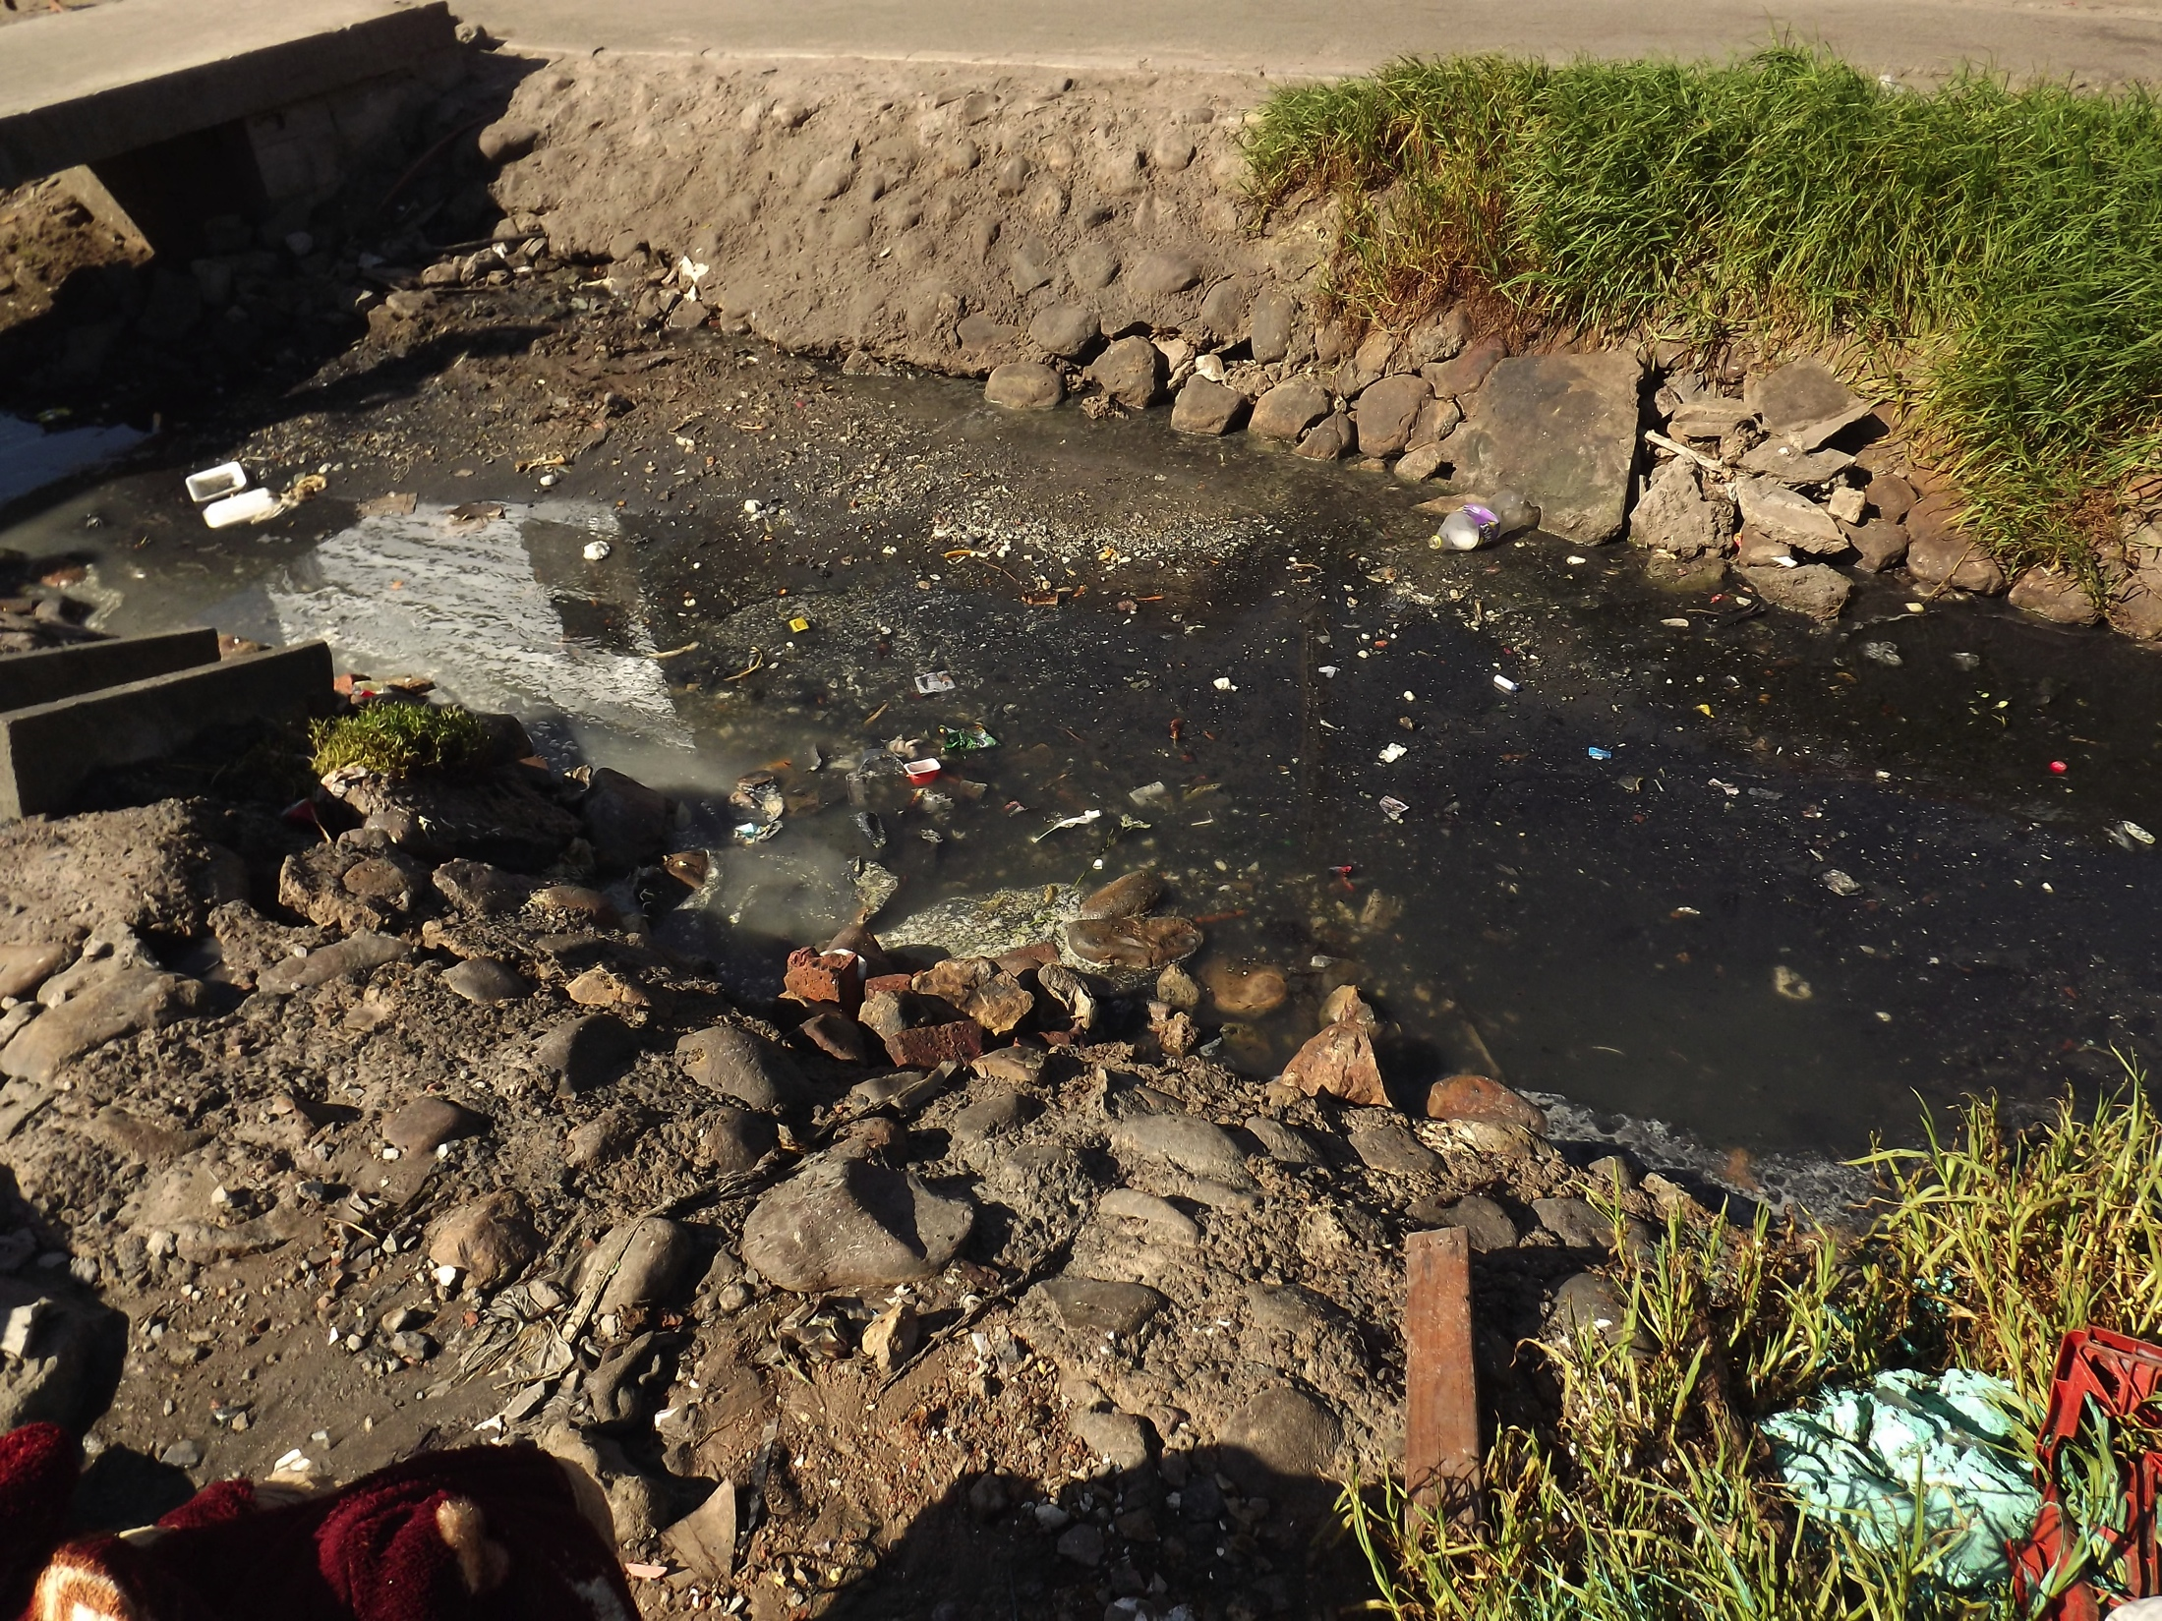

Slide 10
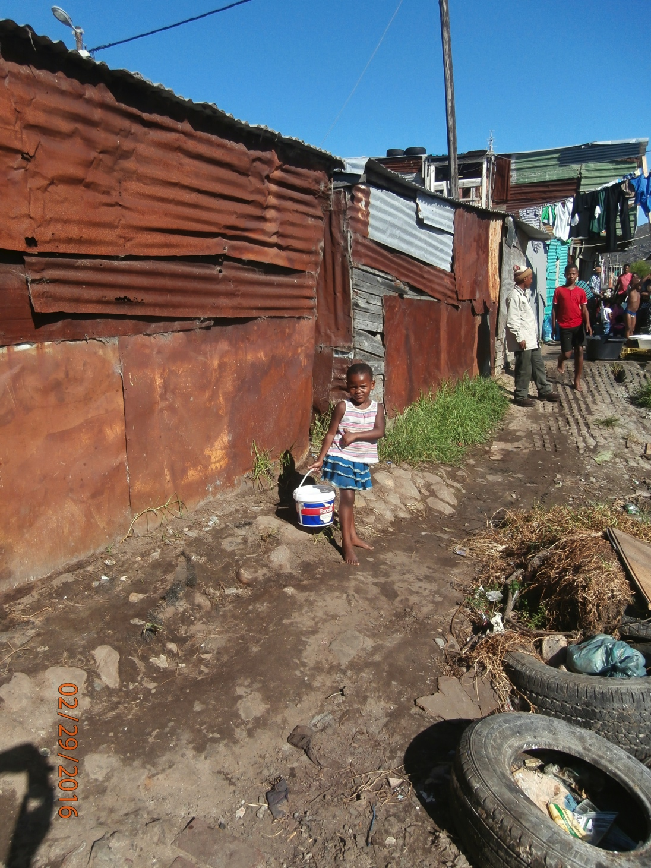
The moisture of the ground
Is partly due from the proximity
of the open sewers

Slide 11
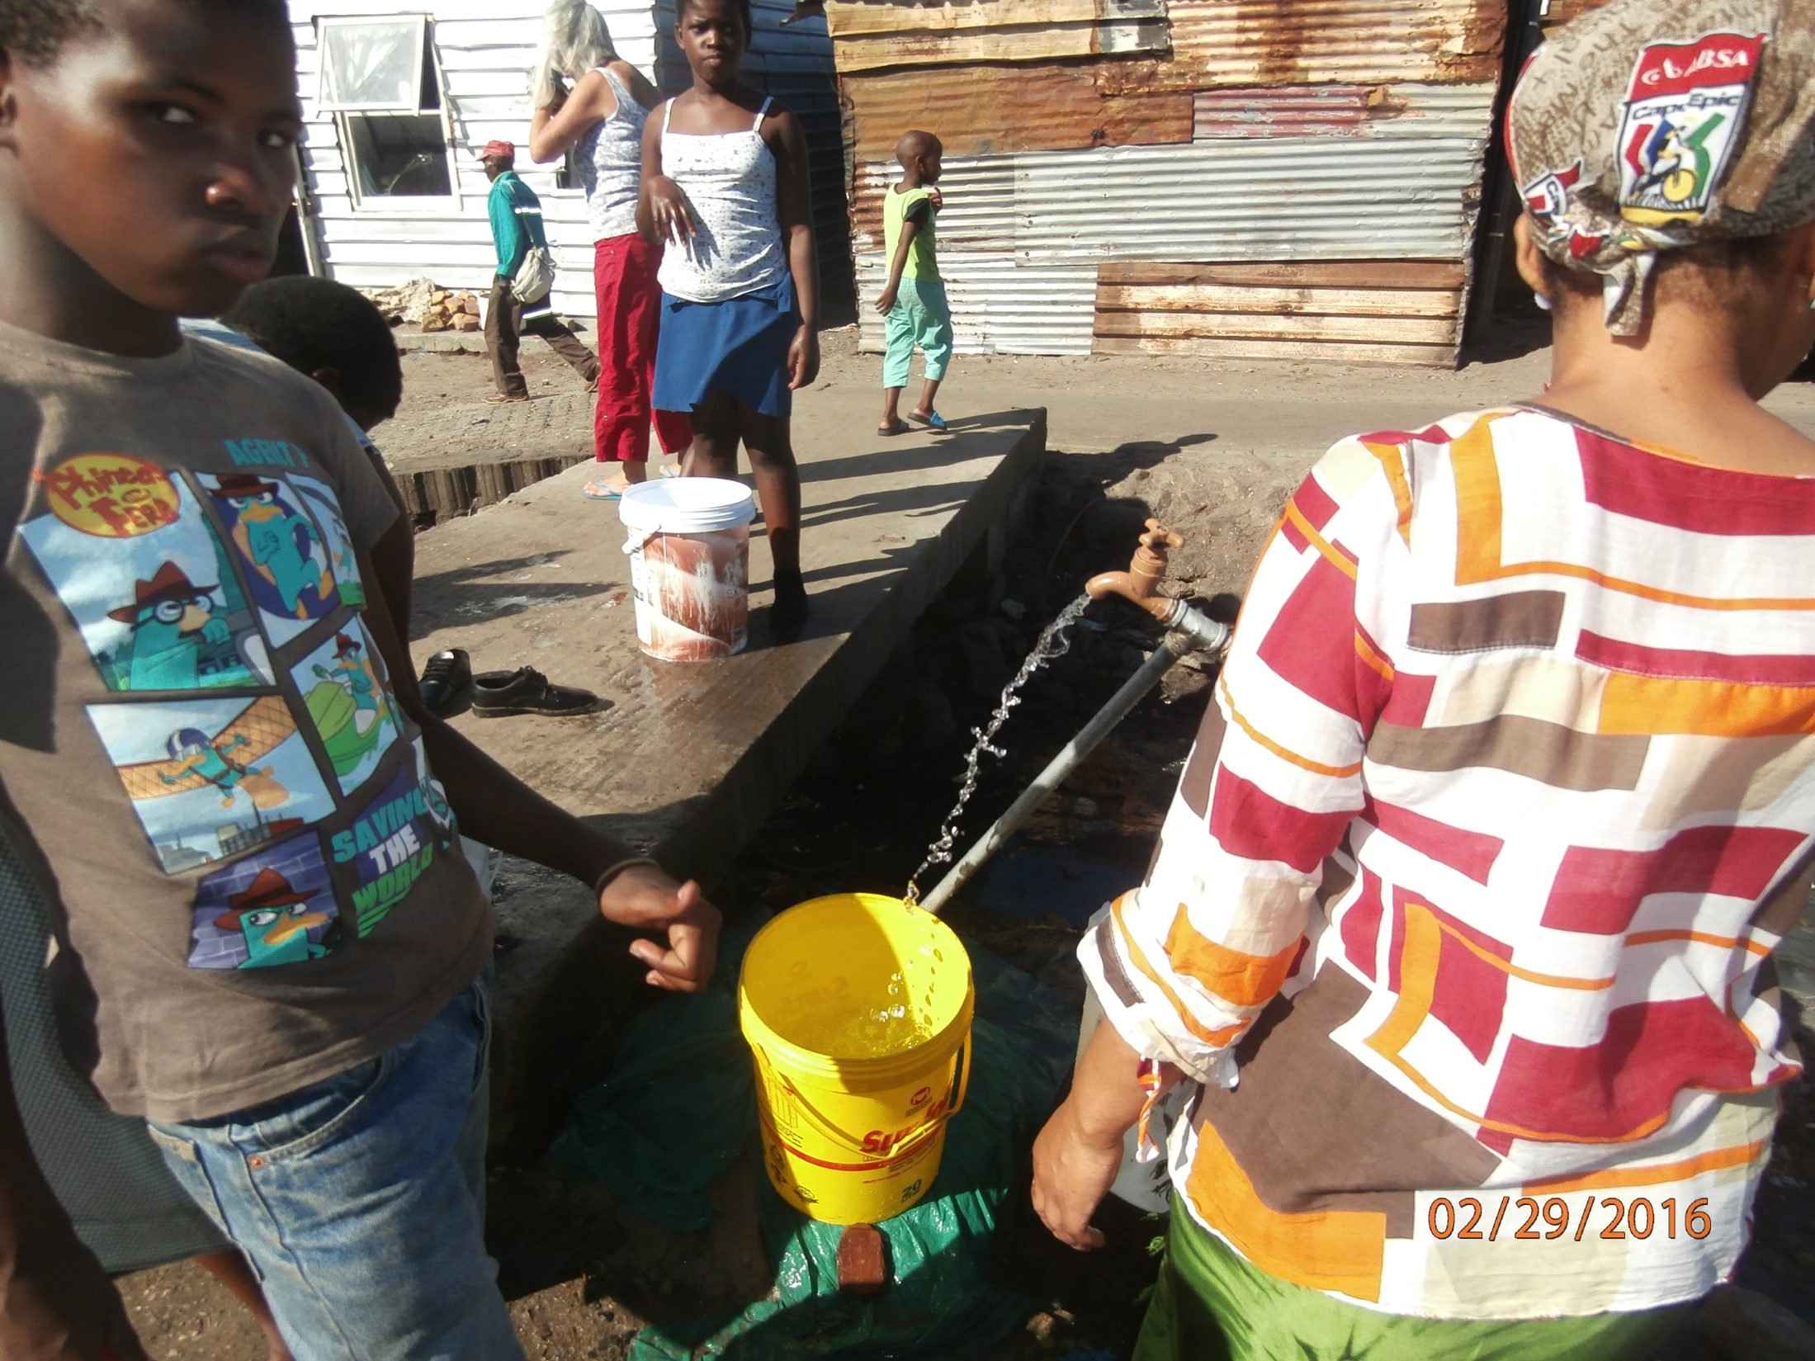
Children waiting their turn to collect water from communal tap. The open drain has a bridge but no railings.

Slide 12
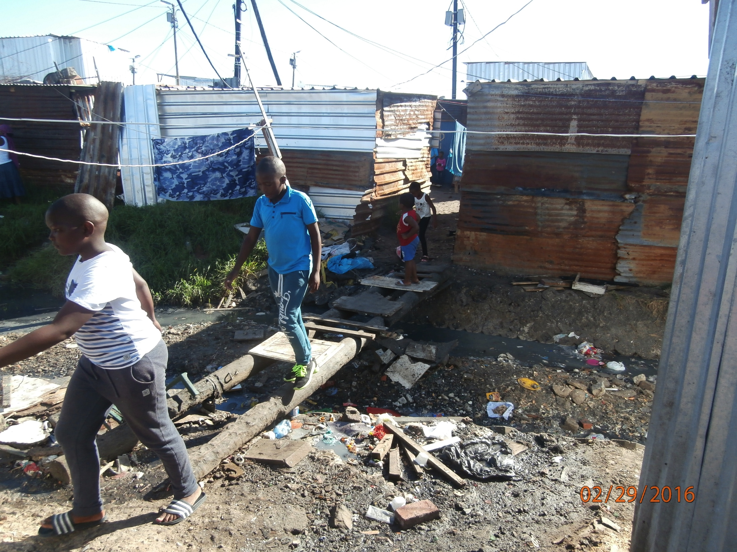
Crossing the sewer. The playground of children. Most bridges are made from debris left over after the last fire.

Slide 13
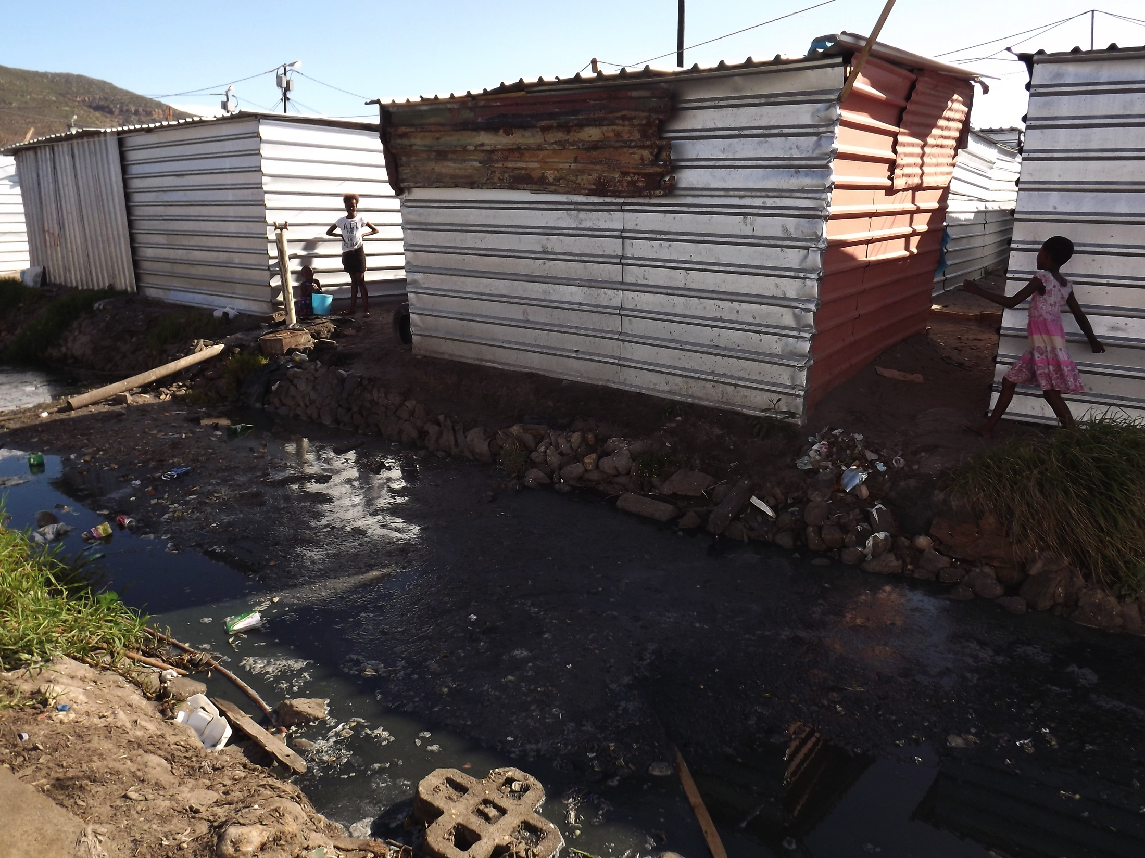

Slide 14
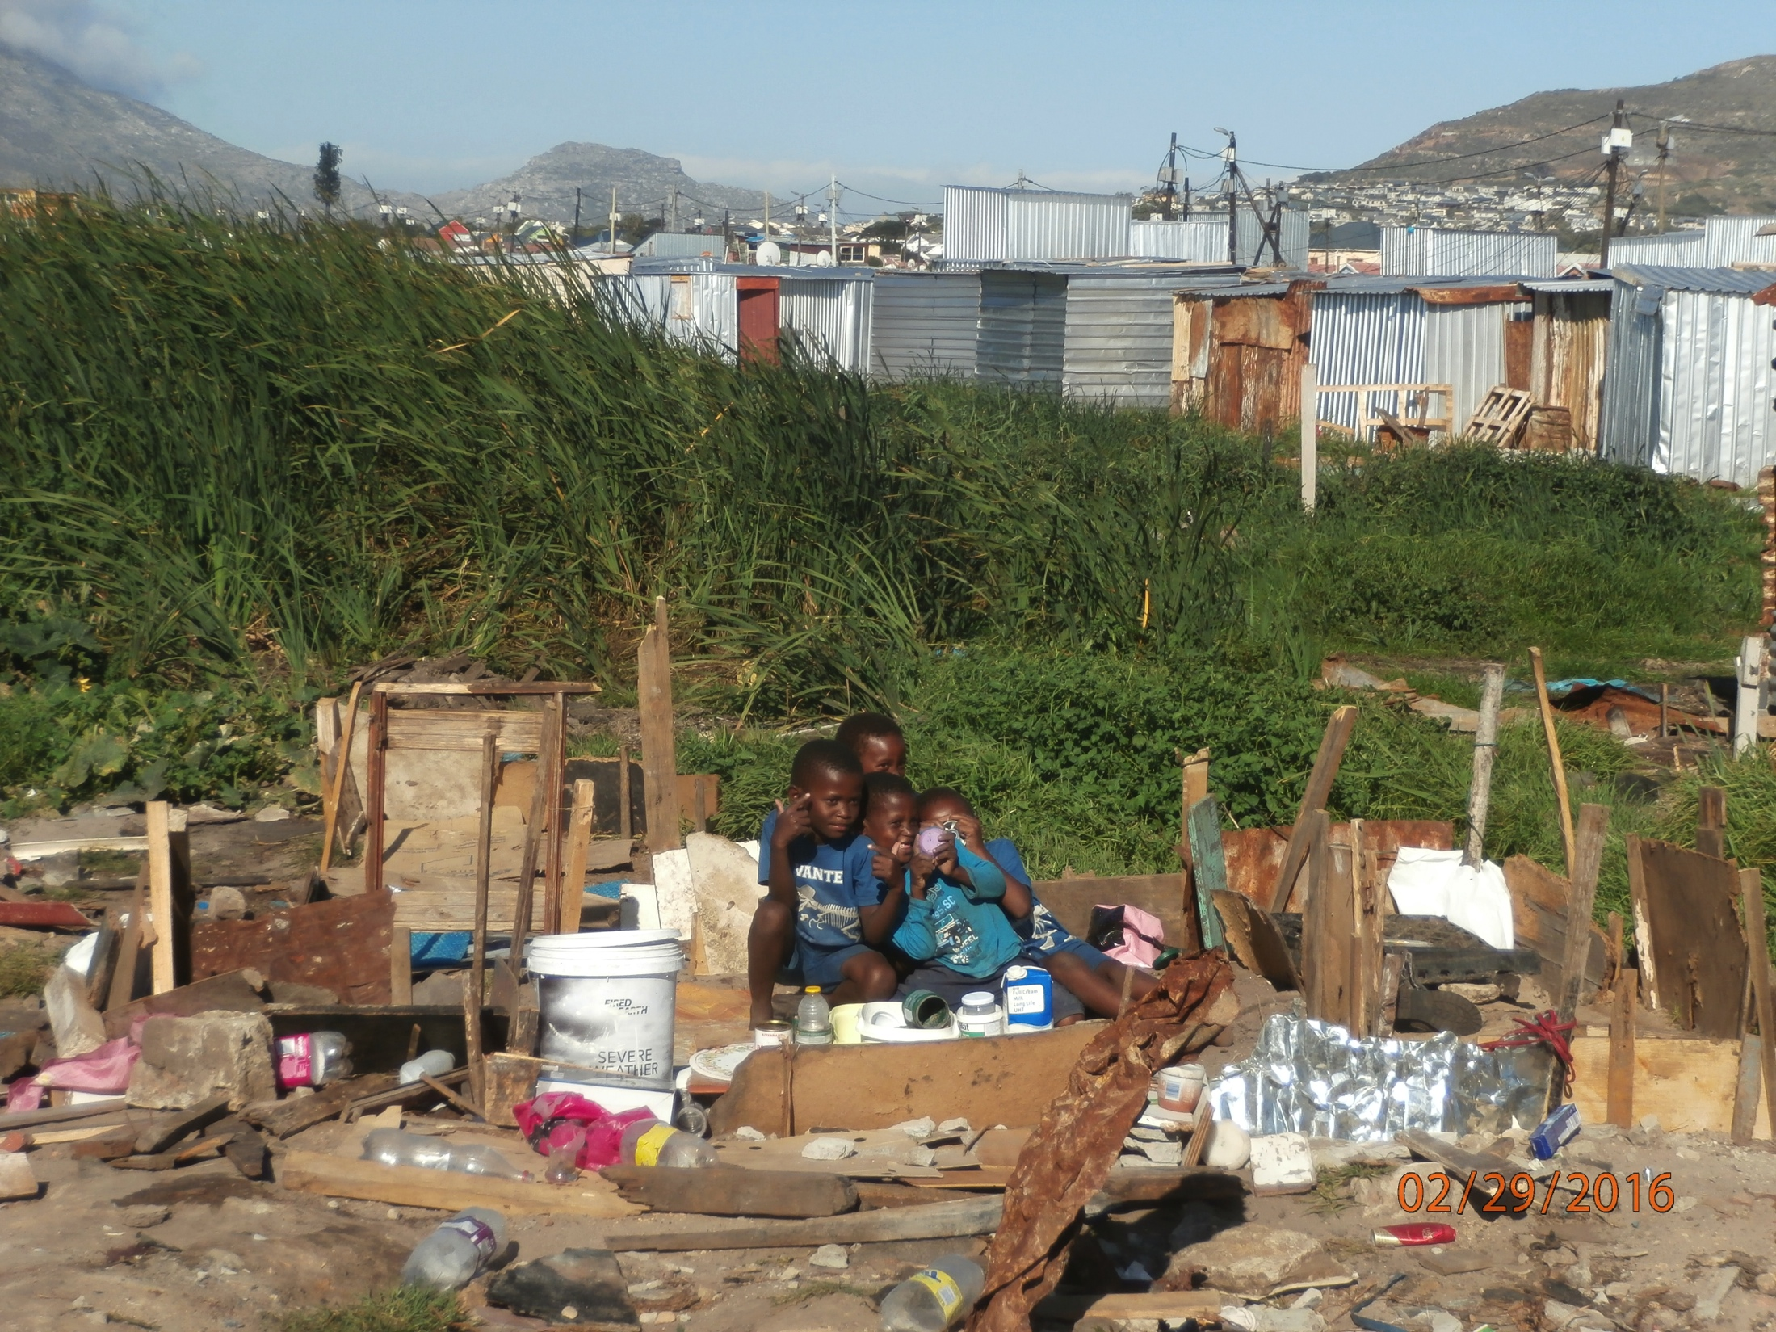
Children playing house in burnt down shacks in the ‘wetland’ area

Slide 15
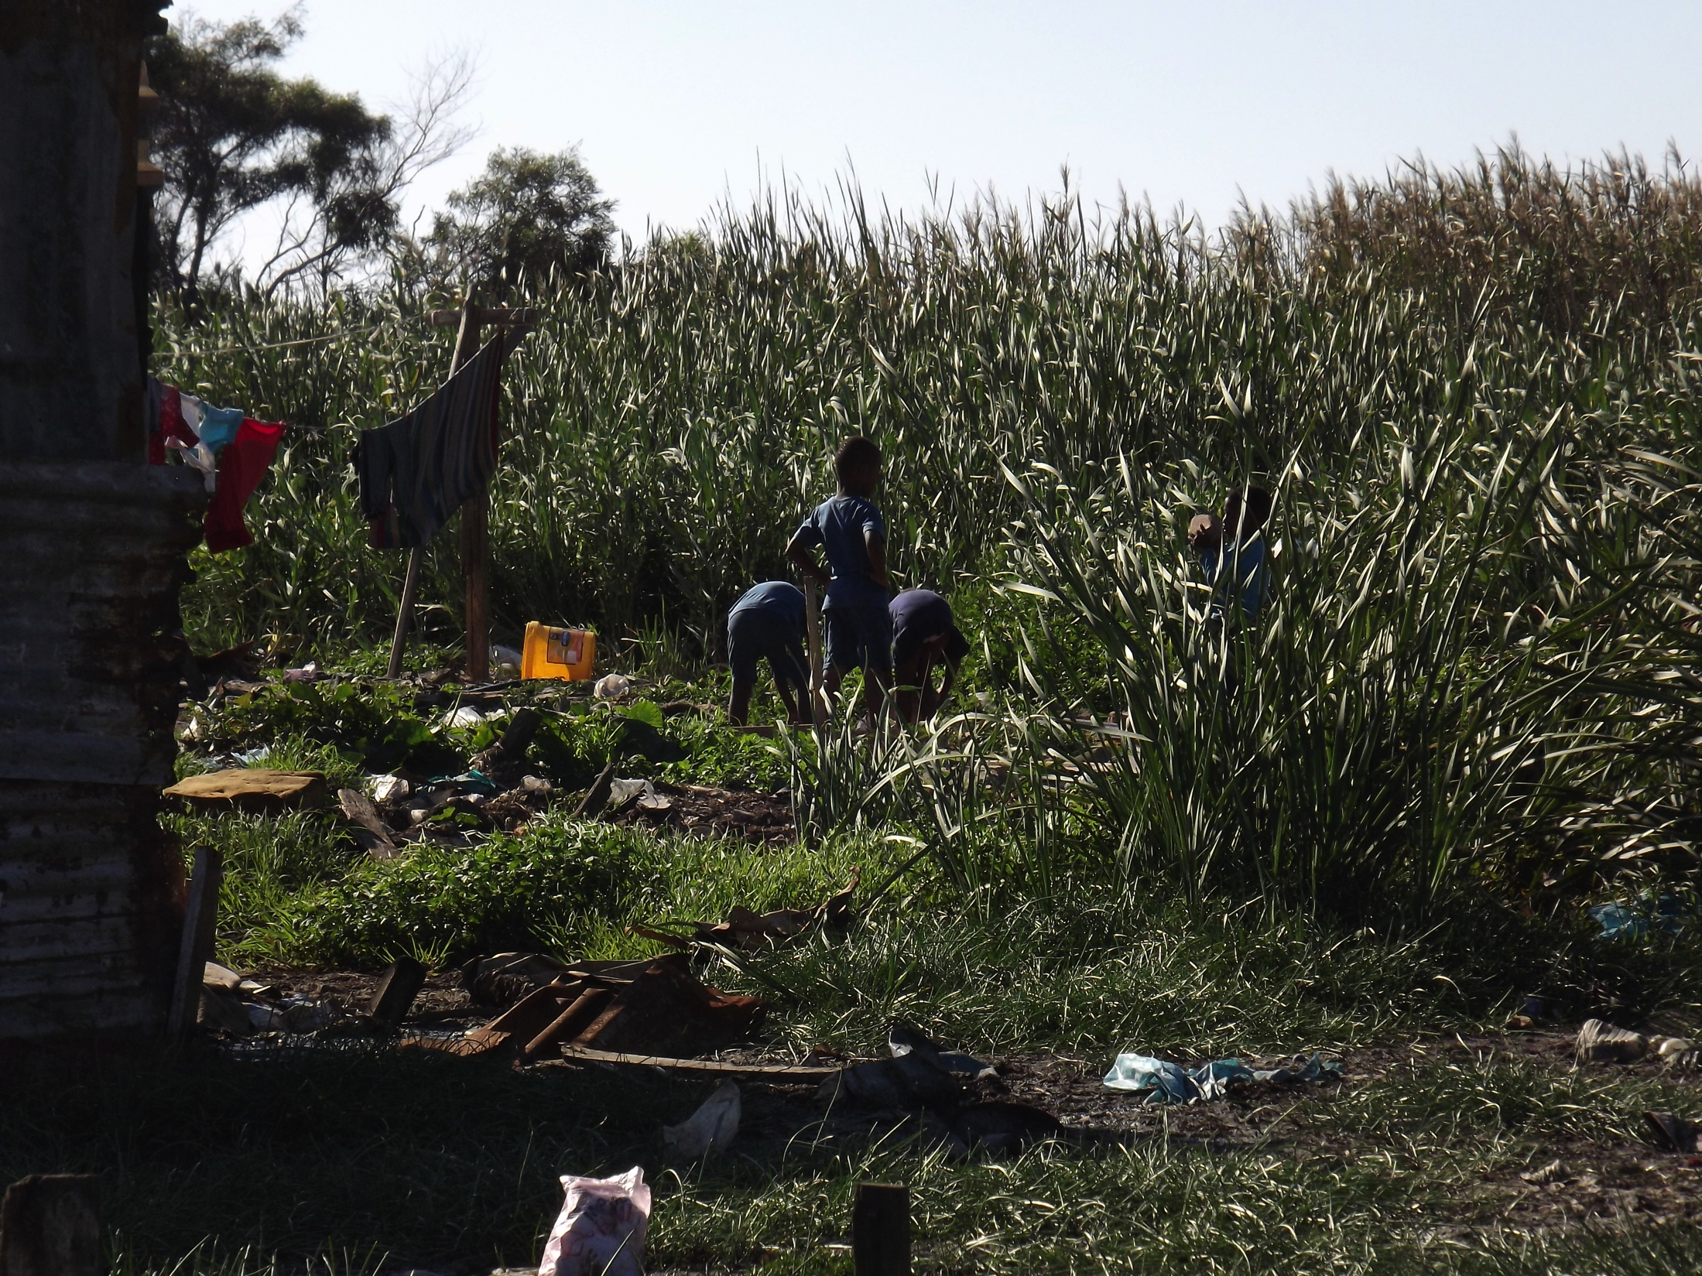

Slide 16
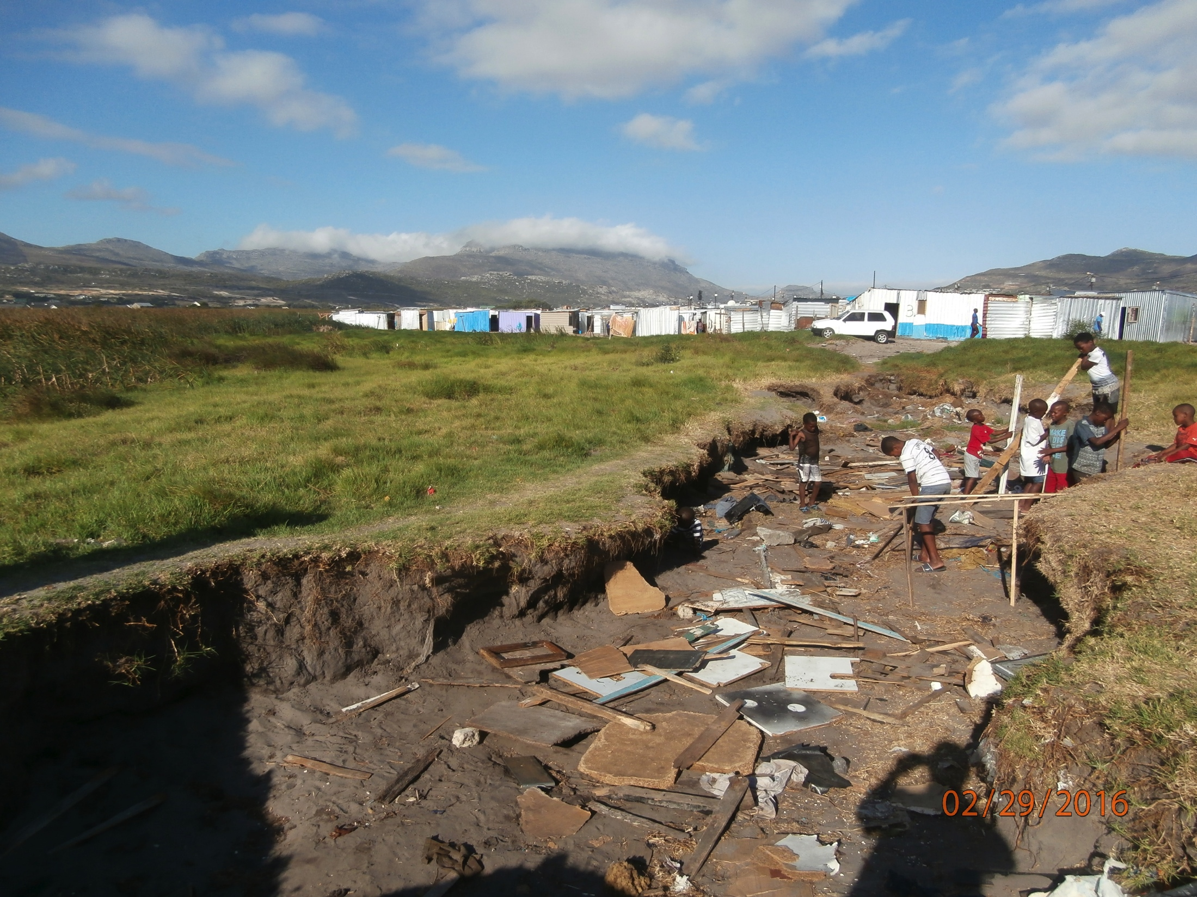
Children playing in a donga, currently dry.

Slide 17
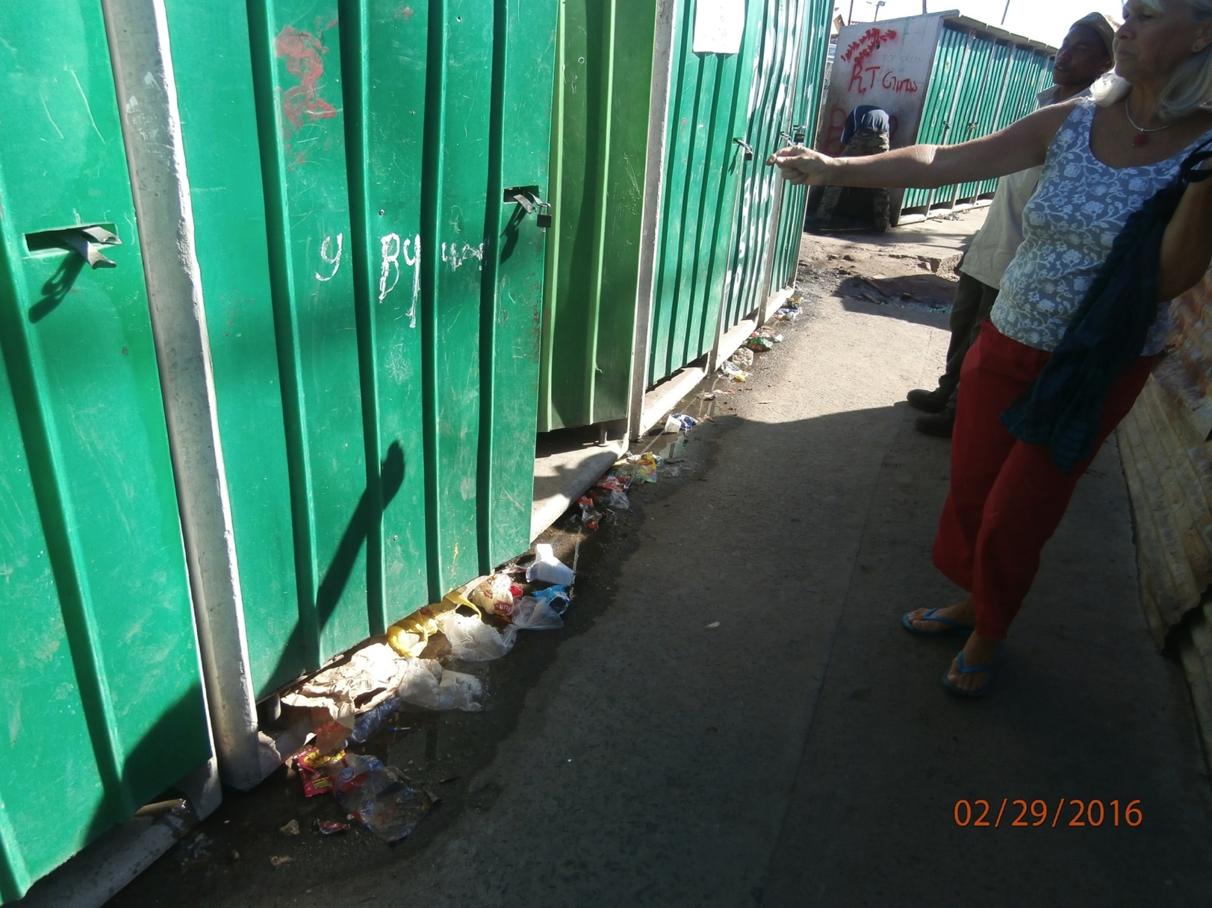
Toilets
Part of the group of toilets that are under-serviced. They are located where service trucks cannot get, but these are toilets easily accessed by people living in Sections A, B or C.

Slide 18
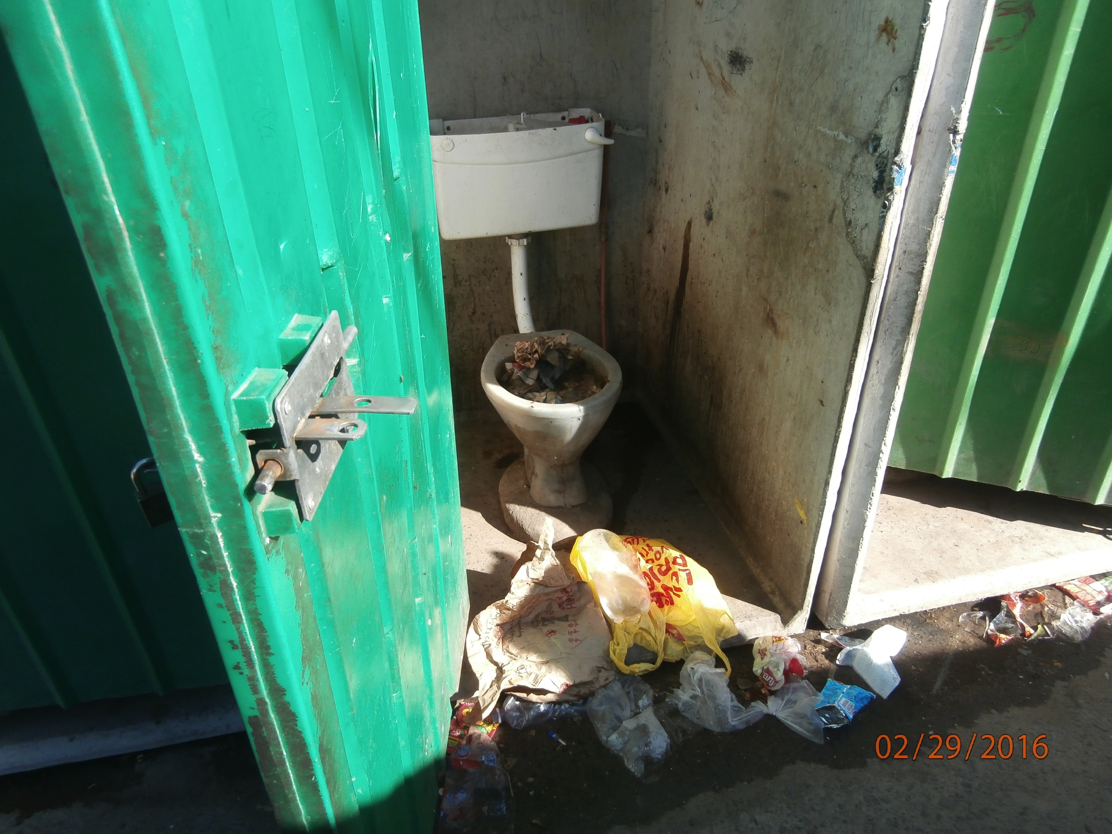
Toilet in an area where servicing is deficient or absent.

