Slide 1
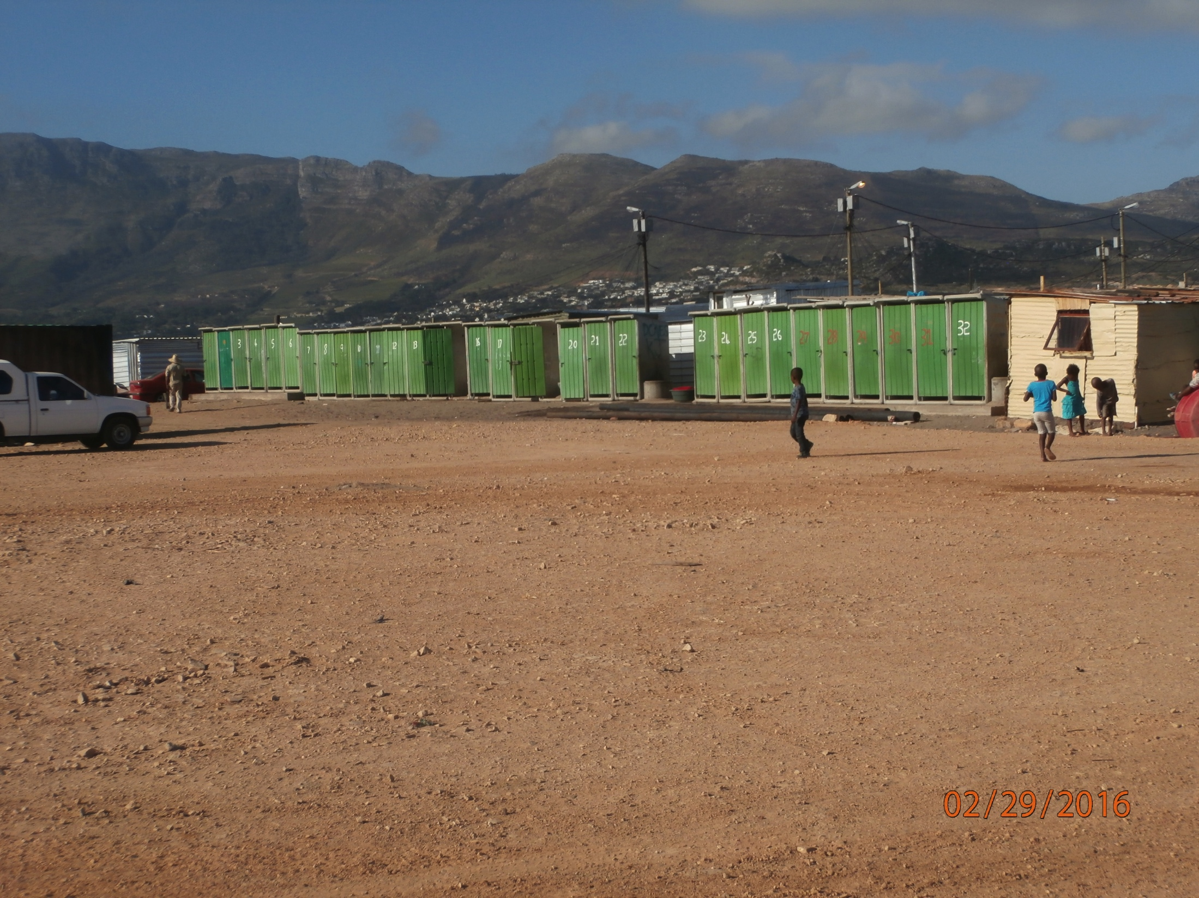
Toilets on the western edge of the wetland. Keys to the locks on the doors are held
By 4 or 5 families as per City arrangement, leaving the majority without access. These are the properly serviced toilets in the area.

Slide 2
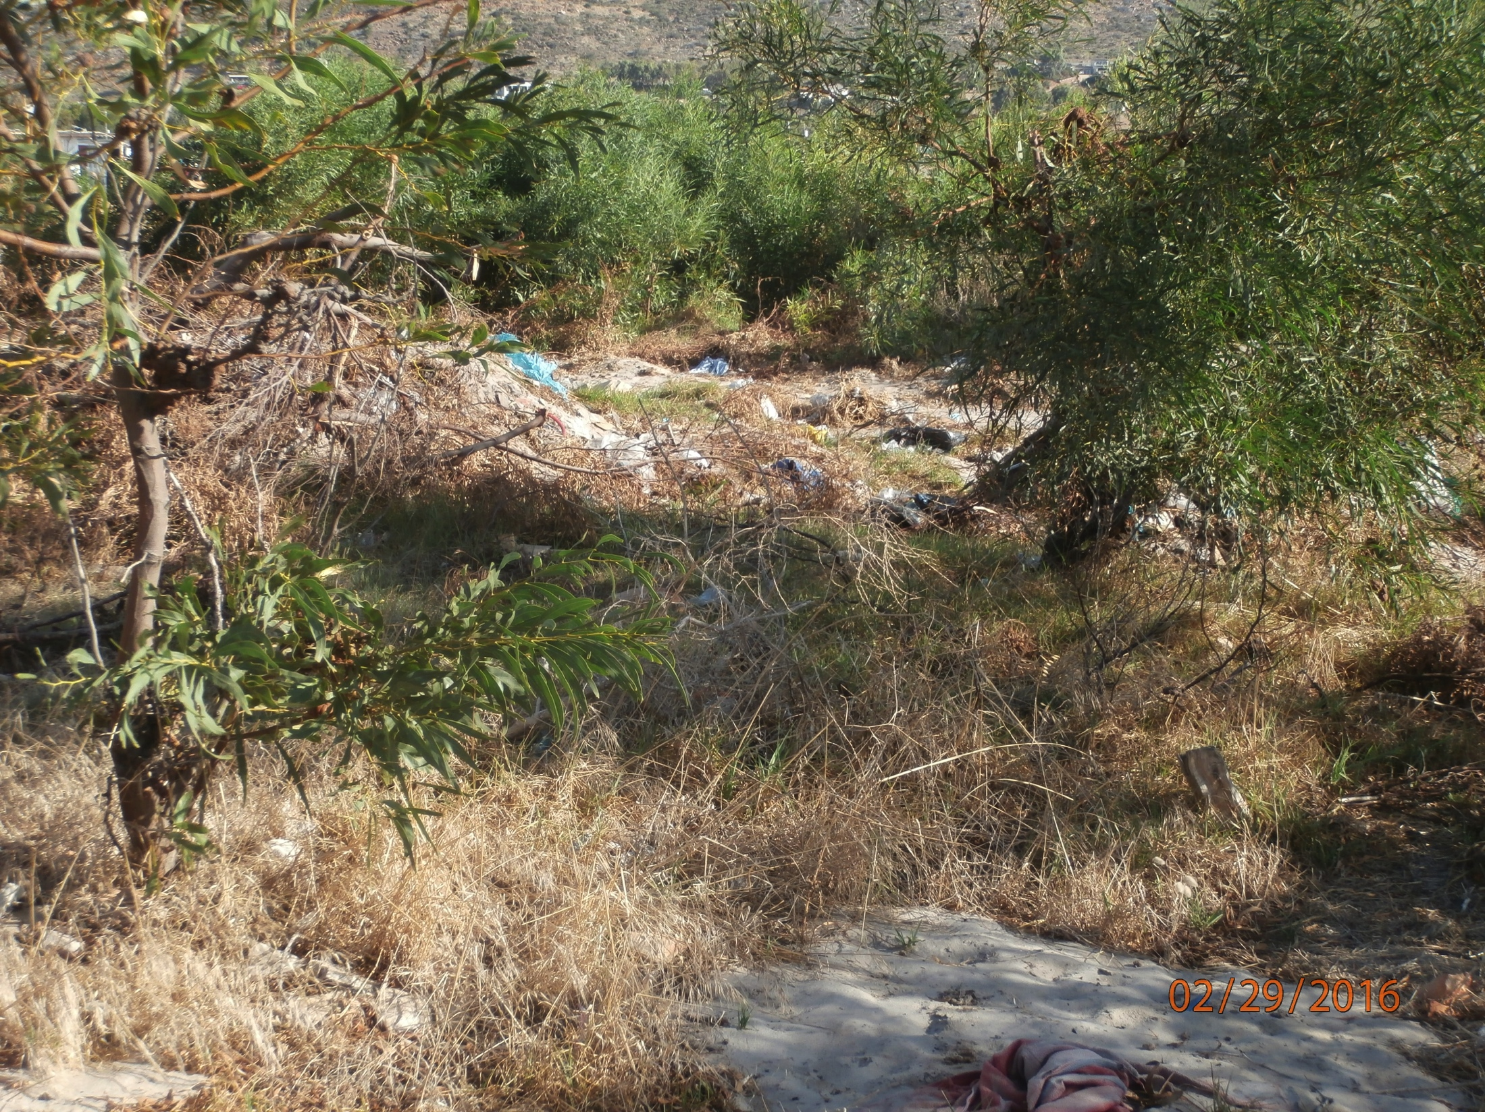
Toilet area for those without keys to formal toilets

Slide 3
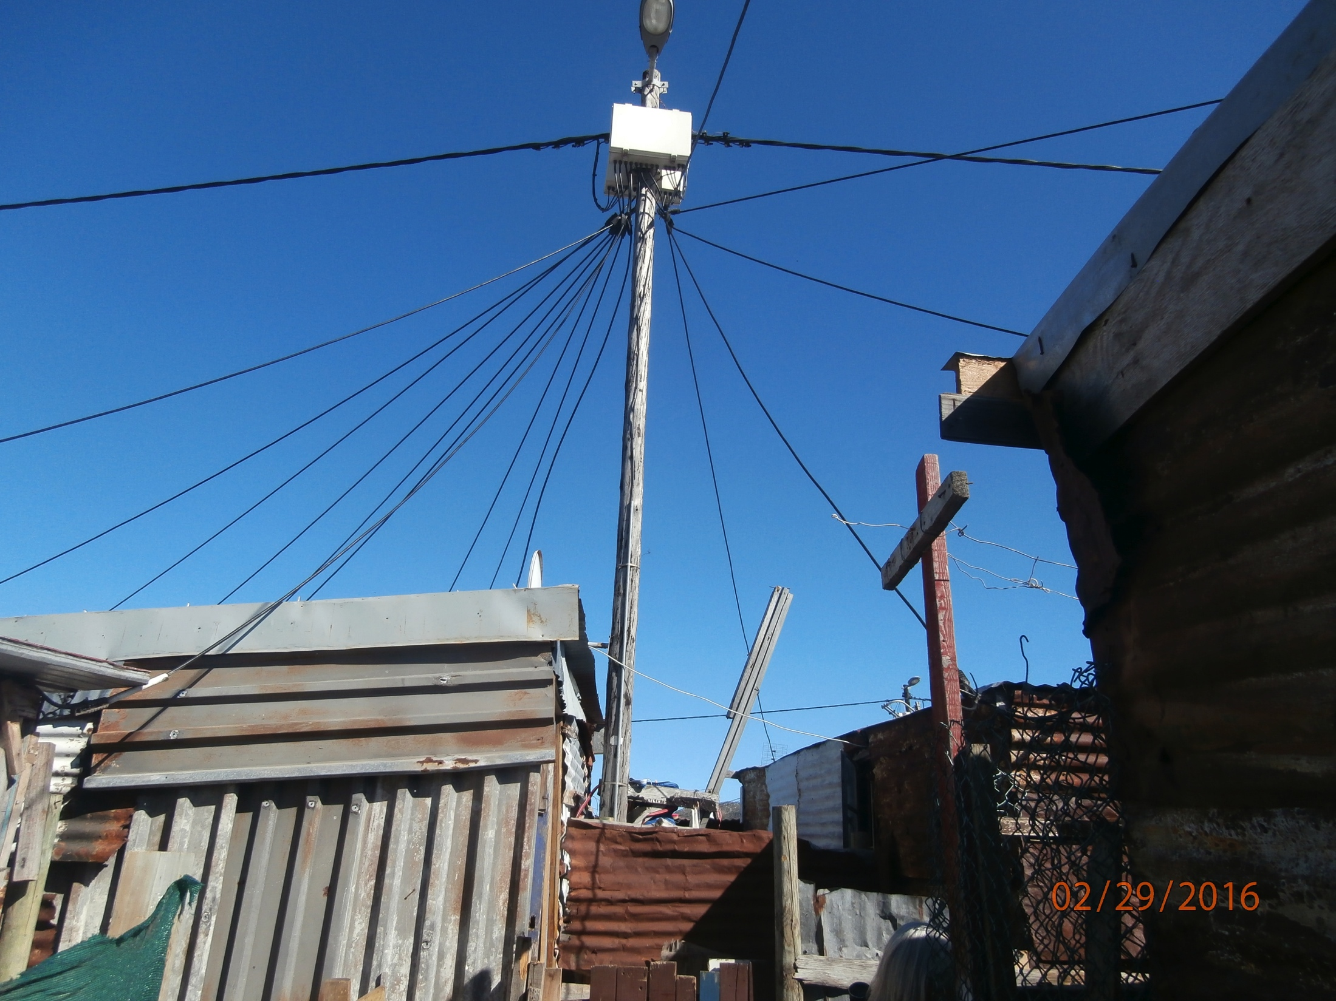
Electricity distribution in
each structure is the handiwork of amateurs, and thus a significant fire risk

Slide 4
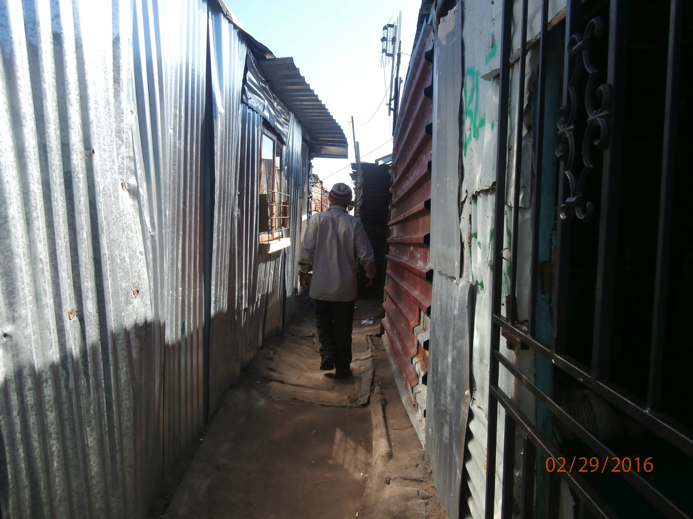
Hundreds of structures are connected through passages such as this one

Slide 5
Four open canals, now
sewers, that separate the houses of 15,000 people.

Slide 6
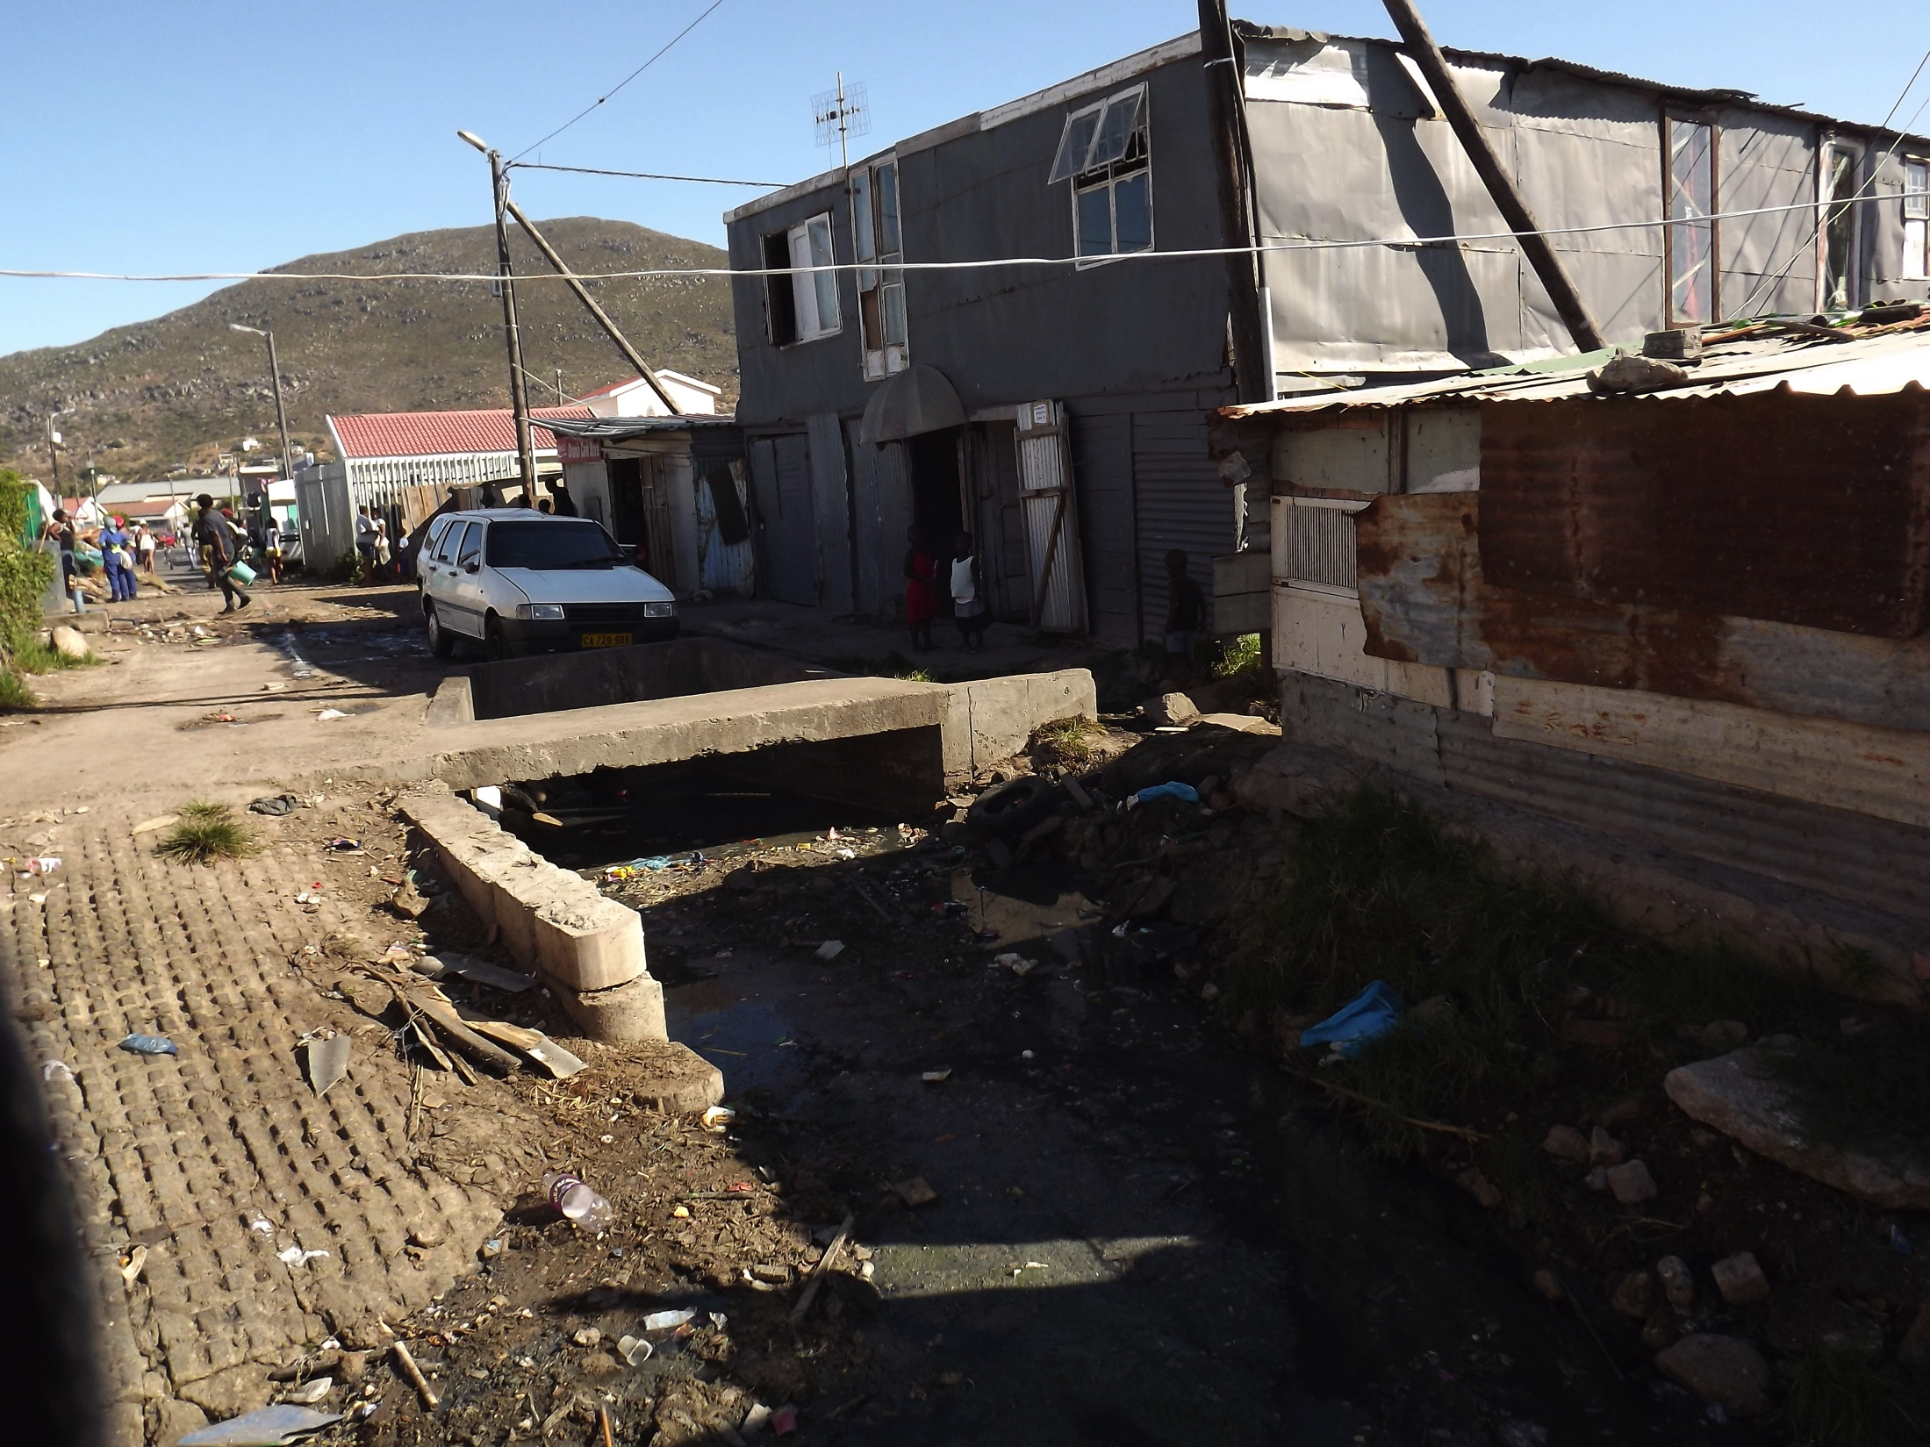

Slide 7
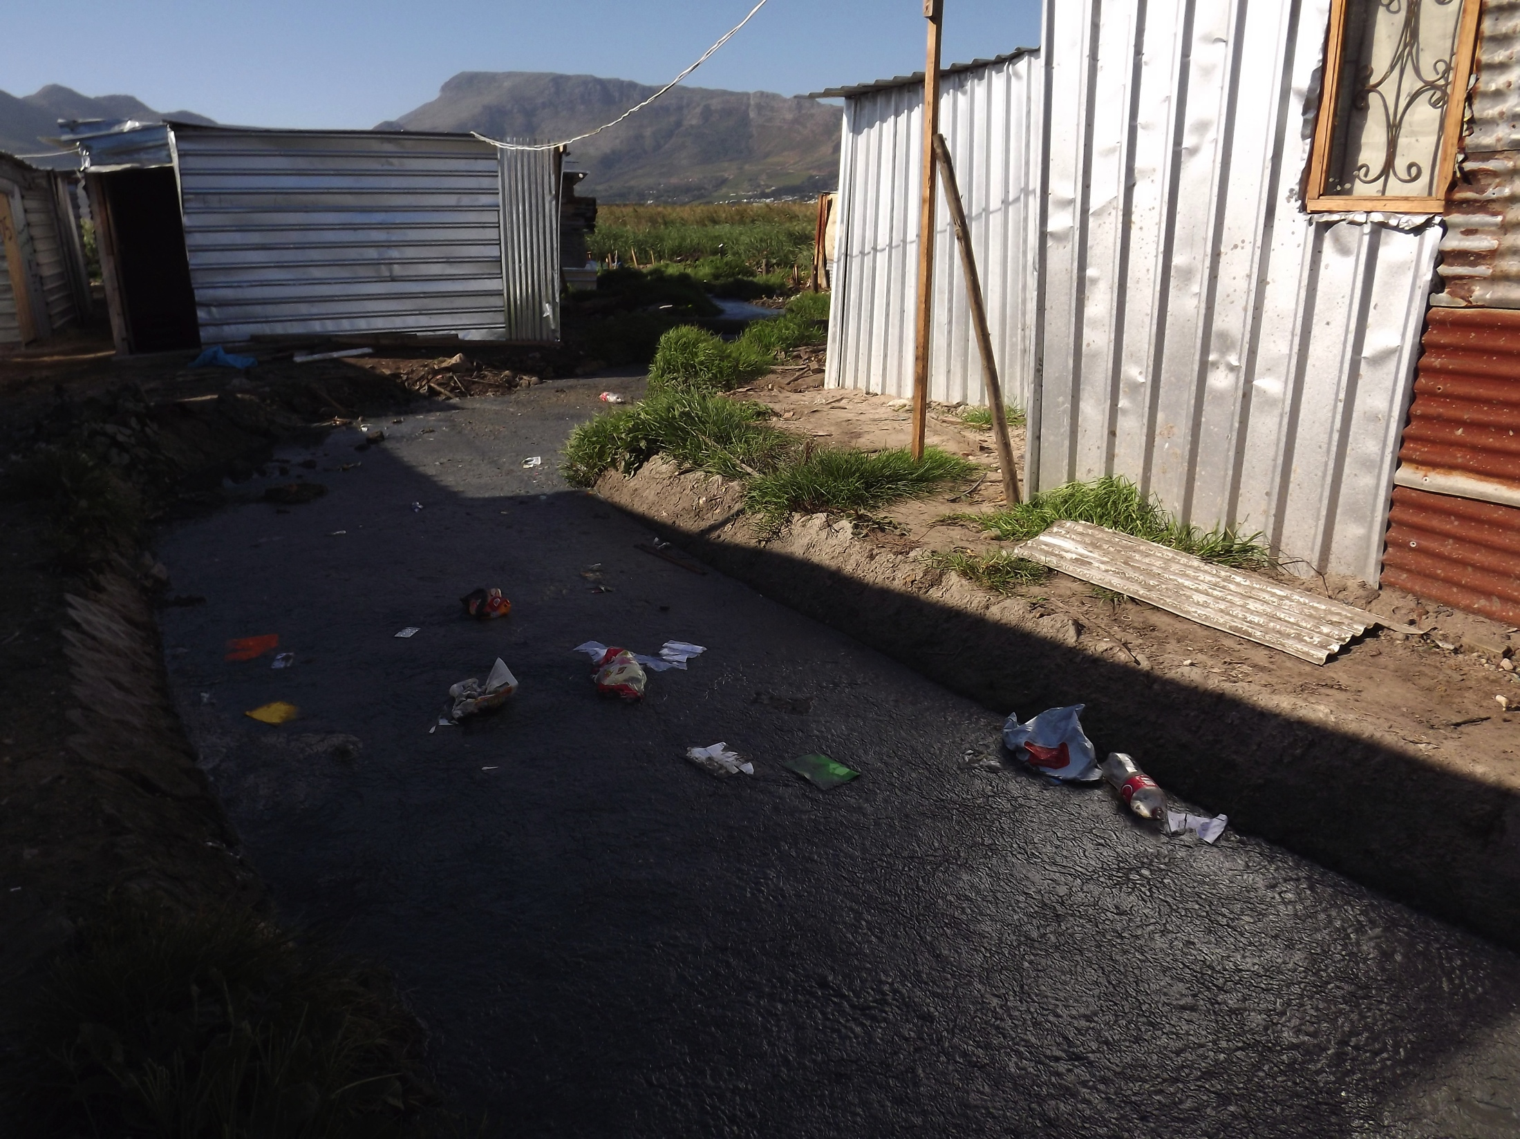

Slide 8
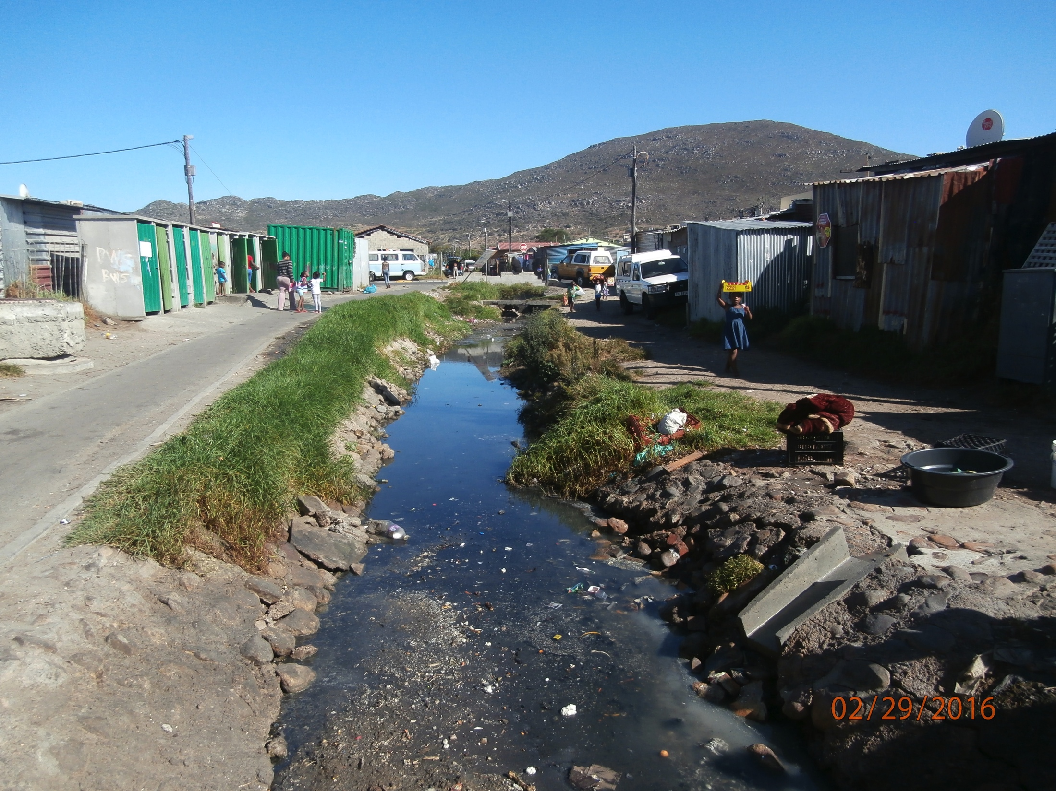

Slide 9
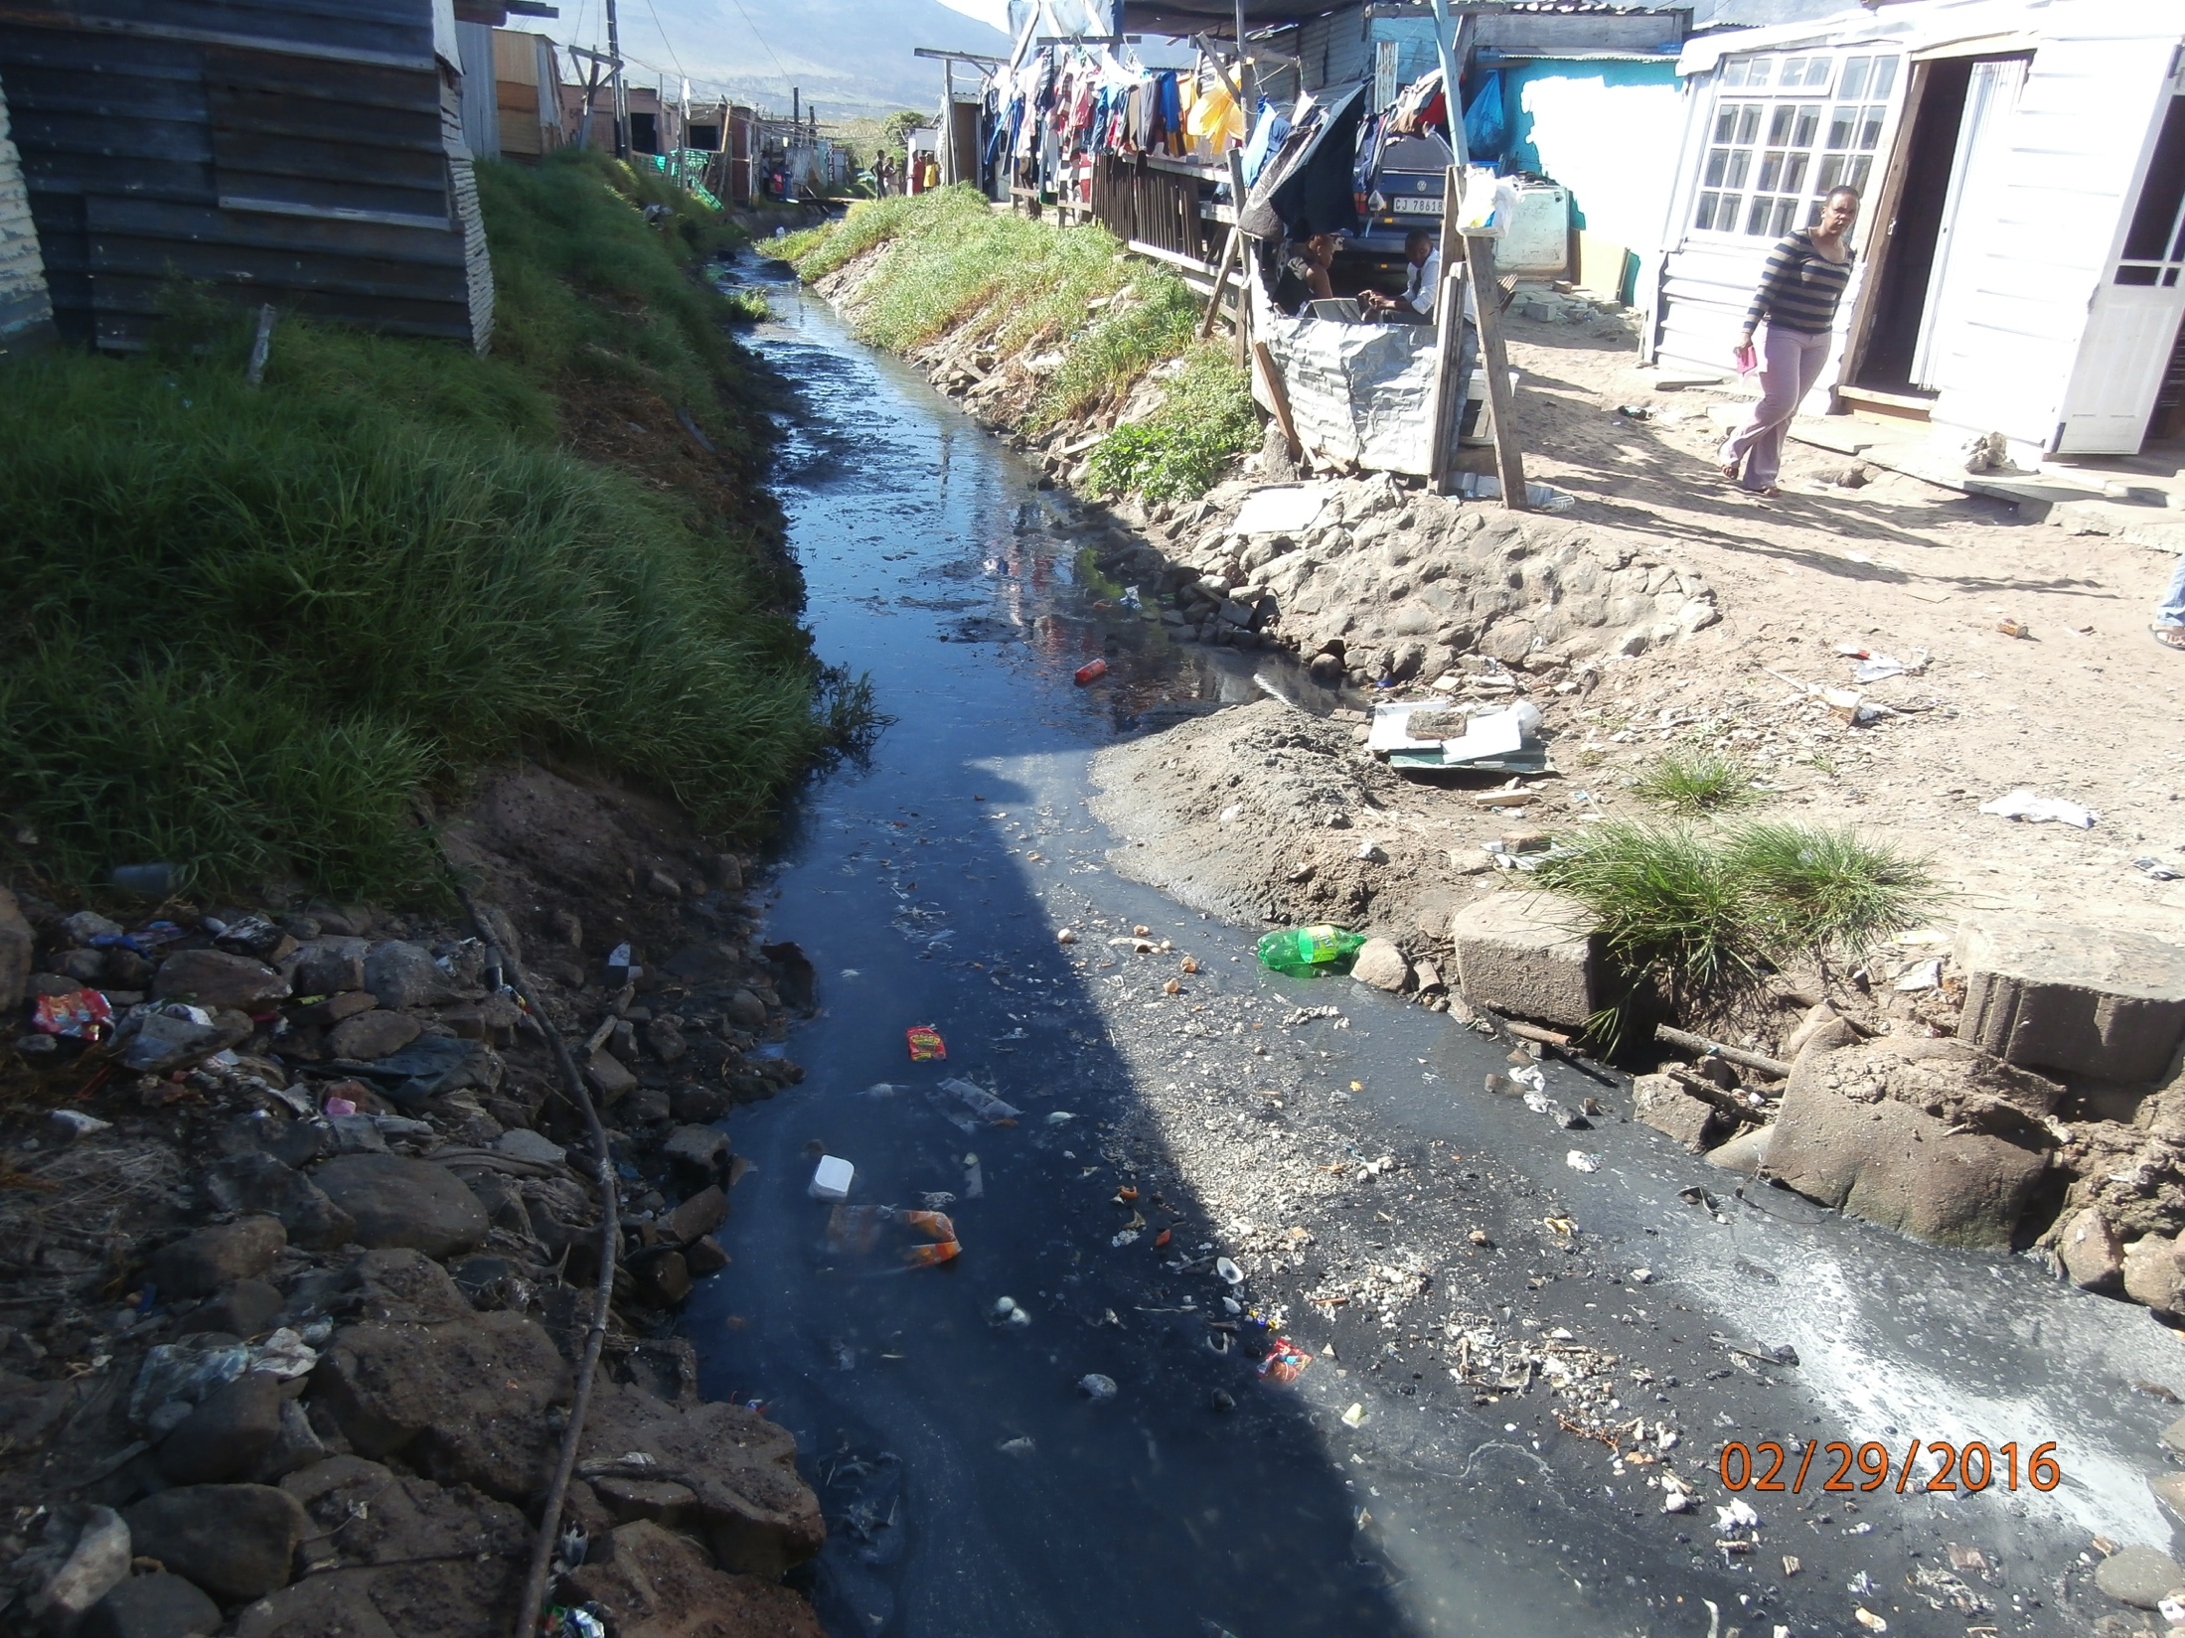

Slide 10
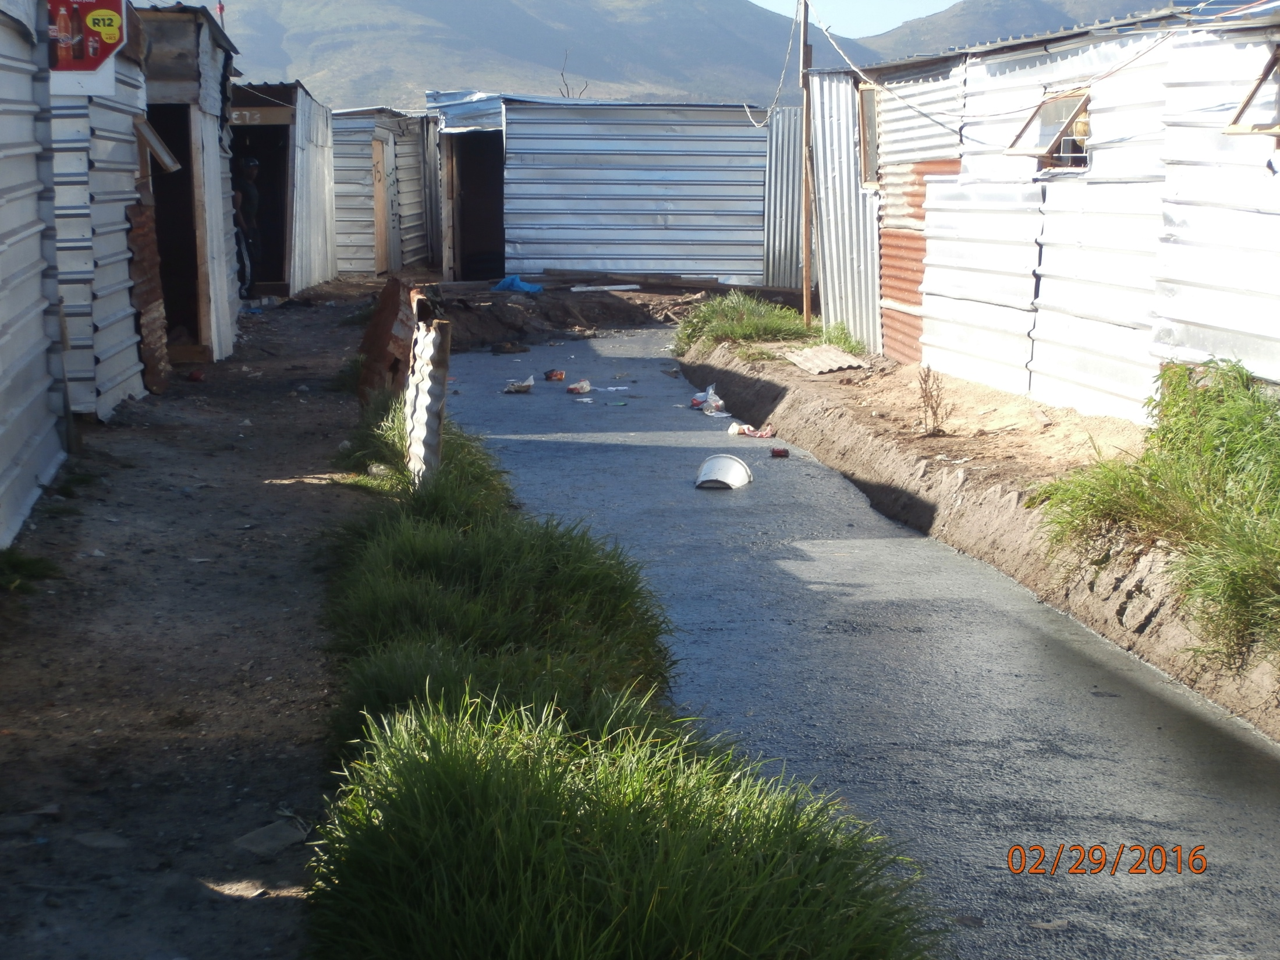

Slide 11
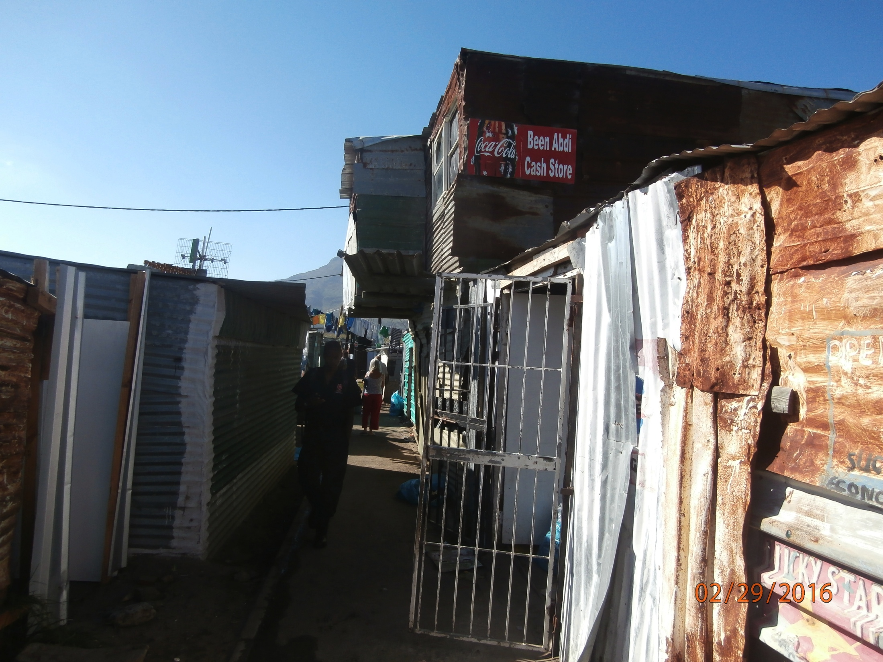
Double-story shacks – the way to create space when none is available on the ground.

Slide 12
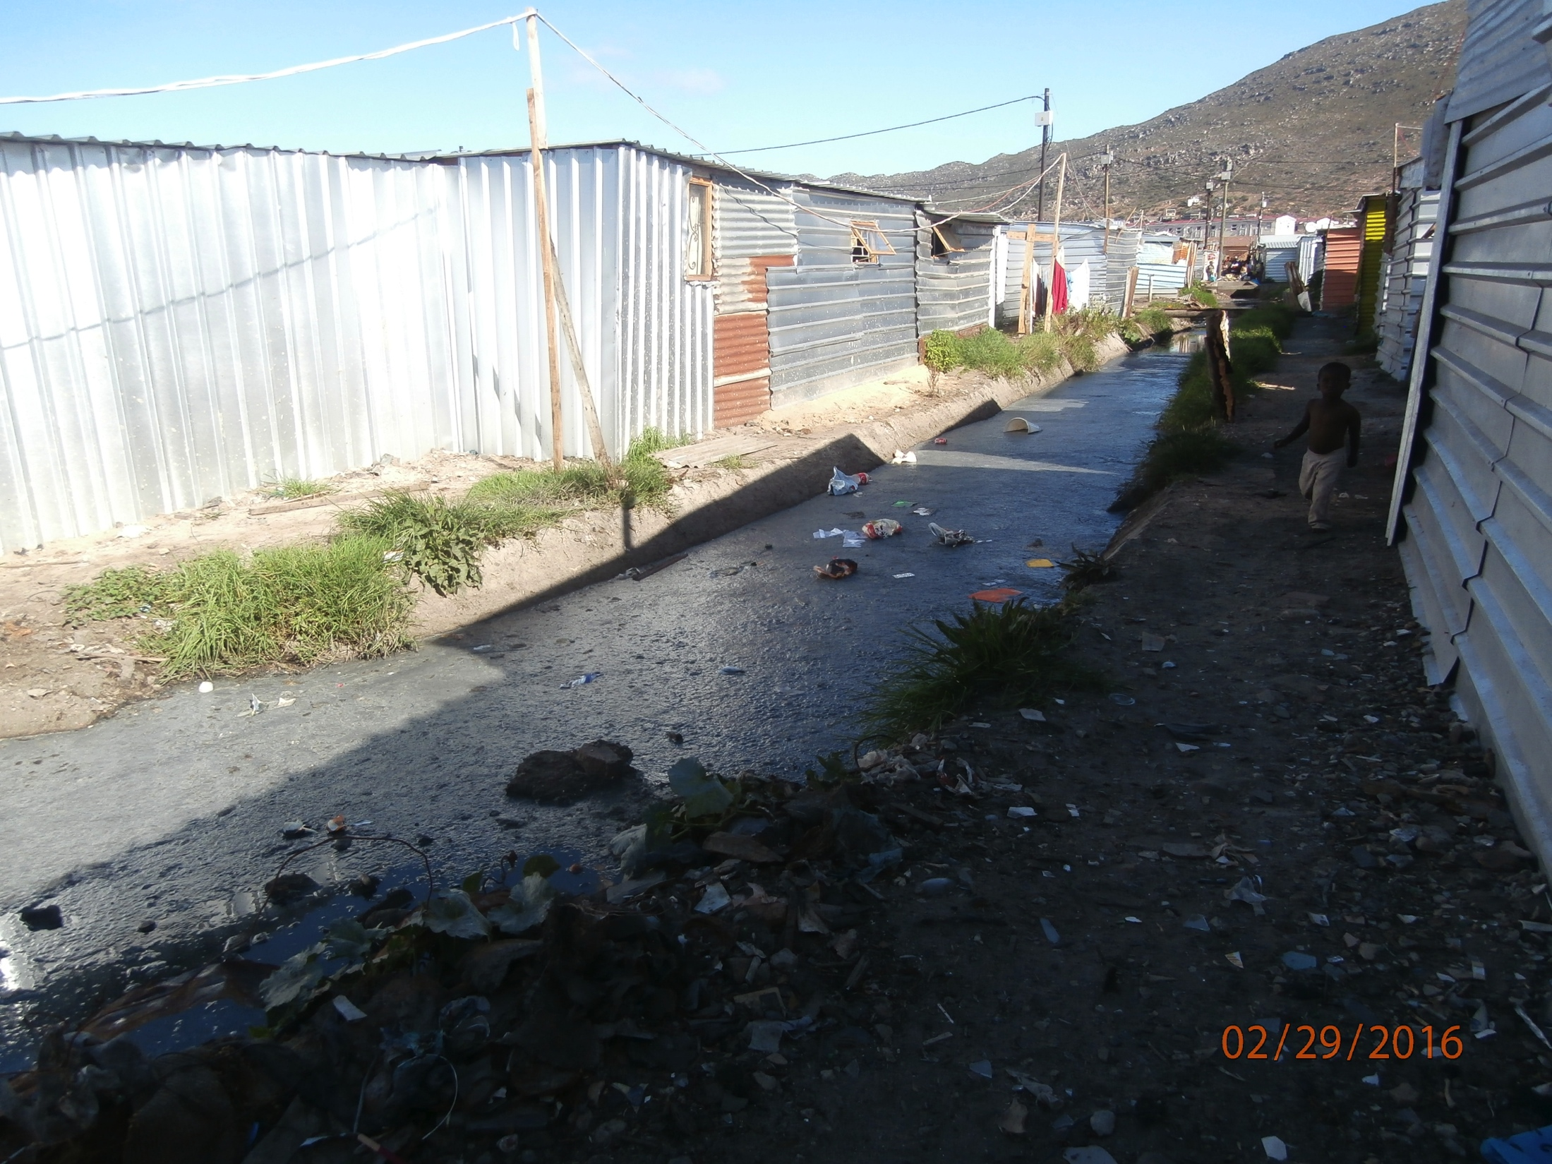

Slide 13
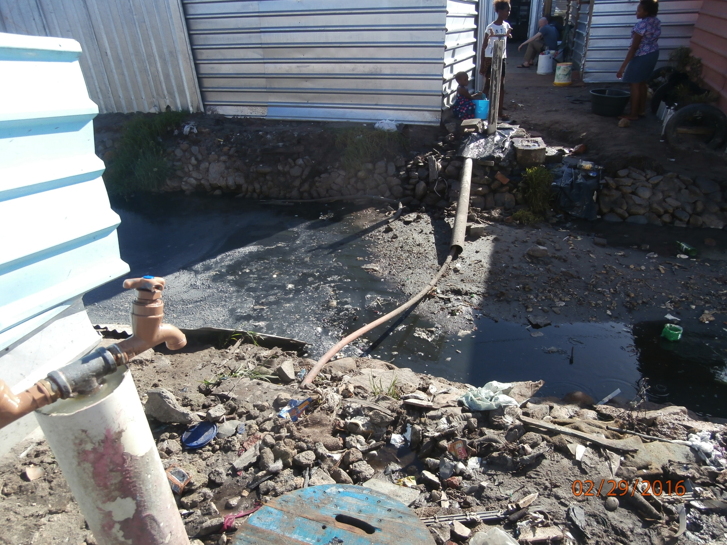

Slide 14
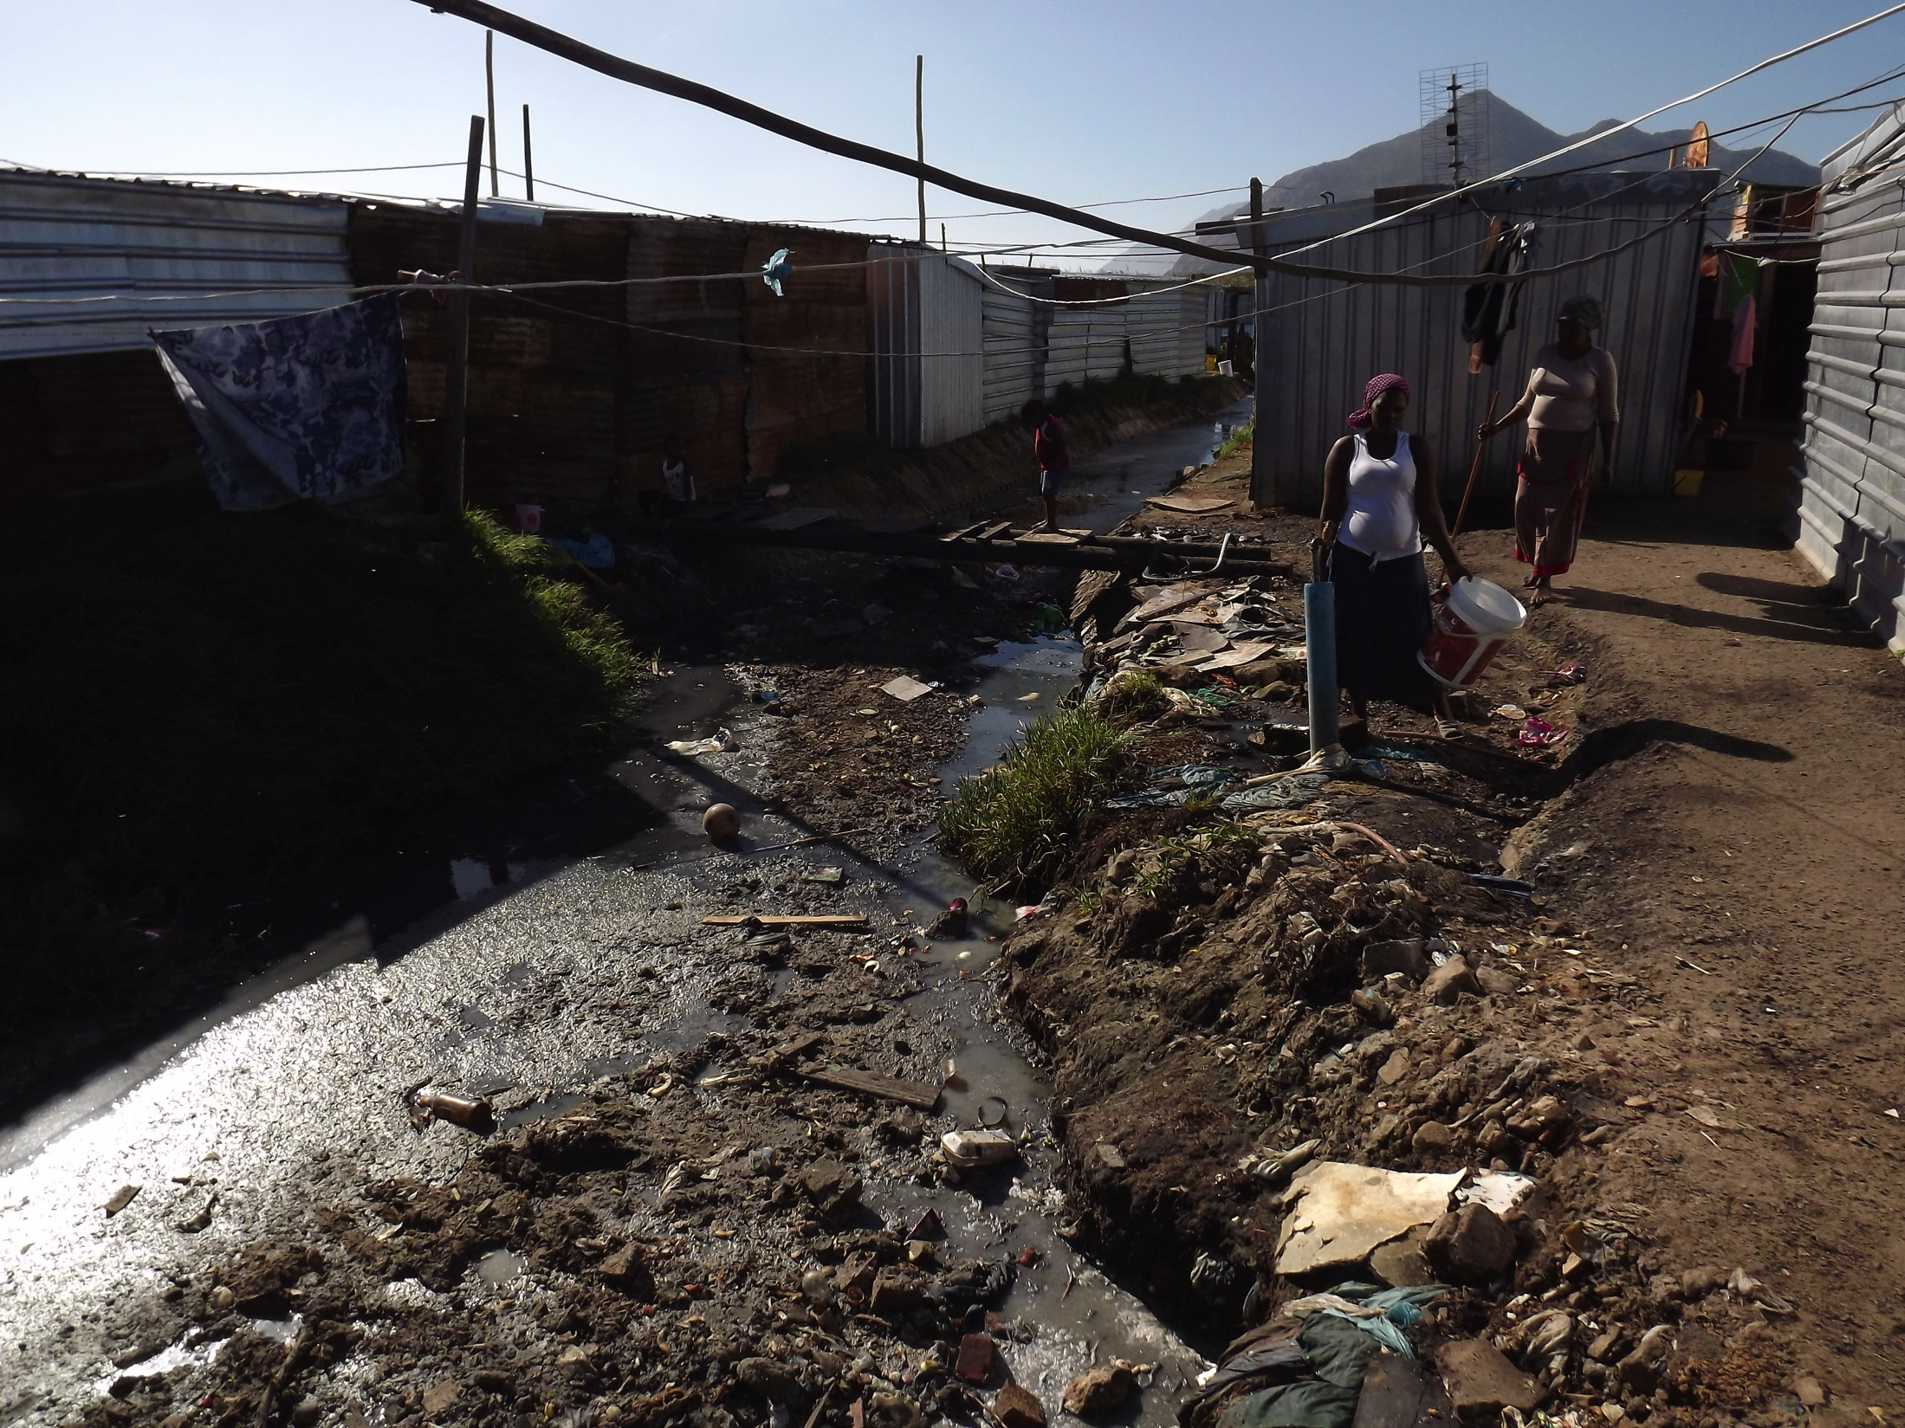

Slide 15
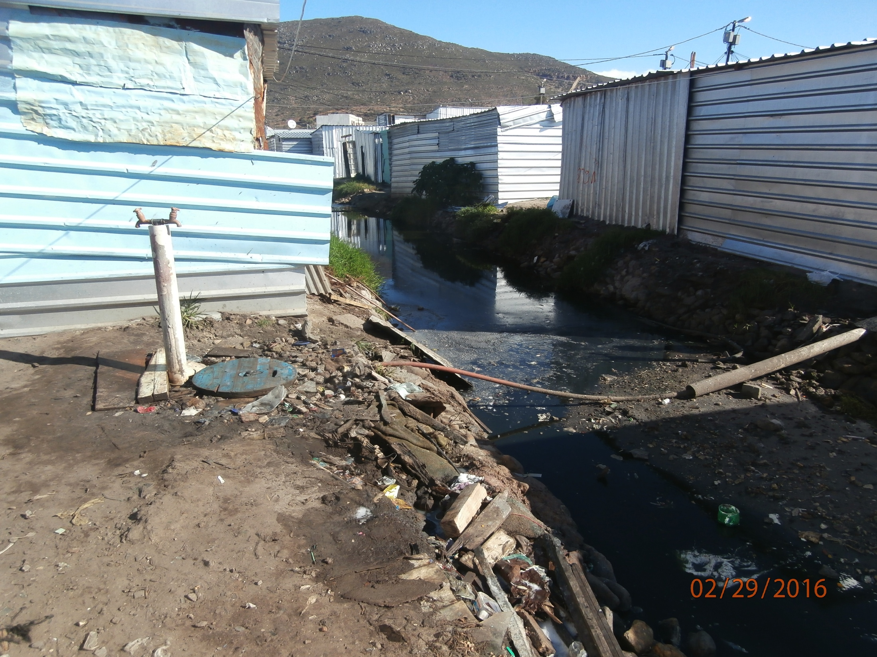

Slide 16
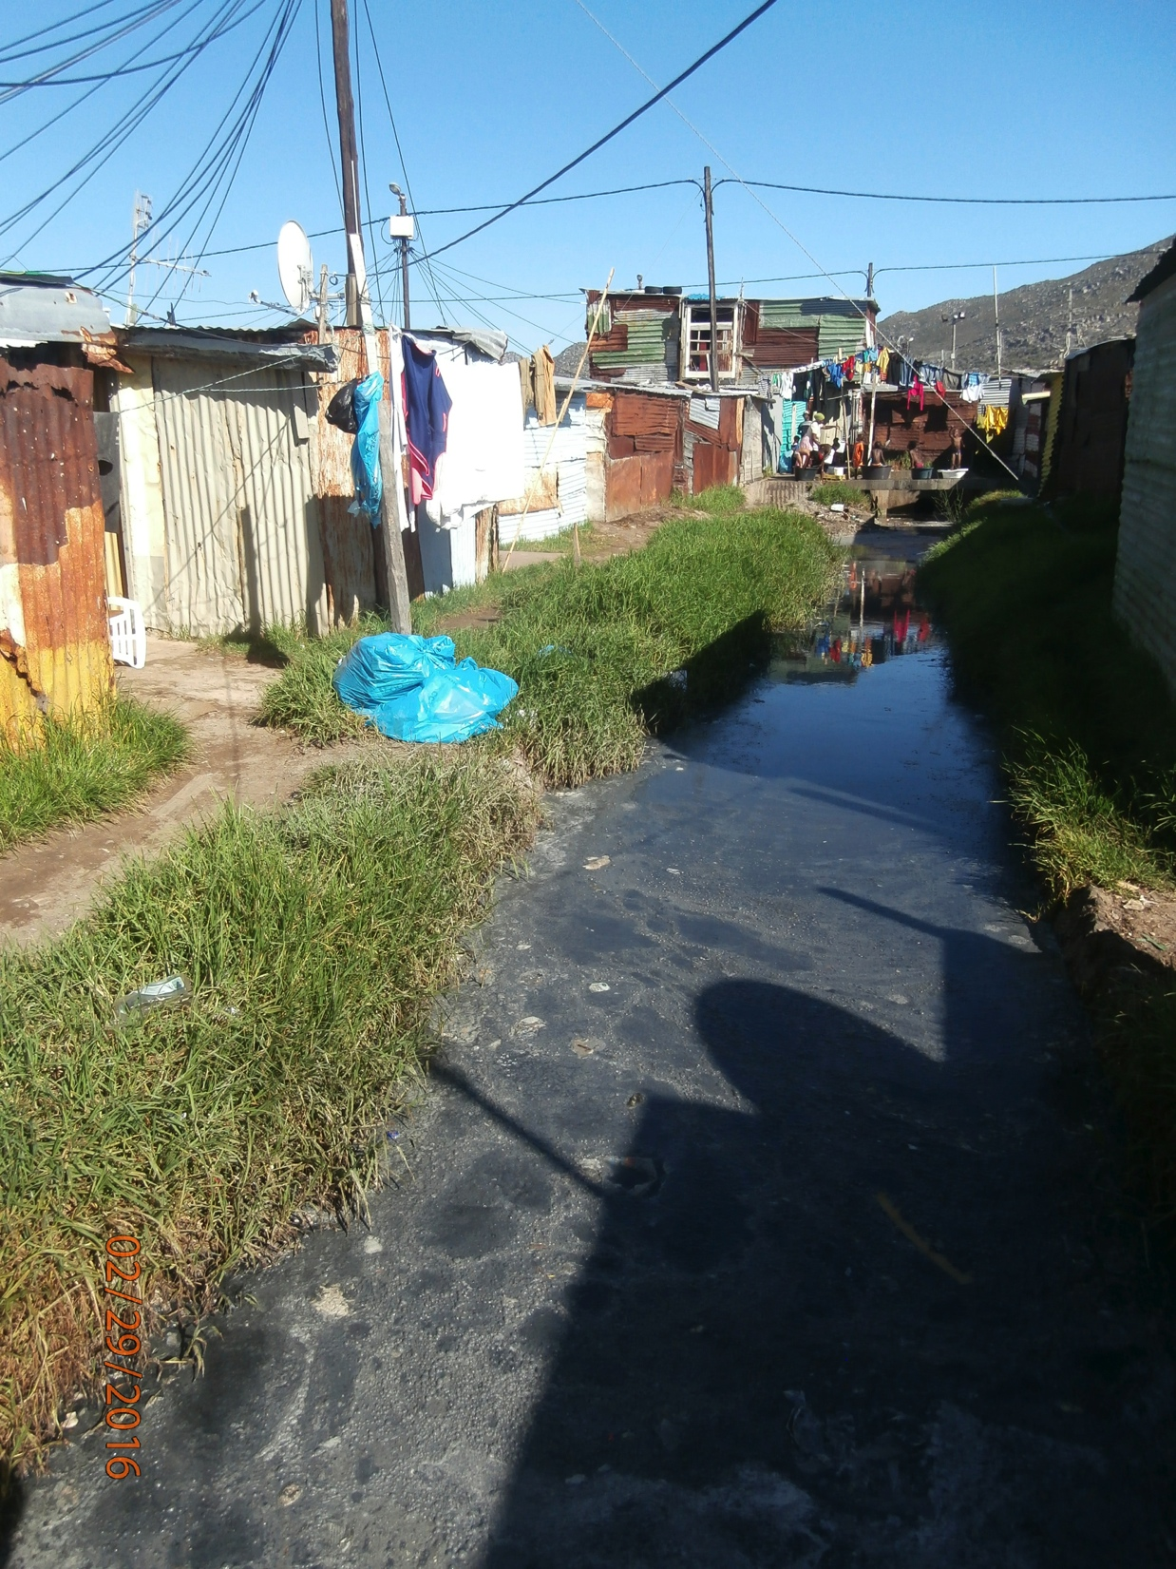

Slide 17
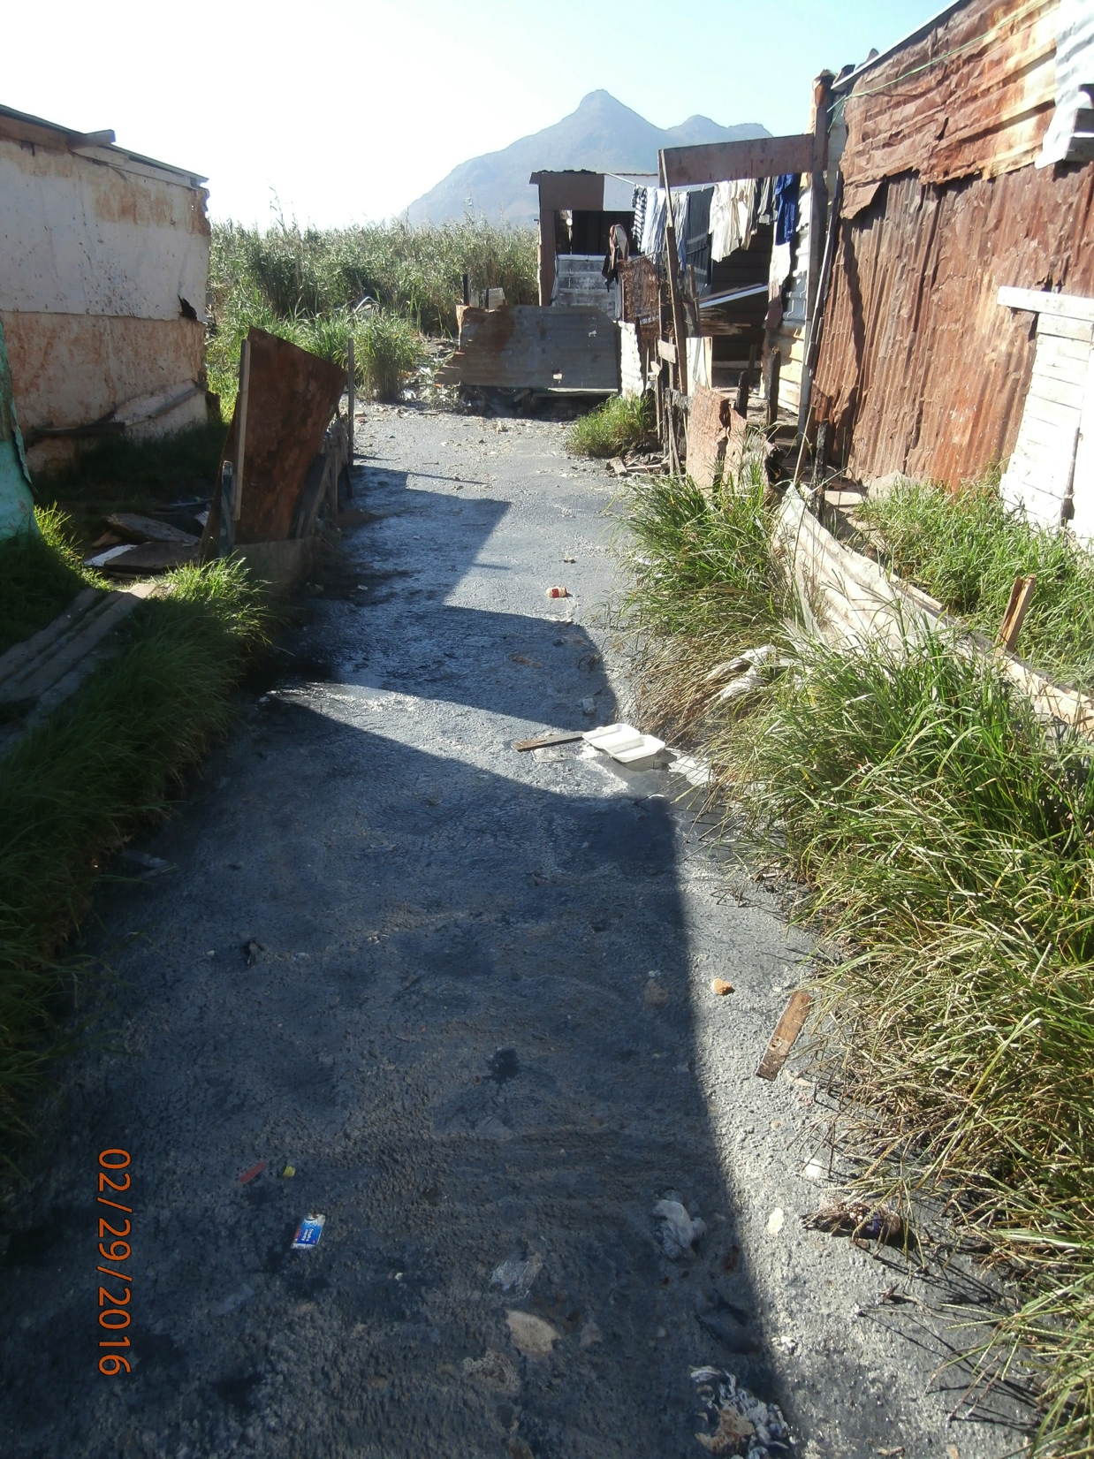
Stagnant
And
stinking

