Slide 1
The right to be heard Study tour to Japan and South Korea Horst Kleinschmidt, March 2017.
Nuclear energy, nuclear war
Boycott, Disinvest, Sanctions
The South African connection

Slide 2
Political Themes
Corporate state capture is global.
National class struggles are global struggles.
Corporate lies that cause death.
Colonial legacies everywhere.
Toward a global people’s movement.
No to the political parties we know.

Slide 3
Apartheid Israel/ Palestine, BDS, Jews for Justice
Japan, South Korea (South and North), nuclear restitution and Colonial legacy
South Africa: Truth and Justice, breaking the divide, discourse and spiritual authority

Slide 4
New vocabulary:
NPO = Nuclear Power Plant.
THAAD = Terminal High Altitude Area Defense system.
Mother of all bombs = The GBU-43/B Massive Ordnance Air Blast is a large-yield bomb, developed for the United States military by the Air Force Research Laboratory. It is touted as the most powerful non-nuclear weapon in the American arsenal. The first operational usage of the MOAB was in April 2017 airstrikes in Syria and Afghanistan.

Slide 5
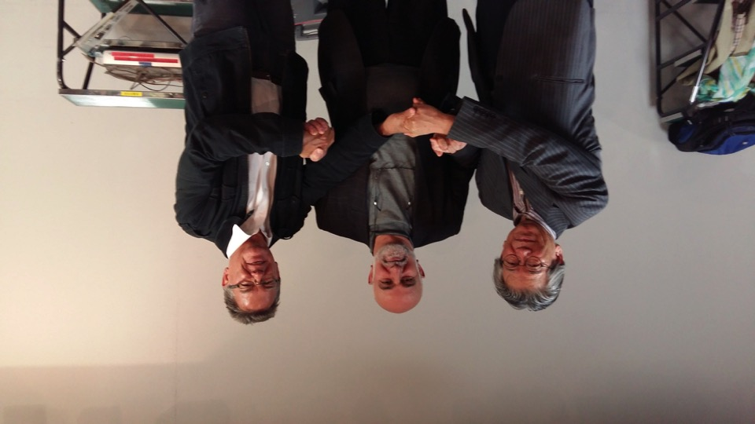
Prof Yong-Bok Kim served imprisonment in South Korea for his resistance to military in his country. Nidal AbuZuluf served imprisonment in Israel and continues to live under harshest colonial occupation. Horst Kleinschmidt served imprisonment during apartheid South Africa in 1975.

Slide 6
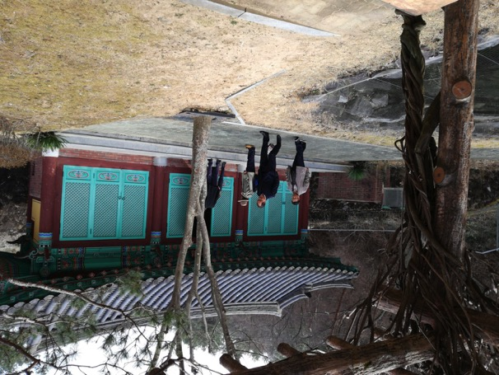
The right to life. Japan and Korea: Three Generations of nuclear victims
The memorial site at Hapchon, South Korea. It commemorates the 22,000 Koreans who died at Hiroshima and Nagasaki. They were forced labour from Japan’s colony at the time: Korea

Slide 7
Seated at the center is Mrs Yoshi Zaki Sachie, a Hiroshima survivor. She was five years old when the bomb was dropped. All she remembers is the Big Light. She was far enough from the epicenter not to be killed. But like others, her health was impaired.

Slide 8
At the back, 3 Korean women who survived Hiroshima, flanked by children born to people affected by radiation
This is at the facility Hapchon Centre for Nuclear Power Victims, in South Korea

Slide 9
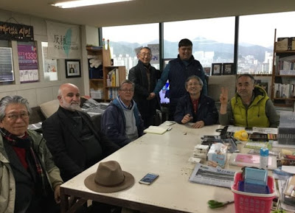
On the right, Mr Lee and his son, standing on the right of Busan. Mr Lee and his wife both have cancer. She has thyroid cancer. She won a court action against the NPP operator at Kori for her illness. In 2015 the court found that the company had kept secret the fact that the NPP leaked radio-active material. Now 1000 more cancer sufferers are suing the company.

Slide 10
Collateral Damage:
Six years after the Fukushima disaster, 45 km beyond its epicenter, children are still not allowed to play with sand, walk in the forest, play on the swings etc. Radiation levels remain too high! So they know what sand feels like, sand is imported and kept in an indoors pen.
The 22,000 people evacuated from Fukushima were obliged to go back to Fukushima in April 2017, but told to not go into their former homes o touch anything in or around them, from vases to private cars. They remain contaminated. They are instead staying in pre-fabricated new houses. All contaminated material will be ‘disposed’ of.
The top soil of scores of square kilometers from the disaster, we saw, is scraped by bulldozers and bagged and taken to an unknown destination. Africa?
If Fukushima happened because of the earthquake and resulting tsunami, the incident is a natural disaster and the state (tax payer) pays the for losses and damage. The court case into the disaster has however recently established that the company, in the interests of profit ignored building provisions stipulated. The NPP was to be built on a hill high enough to avert a tsunami. Instead, to reduce water pumping costs, they reduced the hill to near sea-level. This would make the company rather than the state liable. The Sate-corporate collusion is in the spotlight.

Slide 11
This Government counter tells parents at the adjacent crèche what the radio activity is day to day. I took this photo at the crèche in March 2017. We (here) expect to be exposed to 0.01. In Tokyo they say 0.07 is acceptable. Here, 45 km from Fukuyama it varies from 0.05 to 2.05. The Japanese prime Minister, Abe, says the situation is under control. Local people think the Government counters, on street corners 40 km and more from the accident, cannot be trusted!
Japanese and Koreans justly fear that companies will not reveal timeously when NPP’s leak radio-activity. More than that they fear that in a war, the NPP’s will be targetted or accidentally hit. It is for this reason that they oppose the newly built US naval bases off their coast on Jeju Island. Obama commissioned the base, Trump is rattling the sabers. One diplomatic misstep and the people’s of Korea, Japan and China could face another nuclear conflagration.

Slide 12
At this crèche, 45 km from the accident, children have not played outside for 6 years. So they experience what sand is, a pen with imported sand. housed inside the facility. It is illegal to take sand from these areas to Tokyo.

Slide 13
if they are clear of radio-active
With the help of experts, locals have built these two ‘chambers’ where you can bring your purchased food stuffs to test if they are contaminated with radio activity. After giving you a reading you can then de-contaminate them. It takes about 1 hour for 1 kg tomatoes and 3 -4 hours for milk or water.

Slide 14
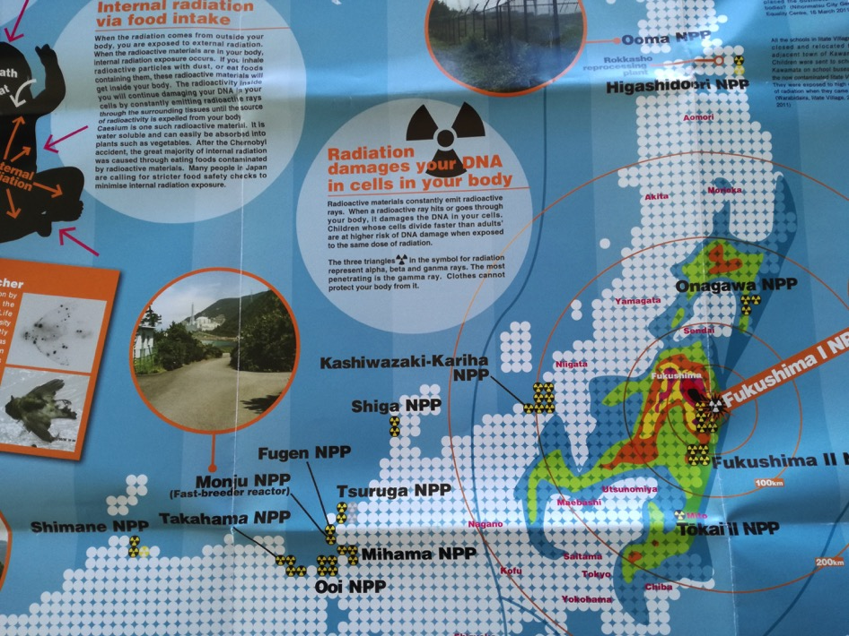

Slide 15
The right to know Corporate and
Government lies and secrecy.
Toshiba is the largest micro-chip maker and supplies
Nuclear manufacturers globally. Its Western subsidiary is Westinghouse. It’s nuclear business has fallen on hard times. The Japanese tax payer is expected to bail them out with
$1 billion.
Japanese and Koreans opposed to NPP proliferation because they believe that profit and nuclear secrecy cannot be aligned. The threat to human existence and life on earth is as threatened by potential nuclear accidents and the potential for nuclear war, as it is from CO2 emissions.

Slide 16
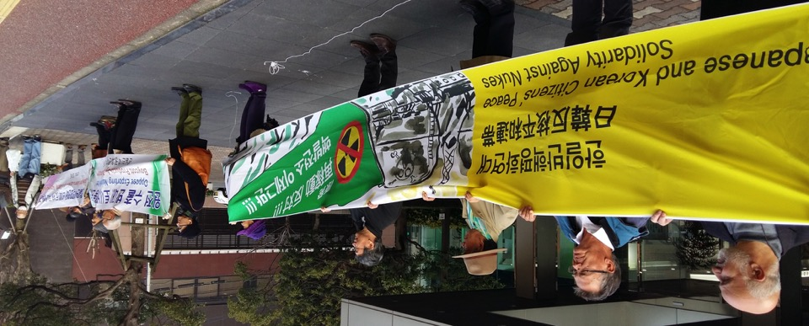
Protest outside Toshiba offices in Fukuoka, southern Japan. Letters were handed
To the company asking for information and inviting them to discussion.

Slide 17
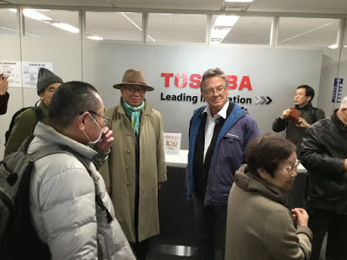
Toshiba shut its office when we asked to speak them.

Slide 18
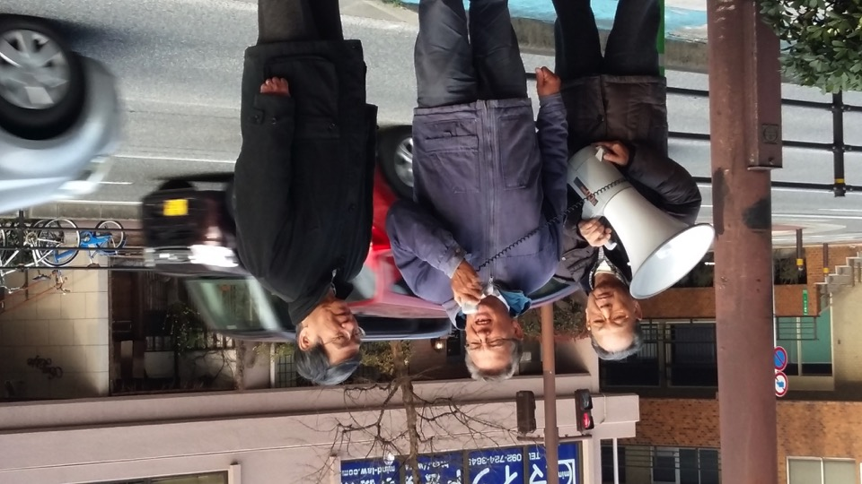
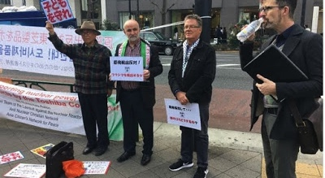
Demonstration outside Toshiba demending closure of their nuclear operations.

Slide 19
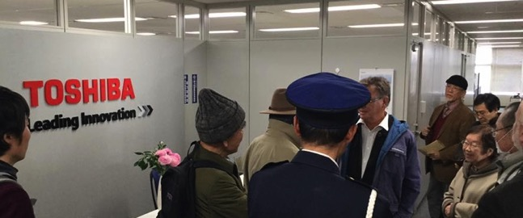
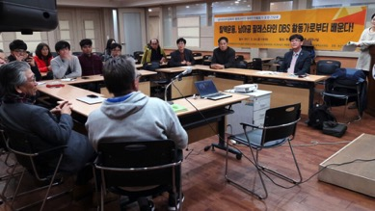

Slide 20
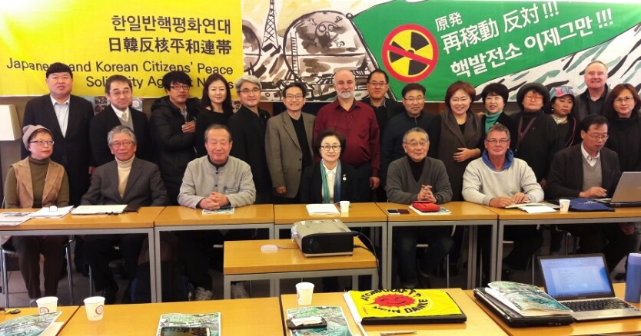
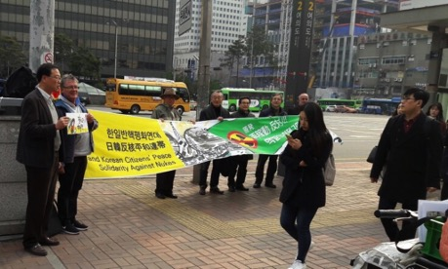
Demo outside Toshiba in Tokyo

Slide 21
The right to resist
“In the era of military dictatorship and
oppressive government rule
the people’s movement for human rights,
democracy blazed up like a flame.
This site was the focal point of the movement.
God be with us.”

Slide 22
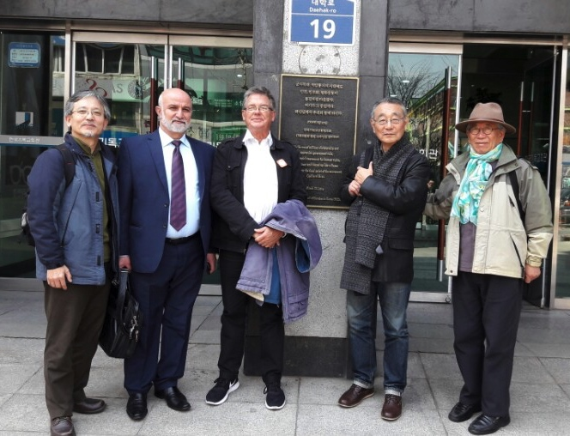
Outside the offices of the South Korean Council of Churches
Rev Lee, Nidal AbuZuluf, Horst Kleinschmidt, Choi Seung…., Prof Yong-Bok Kim

Slide 23
Persuading the South Korean Council of Churches of the need to take the Korea/Japan message to become a global issue.

Slide 24
The right to be free Colonial legacy
Korea was a colony of Japan from 1910 – 1945
North and South Korea came about in 1948 – the result of a war and grim cold war politics.
Japanese of Korean descent still fight for their human rights and against discrimination.
Koreans still demand compensation for the ‘Comfort women’ Japanese soldiers took.

Slide 25
In 1919, the Korea YMCA in Tokyo backed the first declaration for Korea's independence known as the "February 8 Declaration of Independence," that proclaimed independence to the world. This declaration paved the way to the "March 1 Independence Movement" in Korea. Members of this YMCA such as Shin Ik-hee, Choo Yo-han, Chang Duk-soo went to China to press ahead with the Independence Movement the provisional government set up in Shanghai.

Slide 26
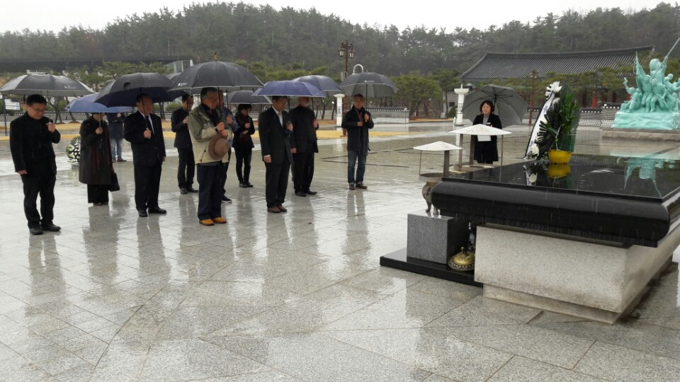
Koreans who fought against Military dictatorship. Those killed, injured and who were imprisoned are commemorated here.

Slide 27
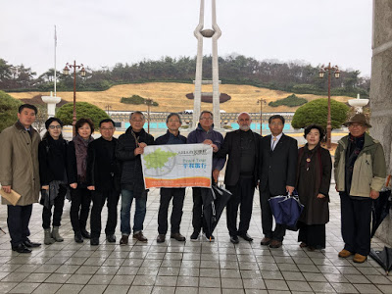
Memorial

Slide 28
A survivor: “We would not have been in Hiroshima if Japan had not colonized us and we would not have been bombed if Japan had not attacked the US. Before the bombing the Japanese treated us as inferior. And, after returning to Korea we were shunned as though we had a genetic defect”.
Choi, Lee, Horst, Nidal and Yong-Bock in front of a memorial to the Korean Hiroshima victims

Slide 29
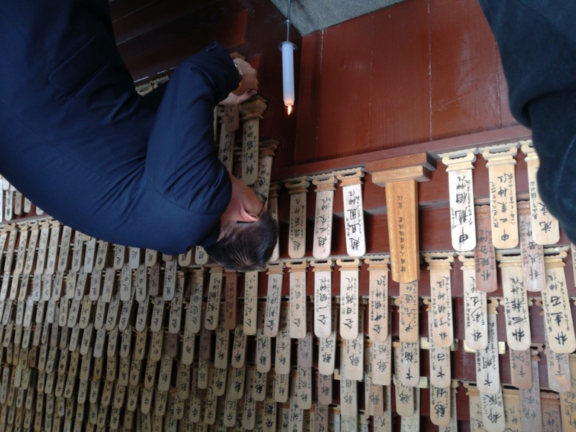
For each Korean identified a name is added and a candle lit.

Slide 30
Compensation from Japan, from the USA. Work in progress

Slide 31
70 years after the bomb annihilated Hiroshima the Korean survivors still press their Government to seek compensation from Japan, the US and potentially the International Court of Justice.

Slide 32
The curse of state capture by multinational corporates

Slide 33
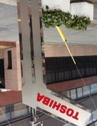
Telling Toshiba that it is unethical to push NPP exports, when locals no longer trust them.

Slide 34
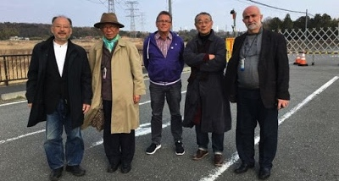
The cranes in the background, some 2 km away, are where the Fukushima accident took place
Government and corporate lies

Slide 35
Safe is 0.01, Tokyo acceptable is 0.07 Here the measuring device, 20km from Fukushima, shows 3.58.

Slide 36
The obligation to act and do. South Korea’s People’s Movement

Slide 37
Hope is what the ribbon stands for. It unites the nuclear campaigners old and new, the ferry disaster secrets, the comfort women claims and more.

Slide 38
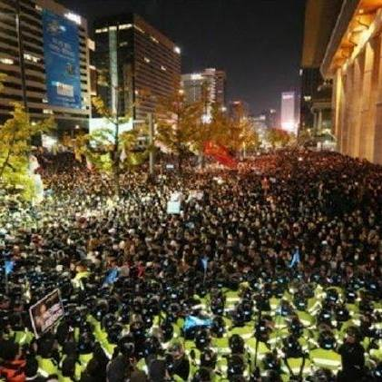
Being part of the 1 million candle protest – each Saturday night before social events commence. It unites divergent social and political Korean society, who want President Park arrested and charged. She is symbolic of much wrongs than her own culpability for corruption.
The campaigns that converge here:
The bribes by corporates of President Park and her Government.
Rehabilitation of the ‘comfort women’ Japan took in WWII.
Lies and secrecy over the 2015 ferry disaster that killed hundreds of children.
Recognition and compensation for the 22,000 forced labourers killed in 1945 in Hiroshima.

Slide 39
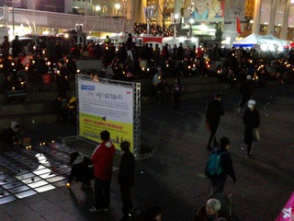
Imagine: 1 million South Koreans met on 25 consecutive Saturday evening from 6 - 8 pm to demand transparent Government, to deal with an array of grievances and to warn the military not to intervene. Broadly they will be happy with the election of President Moon.

Slide 40
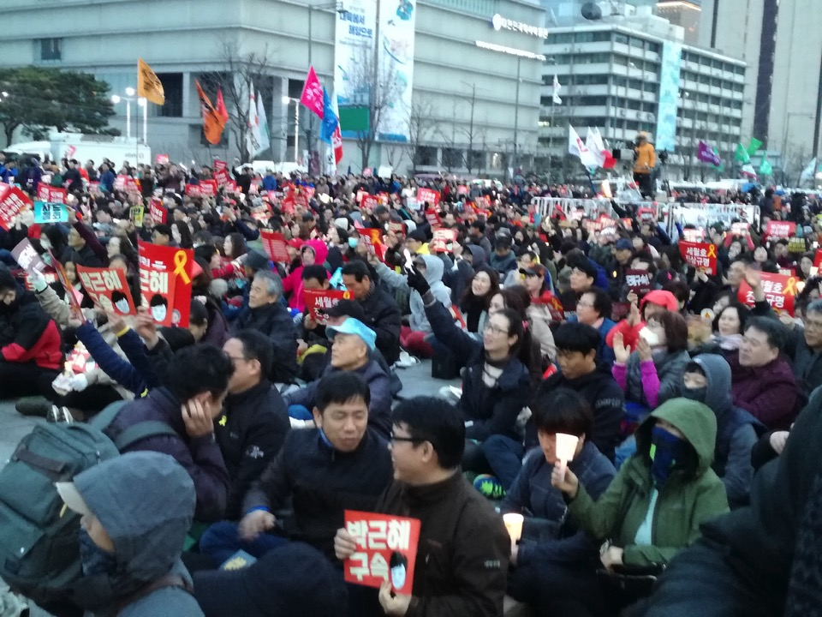
Imagine: Young people not going out to enjoy themselves on Saturday night until they have been to the 1 million candle protest.

Slide 41
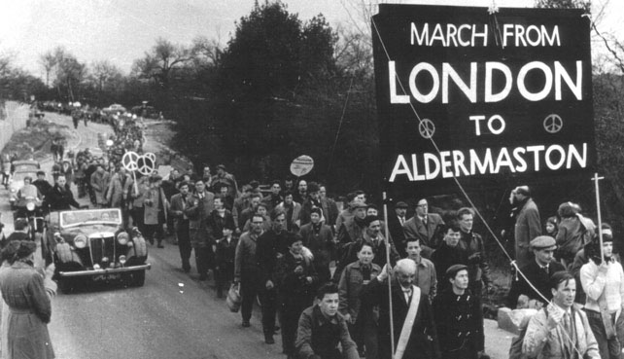
In the footsteps of the British Aldermaston marchers led by Bertrand Russell and Canon John Collins.
A new global people’s movement inspired by Korea and Japan?

