Slide 1
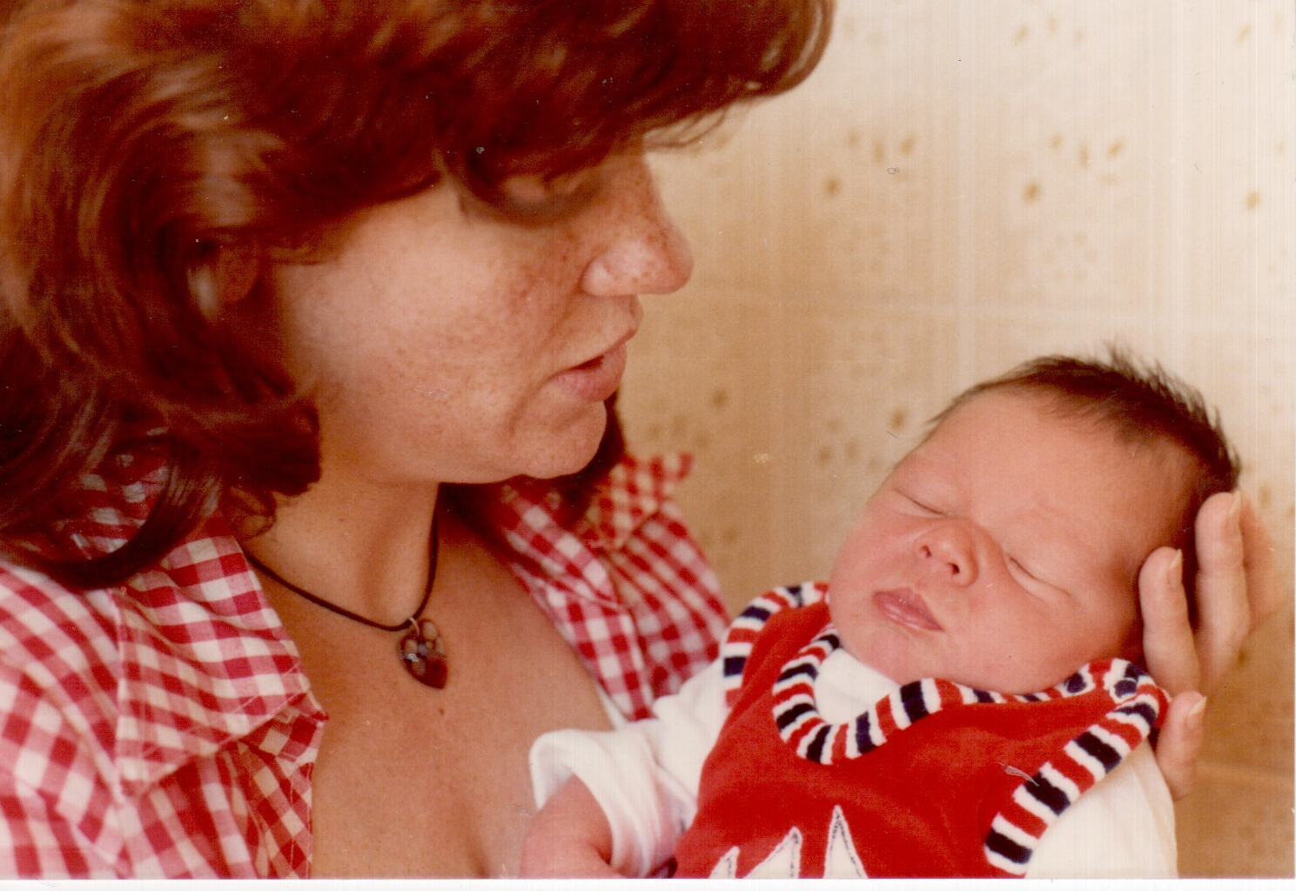
Heidi with Tamara, 6 days old

Slide 2
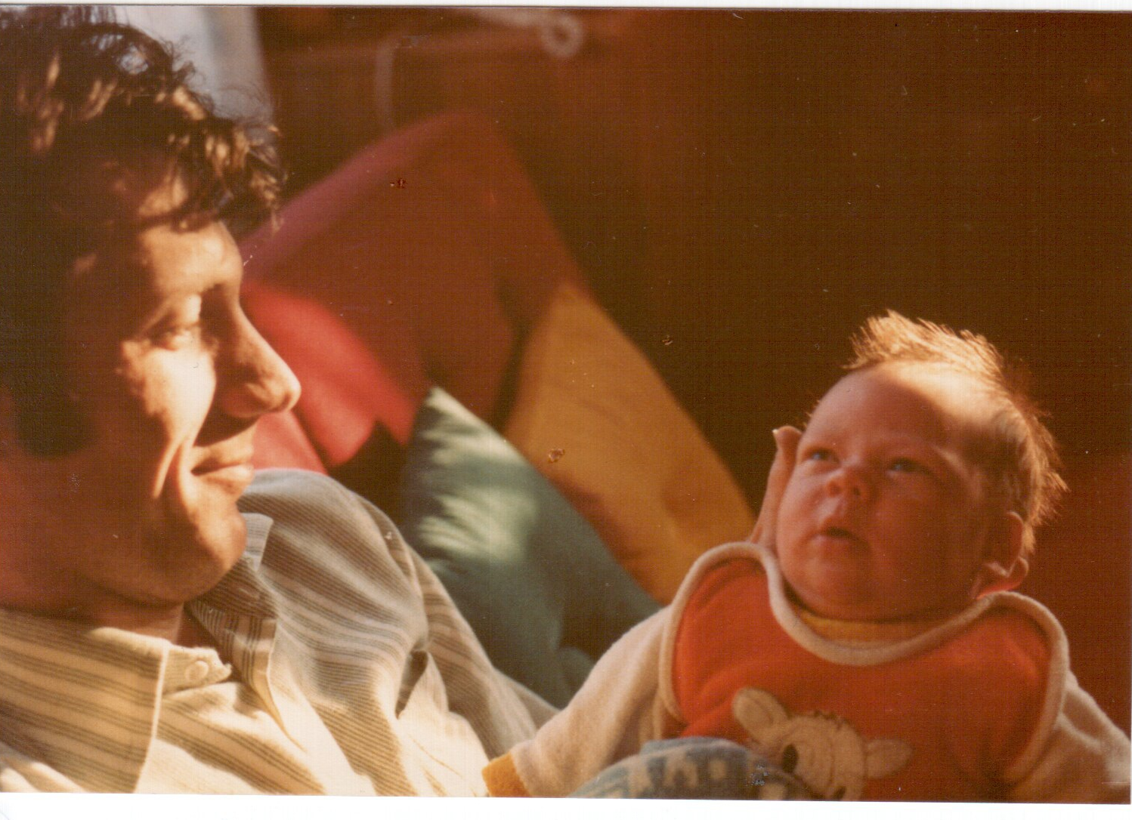
Proud father Franz with Tamara, 2 weeks old

Slide 3
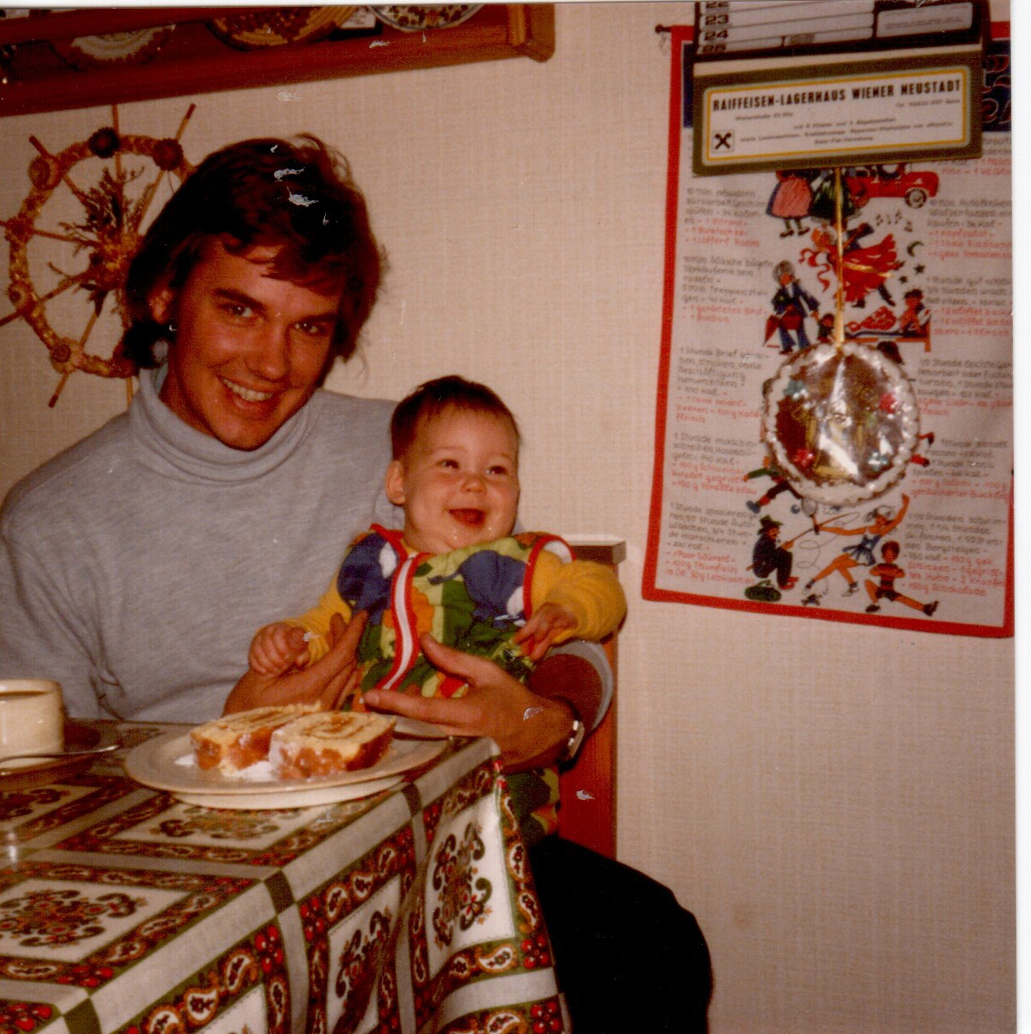
Tamara, at 5 months on 19 November 1978 on the lap of her uncle Horst.

Slide 4
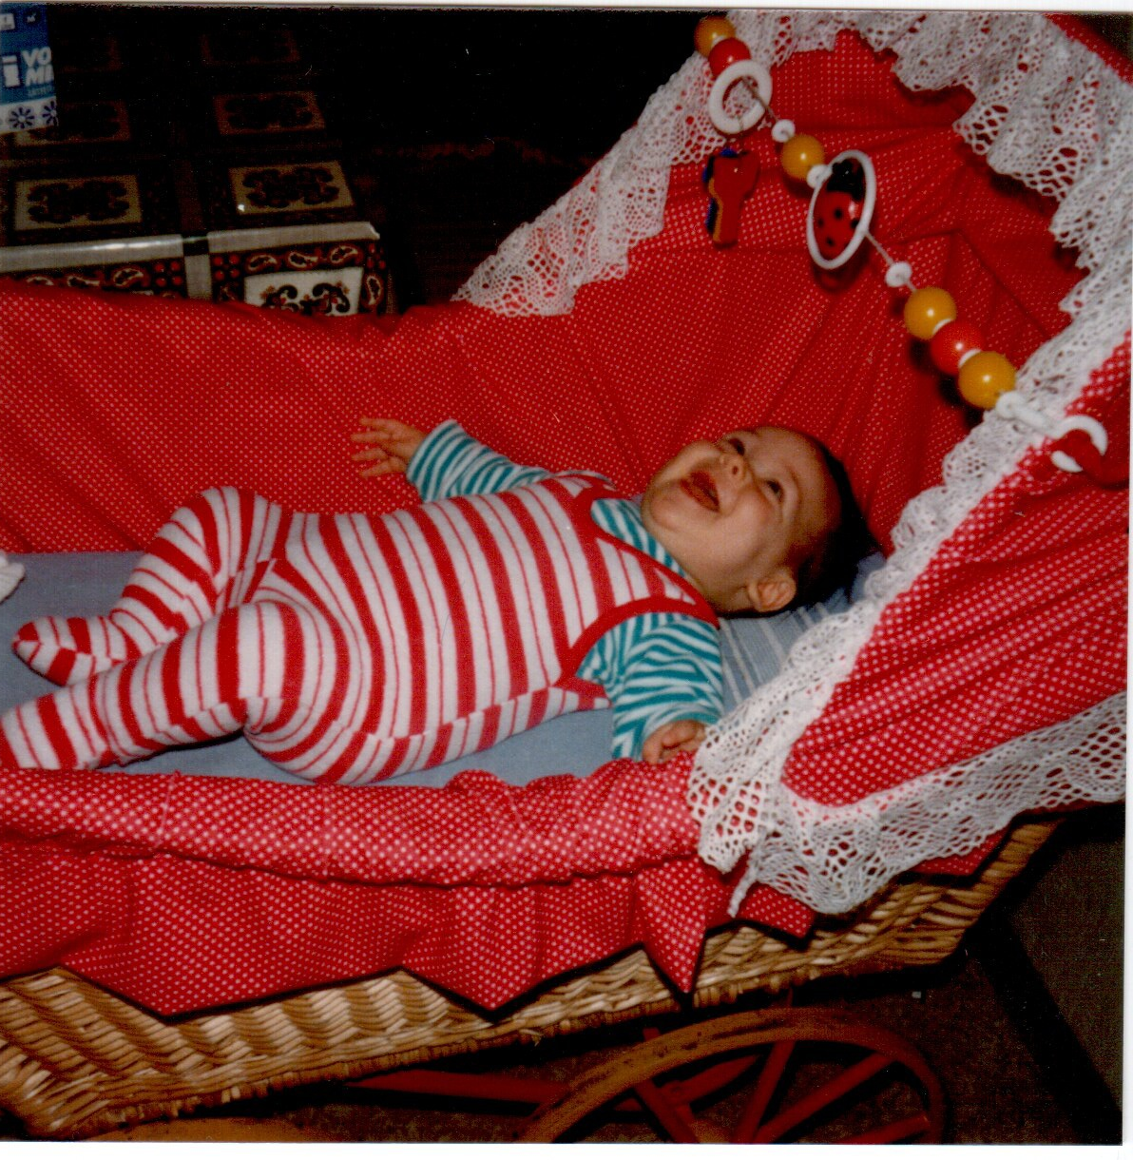
Tamara

